Slide 1
Getting organised for Year 11
Rebecca Whitford
Assistant Headteacher
rwhitford@littleheath.org.uk

Slide 2
Aims
To identify some strategies to help your child get organised for year 11
To share some key information that your child should know about each subject they study
To provide some practical tips for getting organised, which you can share with your child
To provide you with some example revision schedules

Slide 3
How can you help your child to get organised?
Some things to consider:
Support with organisation + planning how they use their time
Support with creating and following a revision timetable
Modelling / signposting revision strategies + study skills
Ensuring that they have access to the correct equipment + resources
Provide access to online study resources

Slide 4
How can you help your child to get organised?
A workspace at home where they can work without distractions
Pen, pencil, highlighter, ruler, maths equipment
Paper / notebook
Revision timetable
Access to online revision resources

Slide 5
Advice for Year 11 students For each of your subjects, make sure that you know:
All deadlines, if this is a coursework subject
Dates of any practical exams, which fall outside the main exam period
Dates of your PPEs and final exams
Which exam board / specification you are following
Which aspects of the course will be in each exam, and how they are assessed (your teacher will give you PLCs for each subject)
Details of any revision sessions that will be taking place in school
Details of any revision materials that have been signposted by your teacher
You will need to find out this information in advance of the calendared PPEs and the main exam period

Slide 6
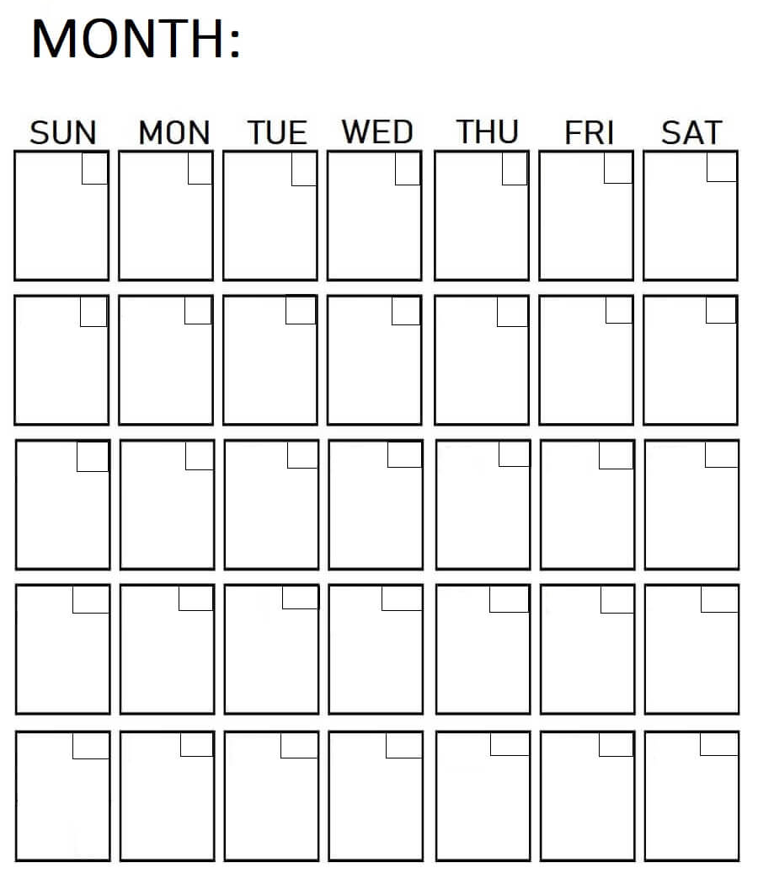
Advice for Year 11 students - getting organised
Find out when your exams are for each subject
Put these dates in your calendar
If you have more than one exam per subject, check which topics / skills are covered in each paper
Block out times when you know you will be busy doing something else.
Add in any school-based revision sessions
Decide how many hours each day you want to allocate for revision (be realistic – you need a balance of revision, leisure time and rest)

Slide 7
Advice for Year 11 students - getting organised
Once you have planned these elements, you will know how much total revision time you have available to you.
The next step will be to plan out how you use this time
Consider - which subject /paper needs the most revision? Why?

Slide 8
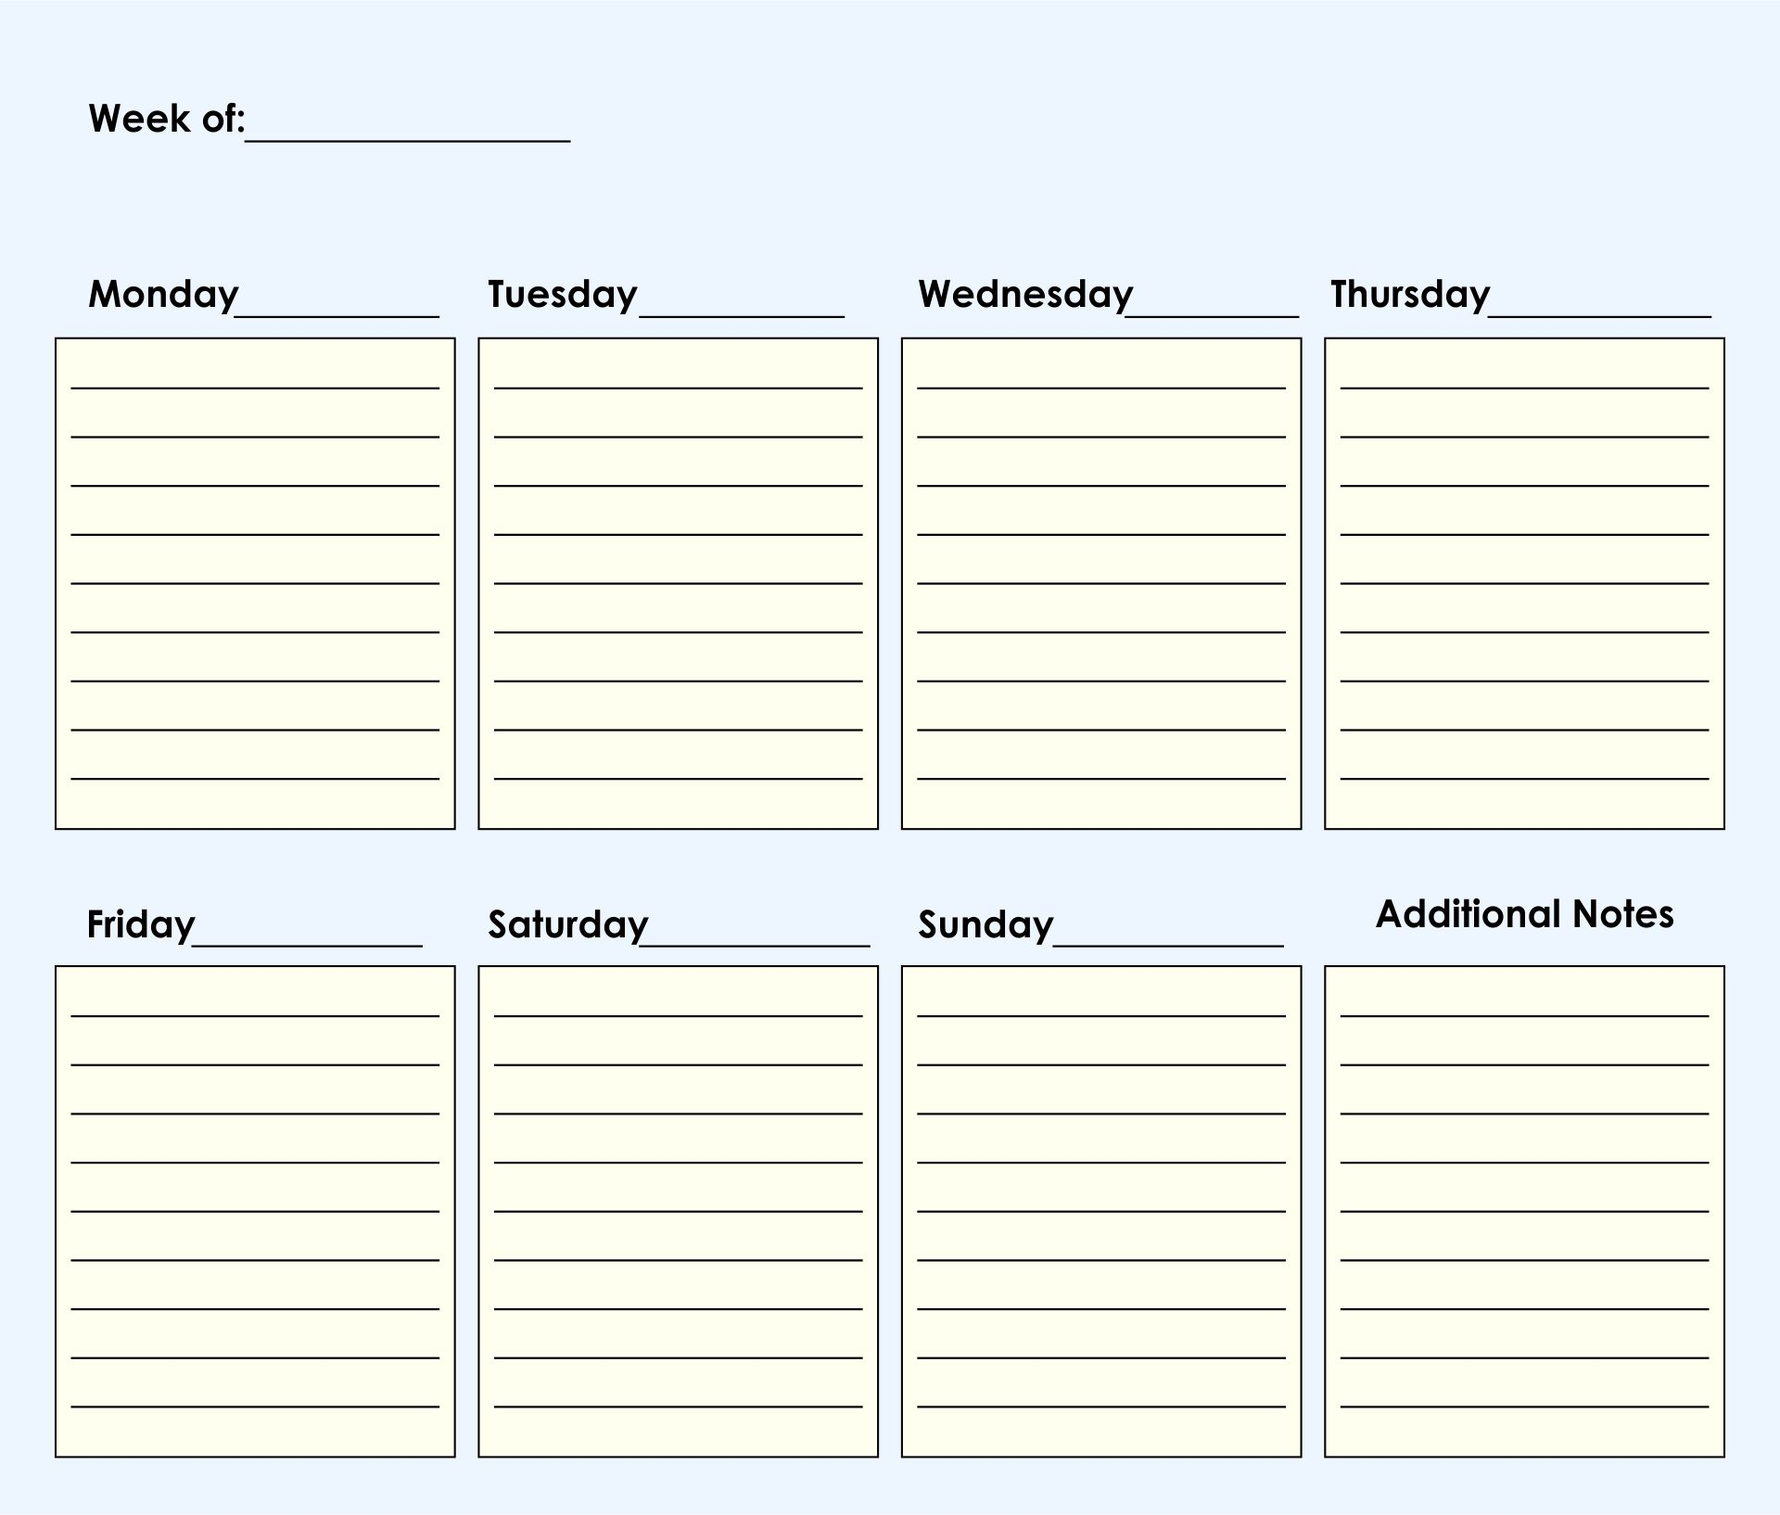
Advice for Year 11 students - getting organised
Planning your revision blocks
You will want to revise for each paper the day before you take that exam, so put your first revision block for that paper on this date
Do the same for all of your exams. Then work backwards, ensuring that you have included revision sessions for each subject
If you have a school-based revision session, include this in your plan
Chunk your time each day, and vary your subjects
Remember to plan in social time and breaks
Stick to the plan as much as you can.

Slide 9
Example revision planner
My weekly revision timetable
Time | MON | TUES | WEDS | THURS | FRI | SAT | SUN
8am
9am
10am

Slide 10
Example revision planner
My weekly revision timetable
 | MON | TUES | WEDS | THURS | FRI | SAT | SUN
Morning
Afternoon
Evening

Slide 11
Studying independently
Studying at the same time every day helps you build a routine, making it easier to get started
Choose a quiet place to work
Make sure you have everything you need
Do not attempt too much study at once. Start with 15 minutes of study, then a 5 minute break, then another 15 minutes
At the end of each session, sit for 1 minute and reflect on your learning. This is a key technique for deep learning.

Slide 12
Using online revision resources

Slide 13
Top tips for using online revision resources
Check which exam board + specification you are following
Your teacher will signpost specific revision resources that they would like you to use – save all of your logins in one place, to help you stay organised!
There are also lots of really useful videos on YouTube with tips on study skills
Each department will signpost the relevant online revision resources - Online revision resources.docx
Study guide books are also available – talk to your class teacher to find out which one is most appropriate for your course

Slide 14
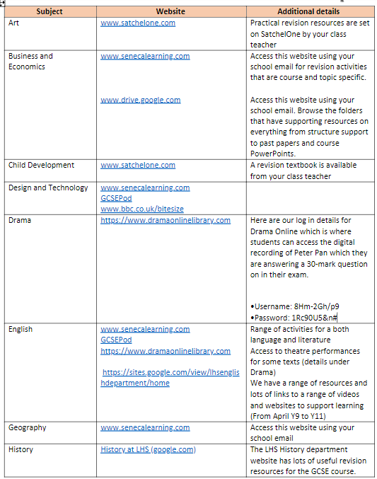
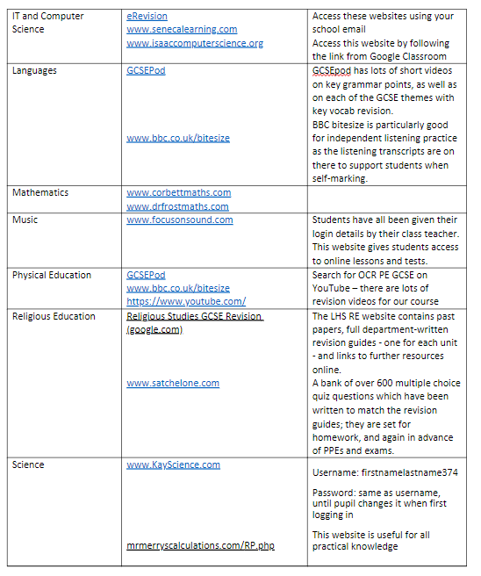

Slide 15
My To Do List
Mandatory homework will be announced on SatchelOne and will appear here.
It will be sets of roughly 10 short answer questions and a supporting video, to ensure and embed GCSE concepts.
It is self-marking and the final score is seen by the teacher.
Videos & Quizzes
This holds the bank of videos and short answer questions for the entire course.
They can all be accessed at any time by pupils.
Teachers can view the activity history of the students.
The “Revision” menu allows creation of quizzes from multiple sections of units.
Resources
Past exam papers.
Collections of past exam paper questions, grouped by unit.
3-6 mark question practice, grouped by unit.
All with answers available.
Note: “Resources” is not available on the app. It is on the website only.

Slide 16
Any questions ?

