Slide 1
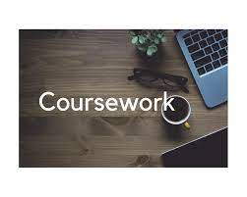
Importance of GCSE coursework Mrs hastings Mrs Kukkuk

Slide 3
Subjects with coursework
Design and Technology Timber
Food and Nutrition
GCSE PE
Health and Fitness
IMEDIA
Music
Drama
Art
Art Textiles
Marketing and Enterprise
Child Development

Slide 4
plagiarism
When doing research, students must read the information and interpret it and reference the source
Students often find extracting information difficult.
Exam boards are very specific in their instructions that students’ work will be checked for plagiarism (and they do!)
Students are at risk of losing marks due to plagiarism.
Different subjects can have different control methods so what one teacher may be able to do is not necessarily what another can

Slide 5
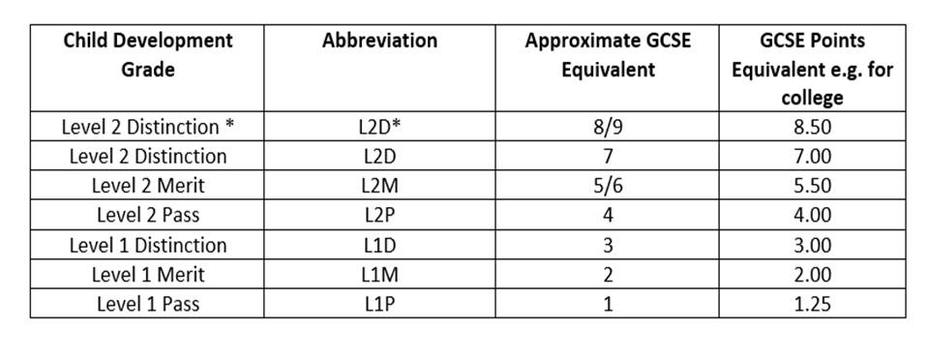
Grading vs gcse grades

Slide 6
How can you help your child?
Some students find it hard to extract and interpret information from different sources. To help your child chunk information, it will be really useful to read an article with your child and discuss the content. Can they tell you what the gist of the article is?
For Year 11 students:
Coursework support sessions – students must please keep an eye on the support session timetable that Mr Coulson will be sending out this week. All Heads of Department are eager for students to attend the sessions available to them. If students attend, we are there to support and give advice.
Coursework can make a significant difference to your child’s overall grade.

Slide 7
Example – child development
In Child Development, we have an exam in the Summer of Year 11, which is worth 50% of the overall grade. Students have coursework tasks in Year 10 and Year 11. These coursework are 50% of the overall grade.
Many students are usually more confident in the coursework elements, as we are on hand in lessons to support and advise (which we are allowed to do).
If a student does not do very well in the written exam, they can significantly improve their overall grade if the coursework is strong.

Slide 8
Student A
Whilst studying Art Textiles this student worked consistently hard on her coursework, she spent time in class ensuring her portfolio work was of the highest standard as she thoroughly enjoyed the practical element. She achieved a 6 overall in her coursework which was her highest grade in her subjects.

Slide 9
Student b
This student studied Child Development, she worked hard in her coursework during year 10 and 11 and achieved a L2D*, she wasn’t keen on exams but knew she had banked a good grade for the 50% coursework.
When the student sat her exam, she did not do as well at the written exam, but because her coursework was of excellent standard, she achieved a L2D overall.
The student’s progress from Year 6 was also remarkable, as the student chose a variety of subjects with coursework, which enabled student to achieve a great set of results.

