Slide 1
English at LHS – Y9

Slide 2
Did you know…?
20 minutes per day (3,600 minutes per school year)
5 minutes per day (900 minutes per school year)
1 minute per day = 180 minutes per school year.
1,800,000 words
282,000 words
8,000 words
Notes:
AR until end of Y9 including DEAR time – important to extend vocabulary and understanding of more complex texts.
Students in Years 7 to 10 read for the first 20 minutes of the lesson
Students silently read their book

Slide 3
Year 9 Overview
September (1 week) |  | Unseen poetry How are teachers presented through these unseen poems?
September/October (4.5 weeks) |  | Genres: dystopia How are our relationships with others (and the environment) explored through dystopian writing?
October to January (10 weeks) |  | Kick the Moon How does Khan portray the impact that individual views and actions have on others and the society around us?
January (2 weeks) |  | Unseen poetry How are children and parents presented through these unseen poems?
February – March (7 weeks) |  | Shakespeare's Romeo & Juliet How does Shakespeare portray conflict and its impact in Romeo and Juliet?
April - June (7 weeks) |  | Viewpoint writing (PLUS spoken language assessment)
June – July (7 weeks) |  | Literature P2: Power and Conflict poetry – Part 1 How do poets communicate ideas of conflict through their deliberate choices? Poems: ‘Remains’, ‘Bayonet Charge’, ‘Exposure’, ‘Charge of the Light Brigade’, ‘War Photographer’, ‘Kamikaze’, ‘Poppies’
Adapted GCSE mark schemes used
Start of GCSE taught/ examined content

Slide 4
English Language
Paper 1 – 1 hour 45 minutes
A: Exploring fiction [1 fiction extract] (25%)
B: Narrative and/or descriptive writing (25%)
Paper 2 – 1 hour 45 minutes
A: Comparing viewpoints [2 non-fiction extracts] (25%)
B: Viewpoint writing (25%)
Spoken Language assessment
Complete a speech and answer questions (up to 10 minutes)
Assessed in class
Notes:
Show sample papers

Slide 5
Spoken Language
Speech about a topic of interest for student
Speaking for between 4 and 6 minutes
Question and answer session to follow (2-4 minutes)
Marked as Pass, Merit or Distinction
All criteria in a level must be met to achieve a grade
This needs to be video recorded
We must submit a sample of 30 videos – 10 of each grade – for moderation by the exam board.

Slide 6
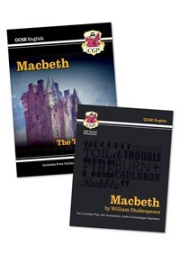
English Literature
Paper 1 – 1 hour 45 minutes
A: Macbeth
B: A Christmas Carol
Paper 2 – 2 hours 15 minutes
A: An Inspector Calls
B: Power and Conflict poetry
C: Unseen poetry

Slide 7
English Literature
Provided by school through exam board
Text bundle sold through school (end of Year 9)
CGP Macbeth text and guide
A Christmas Carol
An Inspector Calls
Price checked at time of ordering currently around £15
Revision guides will also be offered for purchase at cost price. We choose best value at time of offering the bundle.

Slide 8
Year 10 Overview
September (3 weeks) |  | Literature P2: P&C Poetry – part 2 How do poets communicate ideas of personal conflict through their deliberate choices? Poems: ‘Ozymandias’, ‘My Last Duchess’, ‘Kamikaze’, ‘Poppies’
September to November (8 weeks) |  | Literature P1: A Christmas Carol How has Dickens crafted A Christmas Carol to present themes of inequality? What is his message to society?
December to January (3.5 weeks) |  | Language P1 How do writers portray humanity in fiction texts?
January |  | PPEs Language Paper 1/A Christmas Carol
January to April (11 weeks) |  | Literature P1: Macbeth How does Shakespeare explore ideas of power, morality and corruption?
April to June (5 weeks) |  | Language P2 Can we develop a critical view of perspectives and communicate our own viewpoint? Core PPEs: Language P2
June to July (5 weeks) |  | Literature P2: P&C Poetry - part 3 and unseen How do poets communicate ideas of power and conflict through their deliberate choices? Poems: ‘Storm on the Island’, ‘Prelude’, ‘London’, ‘Checking Out Me History’, ‘Emigree’ and ‘Tissue’
Final text (An Inspector Calls) taught in Y11

Slide 9
How do I support my child?
Wider reading
Establishing study/revision habits

Slide 10
Encourage wider reading (as early as possible)
Reading through DEAR time/library books
Fiction texts/extracts (20th/21st century)
many available online
further extracts/tasks will be provided by school
Non-fiction opinion articles (next slide)
Non-Fiction-Anthology-Views-from-the-Verge.pdf (douglaswise.co.uk)
Fear-Anthology.pdf (douglaswise.co.uk)
Literary-Snapshots-PDF-.pdf (douglaswise.co.uk)
Narrative-Writing-Anthology.docx (live.com)
GCSE (9-1) English Language - Unseen 20th and 21st century literary texts (ocr.org.uk)

Slide 11
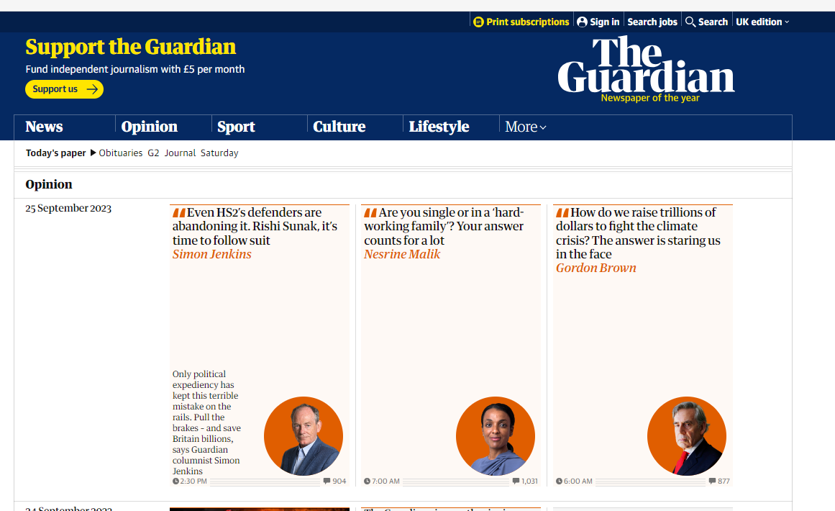
Encourage wider reading (as early as possible)
Opinion | Theguardian | The Guardian
Daily Mail Comment | Daily Mail Online
Similar articles from different sources/viewpoints
Notes:
Reading/discussing articles from multiple sources – start comparing viewpoints

Slide 12
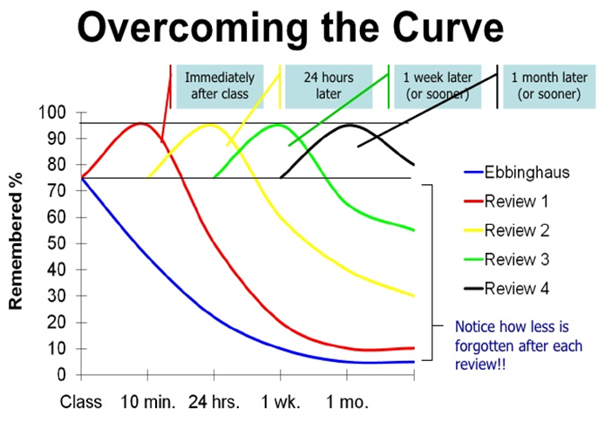
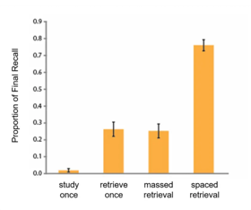
Encourage your child to test out a range of revision activities and space their retrieval/revision

Slide 13
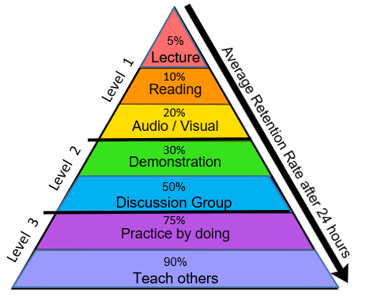
Level 1 RED – listen to audio recordings, listen to your teacher ORANGE – read class notes, revision guides, novel(s), poetry, webpage information YELLOW – watch videos, film adaptations, audiobooks; design a revision video or animation; produce a mind map; draw a diagram
Level 2 GREEN – record yourself and listen to notes, design a revision video or animation, produce a model, break down a topic into steps BLUE – hold a revision study group, attend after school sessions, discuss topics with friends, test others and share ideas
Level 3 INDIGO – complete exam-style questions, experiment and find out how things work VIOLET – explain, demonstrate or model an idea to another person (friend, relative, teacher etc.)

Slide 14
Encourage your child to test out a range of revision activities:
Posters/mind maps
Flash cards
Watch videos
GCSE Pod
Seneca
YouTube (lots of links via
LHS English website)
Make notes, lists etc
LHS English Department (google.com)

