Slide 1

English at LHS – Y11

Slide 2
English Language
Paper 1 – 1 hour 45 minutes
A: Exploring fiction [1 fiction extract] (25%)
B: Narrative and/or descriptive writing (25%)
Paper 2 – 1 hour 45 minutes
A: Comparing viewpoints [2 non-fiction extracts] (25%)
B: Viewpoint writing (25%)
Spoken Language assessment
Complete a speech and answer questions (up to 10 minutes)
Assessed in class
Notes:
Show sample papers

Slide 3
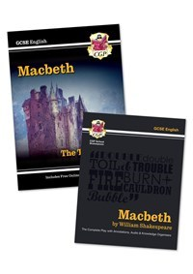



English Literature
Paper 1 – 1 hour 45 minutes
A: Macbeth
B: A Christmas Carol
Paper 2 – 2 hours 15 minutes
A: An Inspector Calls
B: Power and Conflict poetry
C: Unseen poetry

Slide 4
Year 11 Overview (dates for 2023-2024)
September - October (5.5 weeks) |  | Revision: Macbeth and A Christmas Carol
Mon 16th Oct – Fri 3rd Nov (2 weeks) |  | PPEs – November - Literature P1: Macbeth/ACC
November (2 weeks) |  | Revision Unseen poetry / P&C Students will be issued a ‘P&C revision in action’ book.
November to January (7 weeks) |  | Literature P2 – An Inspector Calls How does Priestley explore themes of social responsibility and what is his message?
January/February (3 weeks) |  | Language P1
Mon 19th Feb – Fri 1st Mar (2 weeks) |  | PPEs – Feb - Language P1 - Literature P2: AIC/LotF, P&C poetry & Unseen
March (3 weeks) |  | Lang P2
March to May (8 weeks) |  | Revision - Language & Literature
May/June |  | EXAMS 2024
Language P1: 23rd May ​
Language P2: 6th June ​
Literature P1: 13th May ​
Literature P2: 20th May

Slide 5
How do I support my child?

Slide 6
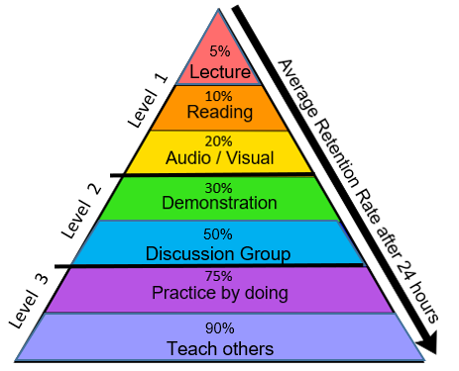
Level 1 RED – listen to audio recordings, listen to your teacher ORANGE – read class notes, revision guides, novel(s), poetry, webpage information YELLOW – watch videos, film adaptations, audiobooks; design a revision video or animation; produce a mind map; draw a diagram
Level 2 GREEN – record yourself and listen to notes, design a revision video or animation, produce a model, break down a topic into steps BLUE – hold a revision study group, attend after school sessions, discuss topics with friends, test others and share ideas
Level 3 INDIGO – complete exam-style questions, experiment and find out how things work VIOLET – explain, demonstrate or model an idea to another person (friend, relative, teacher etc.)

Slide 7
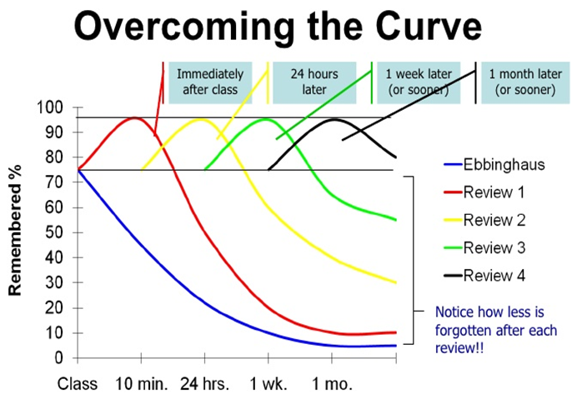
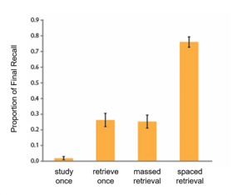
Encourage your child to test out a range of revision activities and space their retrieval/revision

Slide 8
Encourage wider reading
  Fiction texts/extracts (20th/21st century)
    many available online
    further extracts/tasks will be provided by school
  Non-fiction opinion articles (next slide)
Non-Fiction-Anthology-Views-from-the-Verge.pdf (douglaswise.co.uk)
Fear-Anthology.pdf (douglaswise.co.uk)
Literary-Snapshots-PDF-.pdf (douglaswise.co.uk)
Narrative-Writing-Anthology.docx (live.com)
GCSE (9-1) English Language - Unseen 20th and 21st century literary texts (ocr.org.uk)

Slide 9
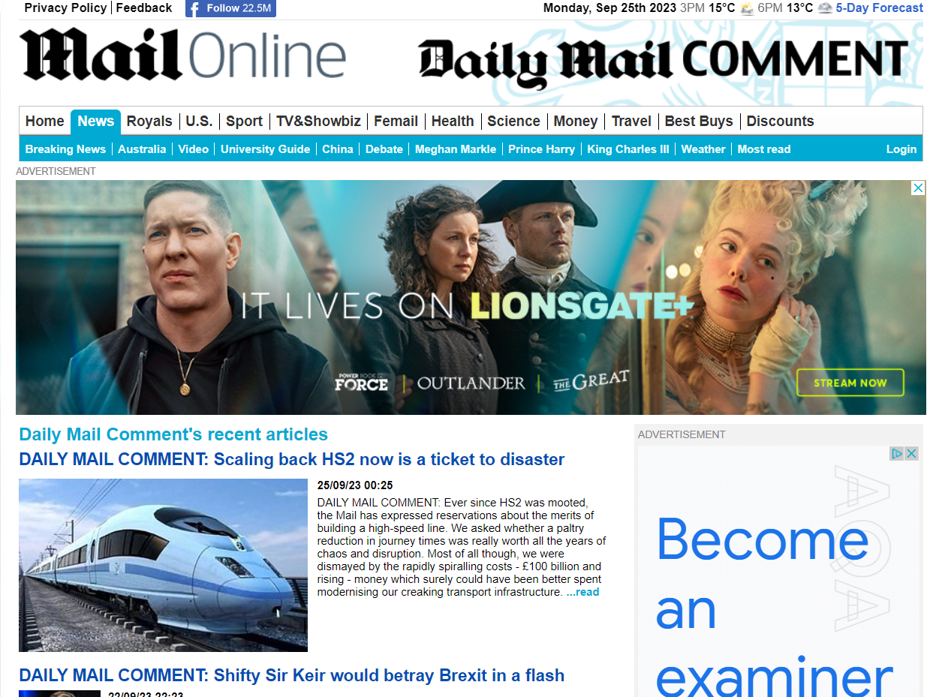
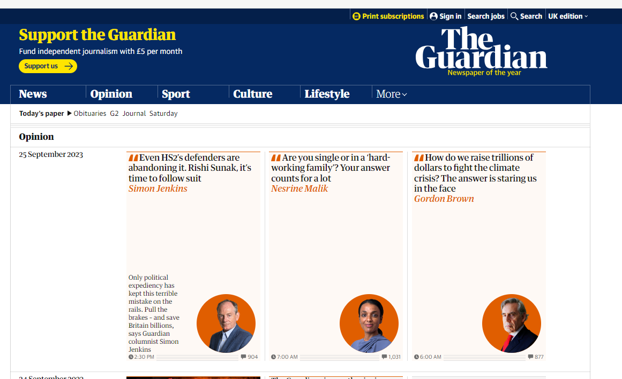
Encourage wider reading (as early as possible)
  Opinion | Theguardian | The Guardian
  Daily Mail Comment | Daily Mail Online
Similar articles from different sources/viewpoints
Notes:
Reading/discussing articles from multiple sources – start comparing viewpoints

Slide 10
Revision websites
LHS English Department (google.com)
  Links to YouTube/other sites for each text studied
  Information about the structure of exams/papers
  Links to revision materials/sample papers
Drama Online - Username: 8Hm-2Gh/p9 Password: 1Rc90U5&n#
  Drama Online - Macbeth (dramaonlinelibrary.com)
GCSE Pod
Seneca
Macbeth Extracts | Shakespeare's Globe (shakespearesglobe.com)

Slide 11
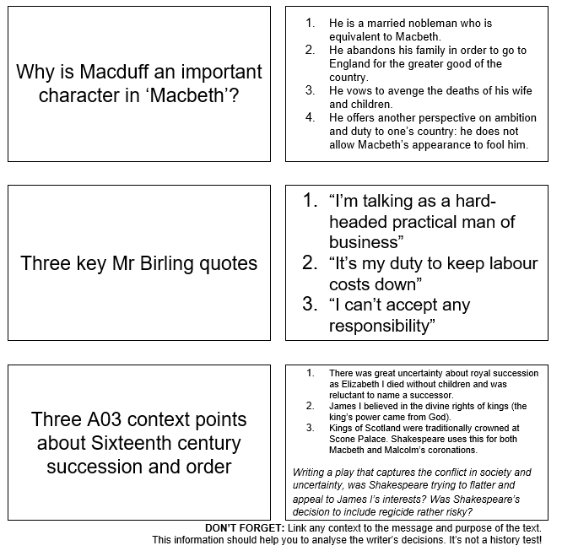
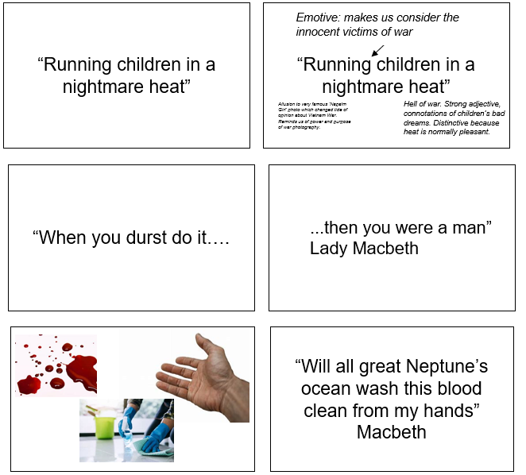
Flash cards

Slide 12
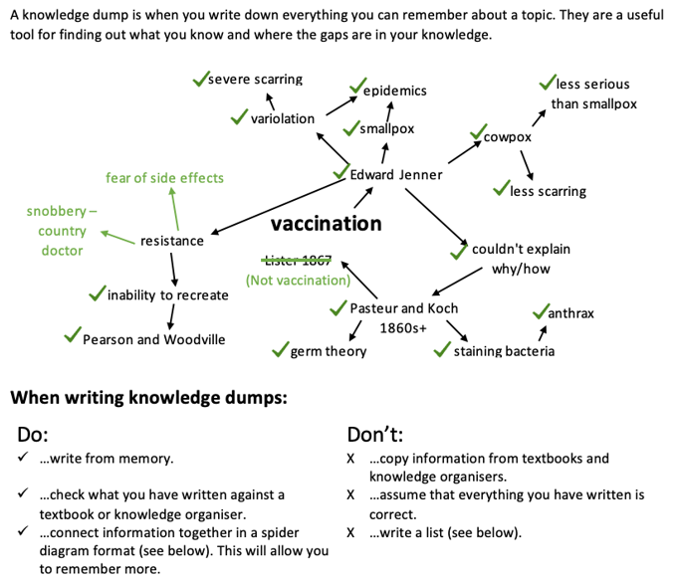
Knowledge dump

Slide 13
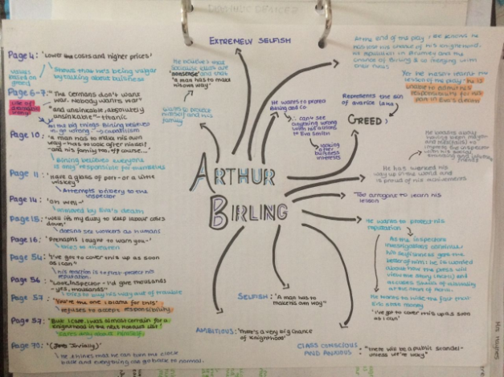
Mind map

Slide 14
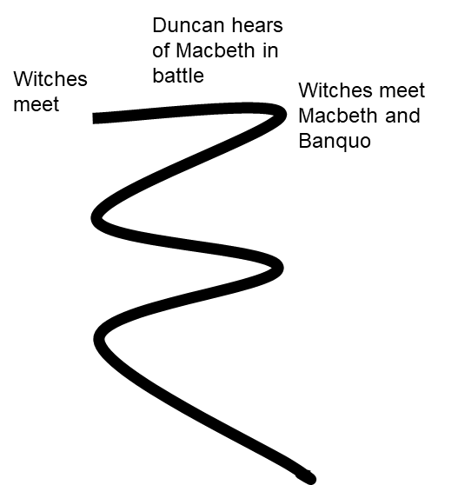
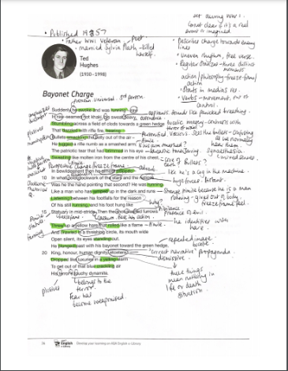

Annotation
timelines
Print out two copies of a poem.
Annotate it once using notes and/or a revision guide.
Cover it over.
Annotate a fresh copy from memory.
Compare and add in anything you missed in a different colour.
Revisit after a few days/weeks.
Create a timeline of the key plot points.
Then make one using only symbols to represent key events.
Repeat from memory.

