Slide 1
Little heath school learning for life  together  one community

Slide 2
Revision workshop revision planning  techniques  positive mindset

Slide 3
How do you revise?

Slide 4
Some revision timetable top tips
Be realistic – don’t create something that is impossible to achieve!
Break the time down into manageable slots….
Divide slots between your different subjects so each subject gets a fair share of the time.
When you write a subject in break it down to a specific area of the curriculum and your PLCs will help you with this – so for example instead of writing Geography you might write ‘Geography – Paper 1 – Coasts’ – also note how you are going to revise – flash cards, mind maps….
Incorporate regular rest breaks or times to do things you enjoy. So if you revise for an hour then take a 20 minute break before resuming it will recharge your mind and body and make you more effective at your revision.
When you get close to the dates of exams make sure the revision for that subject is just before the exam (so if there is a History exam on Monday morning, on Sunday afternoon you will include some time to top up your revision on History).

Slide 5
active revision ideas

Slide 6
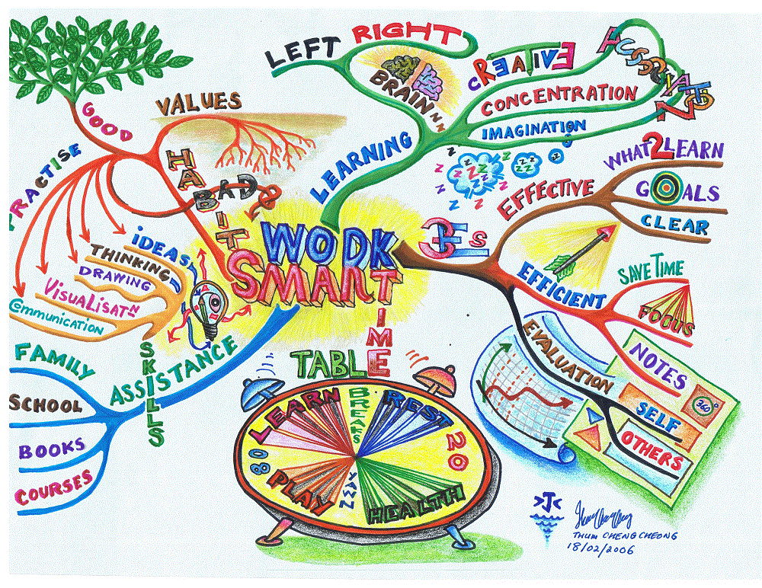
Mind maps
Mind maps are very effective for learning, and they can help you to understand what your strengths and weaknesses are.
A mind map is essentially a visual representation of the knowledge that is contained inside your head.
Make your mind maps memorable - to make an effective mind map, you’ll want to add colour – and lots of it. Bright colour helps your brain remember what you’re doing, as it makes it seem more fun and enjoyable.
Whenever you make a mind map, it highlights the areas that you know a lot about, and also shows you the areas that you don’t. Therefore, you should make a mind map, revise what you didn’t know, and then make another one.
Carry on making mind maps until you’re confident you’ve written down everything you need to know from memory.

Slide 7
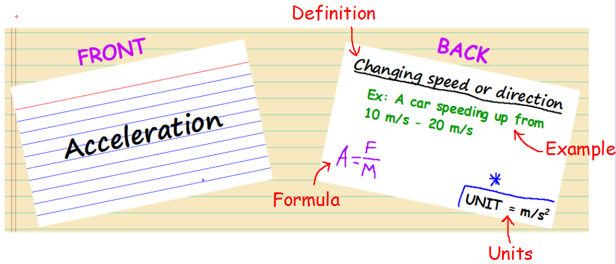
Flash cards
Flashcards are the staple revision technique of any student. The reason they work so well is because they cut out all the useless bits of information that you don’t need to know. Short flashes of important facts and figures stick in your memory, meaning you’ll be able to use the information in your exams.
Every time you make a flashcard, make sure that it is actually testing a “Learning Objective” that is stated in your specific subject specification.
Phrasing your flashcards as questions actually makes it easier for you to recall previously revised information when you are in your actual exam.
How Should You Use Flashcards (So They Actually Work)?
Get someone else to read the question on each flashcard.
For every flashcard you get 100% correct, put it in a pile to your right. However, for every flash card you don’t get exactly right put it in a separate pile (to your left).
Once you have sorted your initial pile of flashcards into the two piles, you pick up the pile of flashcards that you got wrong and then you sort this pile out into their right-wrong respective piles (ask all the flashcards again).
You keep repeating this, until you have no flashcards left in a “wrong” pile.
Repeat steps 1-4 until you can go through the first pile of flashcards and have no wrong ones.

Slide 8
videos
Video tutorials. It may not seem like it, but for some this can be an extremely effective way of revising.
Videos are great for revising, as long as you’re watching videos on your course content… Whatever you end up doing, don’t drift off. It’s extremely important that you stick to your subject content, or your revision time could be wasted.
Some of the best GCSE Revision YouTube Channels (Per Subject):
GCSE Physics – Freesciencelessons
GCSE Biology – Freesciencelessons
GCSE Chemistry – Freesciencelessons
GCSE Maths – HegartyMaths & WrightMaths
GCSE Computer Science – Computer Science Tutor
GCSE English – Mr Bruff & Mr Salles Teaches English
GCSE PE – Ladybridge PE

Slide 9
pomodoro
The pomodoro technique means taking breaks after short periods of revising.
This method of revision supposedly is the best for saving information in your head. The short breaks allow your brain to rest and absorb what you’ve just revised, and so your revision ends up being more efficient.
To implement this revision technique, you need to revise for 25 minutes straight and then immediately take a 5 minute break. Therefore, you would break up your 2 hour revision session down into 4 separate segments – each of these revision segments you would revise for 25 minutes and rest for 5.
When you do a workout, you have rests between the sets of your workout, so why shouldn’t you take breaks when putting your brain under intense stress?
This technique will amplify your already good revision technique. This technique will not help you if you have a poor revision style.

Slide 10
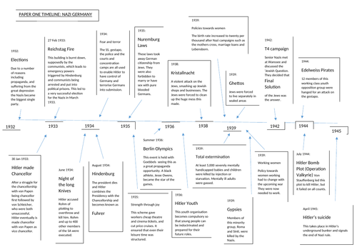
Time lines
A timeline is a diagram that helps you to visualise a sequence of events that have happened or will happen over a period of time.
It is the organisation of information into chronological order
There are a number of different ways to use timelines, and your use of them will depend on your individual learning style.
Some people may find that timelines are a great way to create a comprehensive, detailed overview of a time period. You can almost combine the idea of a mind map with your timeline, branching information off dates and events.
You may want to keep it simple, with a date and event. This can be extremely useful as a way of understanding the order of events, and means that you will be able to fit more events on to your page!

Slide 11
Past papers
Past papers are a great way of revising. The great thing about them is, there’s a past paper for every subject you could possibly do.
They not only improve your knowledge of the content, but they also boost your exam technique, too. Exam technique is essential for any student to succeed.
Possibly the most common (and most simple) way of going through past papers is to do all the questions in the allotted time, and then check your answers after. This way is great for preparing you for exams, as it is pretty much what will happen on the day.
Another way, is to take as much time as you need to do the questions. Just work on getting them right with full marks, and then move onto full exam style revision later.
You can even check the answers every once in a while, if you need help. This repeated exam technique practice combined with constant revision is a sure-fire way of exam success.

Slide 12
Be the teacher
Teaching other people is a great way of improving your own understanding of a subject or topic. Relaying your knowledge and helping someone else to understand helps both parties involved, so it’s a win-win.
Everyone has that one subject that they enjoy or are good at, so why not share your knowledge with your fellow students?
When you are teaching someone, they will ask a lot of questions. Each of these questions you will have to explain in detail. Therefore, it is very likely that they will ask a few questions you won’t know the answer to which means you will recognise learning gaps.
Similar to mind maps, teaching someone else reveals those hidden gaps before you reach your exam.
It’s also a fun and memorable way of revising

Slide 13
Group revision
Group revision consists of working with friends towards the same goal – being ready for exams.
Sitting down with your mates and revising can actually be better than revising on your own. Seeing familiar faces helps your brain remember the knowledge you need to know for your exams.
When undertaking a group revision session, it’s important that you focus on the task at hand. Do this, and it’s plain sailing from there.
Group revision helps you associate revision with fun times. This in turn will help your motivation to revise as you start looking forward to it.
Group revision, done right, can be super effective.

Slide 14
BBc bitesize
Video series created by BBC with tips, hacks and advice created by students and experts
Some have been through their GCSEs or National Qualifications already and some have got them coming up.
They come from all different backgrounds and all corners of the UK and they’ve all faced different challenges in getting to grips with exam revision
Help with looking after wellbeing as well as managing stress and anxiety
Top revision techniques for exams - BBC Bitesize

Slide 15
Gcse pod
School has funded this fantastic resource for all students – make the most of it, there are PODs on everything
How many PODs can you do?
Your login details are your school email, so: firstname.surname@littleheath.org.uk
Your password is your date of birth, so if you were born on the 1st of January 2006 it will be: 01012006 (no dots dashes or spaces, and 8 digits) or Littleheath
GCSE Learning and Revision | GCSEPod

