Slide 1
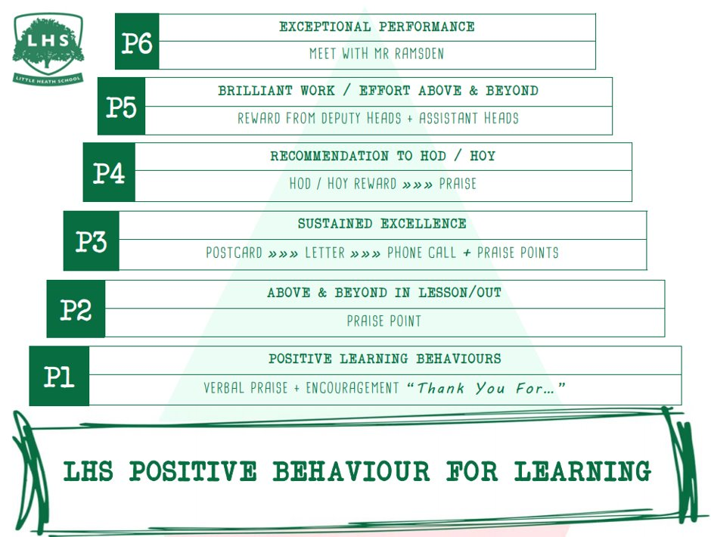
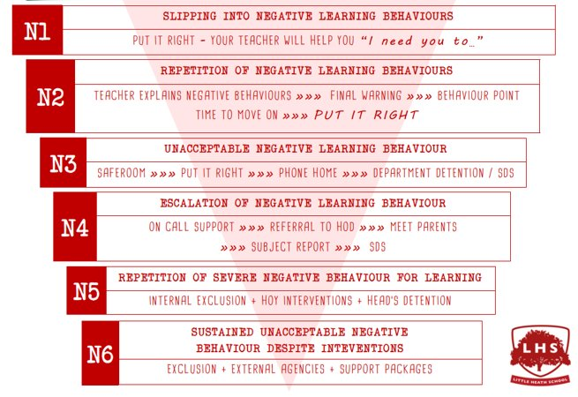



Title: Why might you want to study English Literature at A Level?
Aims:
To entice you all into signing up for English Literature.
Do Now: What issues in society do we need to protest about? With your partner, write your ideas onto your mini-whiteboard.
Thank you for being ready to learn!

Slide 2

Think/pair/share: HOW might a writer present protest through their writing?
You could consider:
Plot
Narrative
Voice
Character
Themes
Setting

Slide 3
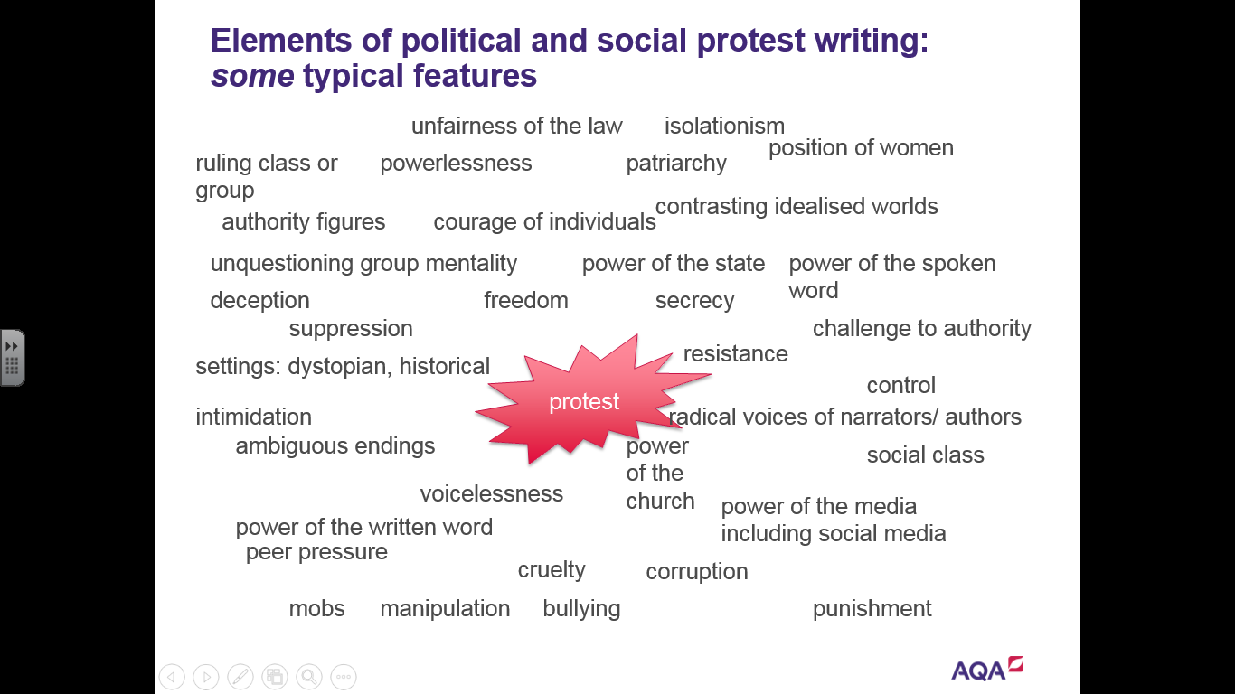

Slide 4
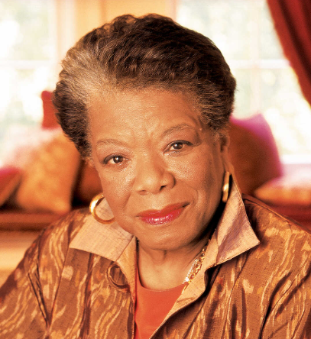
‘Still I Rise’ by Maya Angelou
WHAT elements of social and political protest can you find in this poem?
HOW does Angelou present her ideas?
Task: Annotate the poem with your partner and be prepared to share your ideas.

Slide 5
Paired Writing: Write a response to this question ensuring your have a strong opinion about how far you agree with this statement.
Be prepared to share!
‘In her poem ‘Still I Rise’, Angelou ultimately celebrates the resilience of Black women’.
To what extent do you agree with this view?
AGREE to some extent DISAGREE
Remember to include in your answer relevant detailed exploration of Angelou’s authorial methods.

