Slide 1
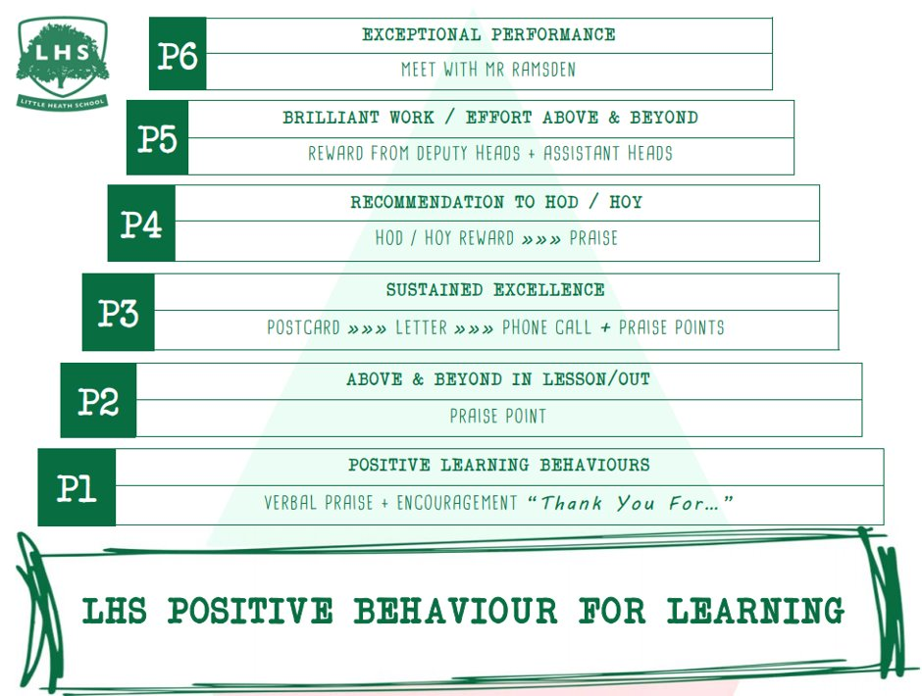
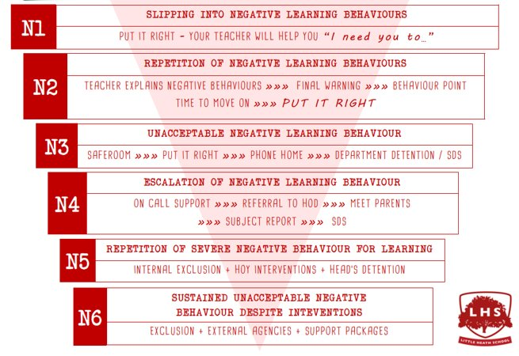


Title: A Level PE
DNA:
- label the heart work sheet.
Aims:
Identify the elements of the exam papers
Attempt exam style questions in each paper
Thank you for being ready to learn!

Slide 2
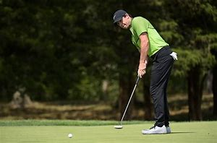
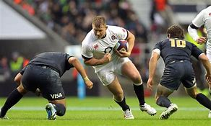
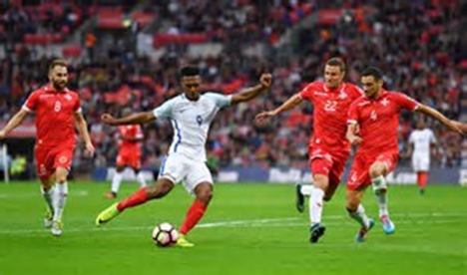
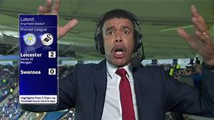
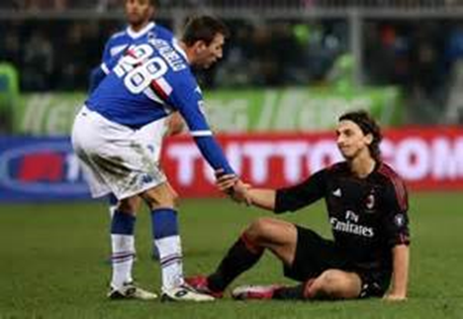
A Level PE
What you can expect from us.
What we expect from you.

Slide 3

A’ Level PE Course – 2 year course
Assessment overview Content overview
Physiological factors affecting performance (01) 90 marks 2 hour written paper | Applied anatomy and physiology Exercise physiology Biomechanics | 30% of total A’ Level
Psychological factors affecting performance (02) 60 marks 1 hour written paper | Skill Acquisition Sport Psychology | 20% of total A’ Level
Socio-cultural issues in physical activity and sport (03) 60 marks 1 hour written paper | Sport and Society Contemporary Issues in Physical activity and sport | 20% Of total A’ Level
Performance in physical education (04) 60 marks Non-exam assessment (NEA) | Performance/Coaching Evaluation and Analysis of performance for improvement (EAPI) | 30% of total A’ Level

Slide 4
How you will study over the 2 years
Year 12:
01 paper – Physiological effects of sport
02 paper – psychological effects of sport
04 practical – a practice moderation and EAPI talk
Year 13
01 paper – continue as bigger paper.
03 paper – social cultural aspects of sport.
04 practical – moderation for final practical grade and EAPI talk

Slide 5
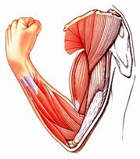
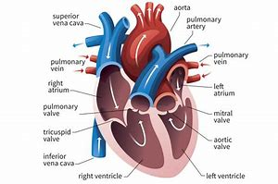
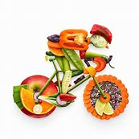
01 paper – 30% of final grade
Bones and muscles
Levers
Energy systems
Cardiovascular system
Respiratory system
Types of training
Training cycles
Injury
Diet and nutrition

Slide 6
Task: Route of Blood
Vena Cava
Right Atrium
Tricuspid Valve
Right Ventricle
Semi-lunar Valve
Pulmonary Artery
Lungs
Pulmonary Vein
Body
Aorta
Semi-luna valve
Left ventricle
Bicuspid valve
Left Atrium

Slide 7
The heart is split into 4 chambers. Name the two chambers at the top of the heart.
“the volume of blood which is ejected from the left ventricle in one contraction” is known as the what?
Muscles work in A…………… pairs
What is the name for the group of muscles that cover your stomach?

Slide 8
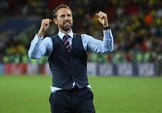
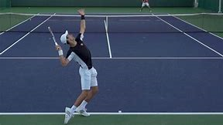
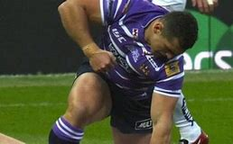
02 paper - 20% of final grade
Skill classification
Theories of learning
Types of learning
Personality
Aggression in sport
Types of leaders
Stress in sport
Motivation in sport

Slide 9



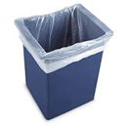
Feedback
A volunteer needs to throw some paper into the bin. They will throw backwards and not be able to see the bin. They will do this 3 times, all differently.
They will then received 3 types of Feedback on attempting to throw the paper into the bin 3 times:
No feedback
Knowledge of results – scored or not
Knowledge of performance – eg. “throw to the left a bit

Slide 10
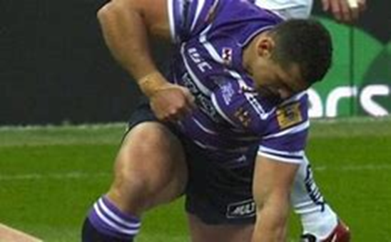
A basketball free throw is classified as what type of skill? Close or Open?
2) Some people believe you develop your personality by inheriting it from your parents, other believe you develop it from copying the people around you.
What do you think? Inherited or copying?
3) What are the possible reasons someone could become aggressive in sport?

Slide 11
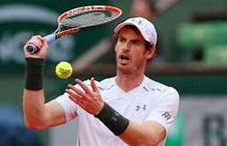
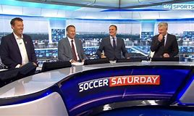
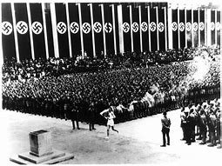
03 paper - 20% of final grade
Development of sport since the 1800s
The modern Olympics
Case studies of the Olympics (The 1936 Nazi games)
Commercialisation of sport
The golden triangle
How media influence sport
Drugs in sport
Entertainment and sport

Slide 12
Exam question: What causes violence in sport?
2. What causes violence in sport?
Pressure to win – management, sponsorship
Desire to win – intrinsic and extrinsic motivation
Nature of the game – physical, aggressive, ice hockey, bats, boxing,
Spectators and alcohol/drugs – increases violence, passion, over confident in rowdy situations.
Rivalries between clubs
Spectators to see others being violent - encourages
Media increase tension – pre game tension, social media,
Officials – unfair decisions, poor control over the game,

Slide 13

How might the media impact of timing of games played on the tv?
What is the difference between an amateur and a professional?
Give an example of a sport in the modern day Olympics.
Today, how has the media created more entertainment for us to watch sport?

Slide 14
04 – Practical and talk
Practical
Coursework - EAPI
1 sport.
This means you only focus on one sport to be your best.
You will need to keep a log book therefore it is expected that you play this sport outside of school
This is a talk
You will watch a video of a performer in your sport.
You will need to identify their strengths and weaknesses and relate the theory to what you have seen.

Slide 15
What we expect from you
Commitment to 1 sport outside of school. We will not offer practical lessons within school time.
Folders to be kept up to date and tidy, clearly identifying the content for each section of the course. You will need a divider for each section (01, 02, 03, 04)
Completing homework to a good standard. A Level requires a lot of work outside the classroom.

