Slide 1
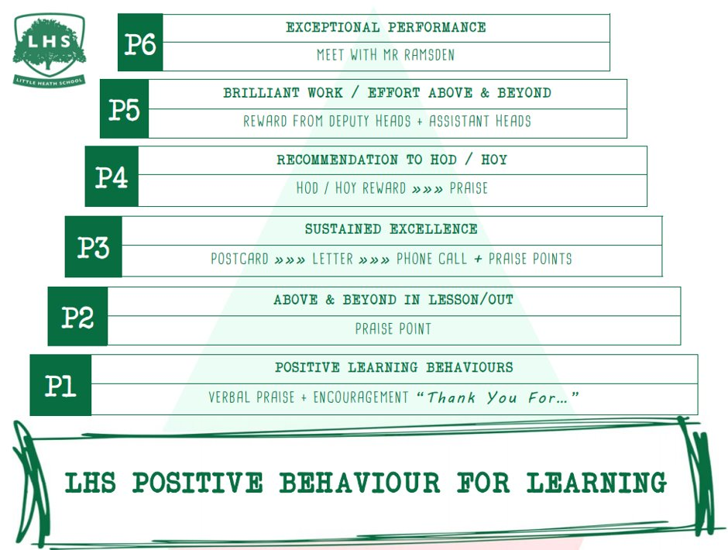
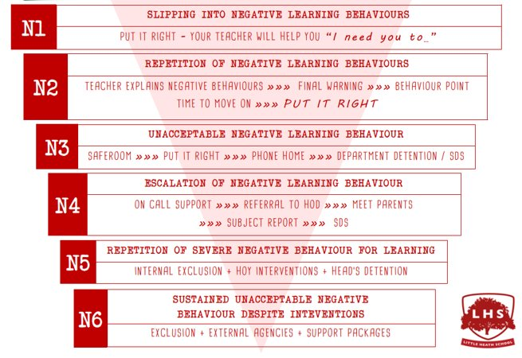


Health and Social Care
DNA:
What is H&SC research and why do we need it?
Aims:
You will be able to state reasons for the importance of research in health and social care.
You will learn the difference between “ethics and bioethics”
You will choose a health issue and create an action plan for this research.
Thank you for being ready to learn!

Slide 2
Why do we need HSC Research?
Diagnose diseases and health problems
Prevent the development or recurrence of disease and reduce the number of people who become ill
Treat illness to improve survival rates or increase the number of people who are cured
Improve the quality of life for people living with illness

Slide 3

BTEC Health and Social Care – National Diploma (Level 3).
KS5
Double Award
(Yes you get 2 grades)!

Slide 4
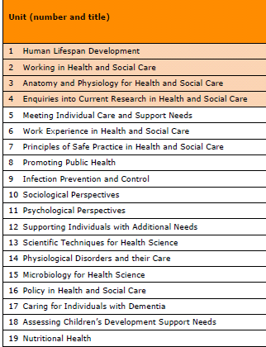
What units do we cover?
You gain 2 grades by the end of this course…
2 exams in year 12
1 controlled assessment in year 13
5 assignments/reports over 2 years
We will cover unit 1 , 2 , 4, 5, 7, 8, 14 & 19.

Slide 5
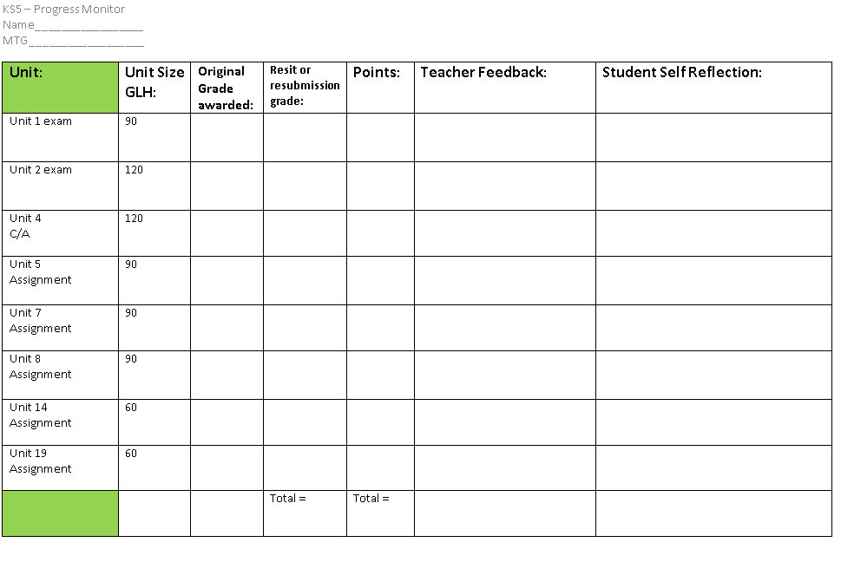
POINTS = YOUR GRADE
PP= 72 POINTS
MM = 104
DD = 144
DD* = 162

Slide 6
Unit 4 – Controlled Assessment
Areas that are covered:
Purpose of Research
Issues in HSC
Planning Research
Rationale for Research
Qualitative & Quantitative Methods
Advantages and Disadvantages.
Research questions
Target Groups and Samples
Ethical Principles
Safeguarding Ethics
Confidentiality
Informed Consent
Legislation
Non –Judgmental Practice
15. Primary and Secondary Research
16. Literature Review
17. Notes and Records of Sources
18. Reading Techniques
19. Academic Reading and Analysis
20. References Conventions & Techniques
21. Selecting Reliable sources
22. Electronic Sources
23. Connecting Sources
24. Suitability of Sources
25. Interpreting Quantitative Data
26. Interpreting Graphs and Tables
27. Bias in Quantitative Data
28. Interpreting Qualitative Data
29. Interpreting Words
30. Bias in Qualitative Data
31. Recommendations for Practice and Provision
32. Identifying Future Research
33. Reflecting on Research

Slide 7
Research Ethics and how Health Research is Reviewed
www.nuffieldbioethics.org/education

Slide 8
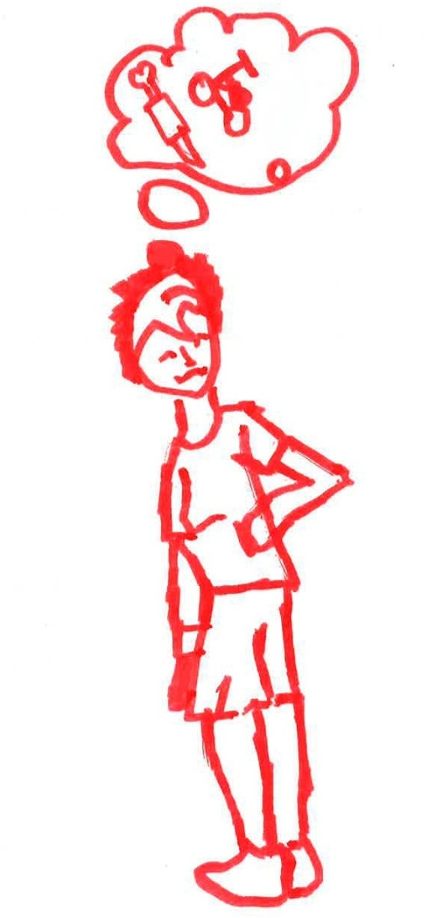
‘Clinical research’ - What is it?
What does research do?
Collects new information
Tests different ideas
Finds out more about a disease and how it is treated
What does it include?
Clinical trials for new medicines
Questionnaires and surveys
Watching people (observing them)

Slide 9
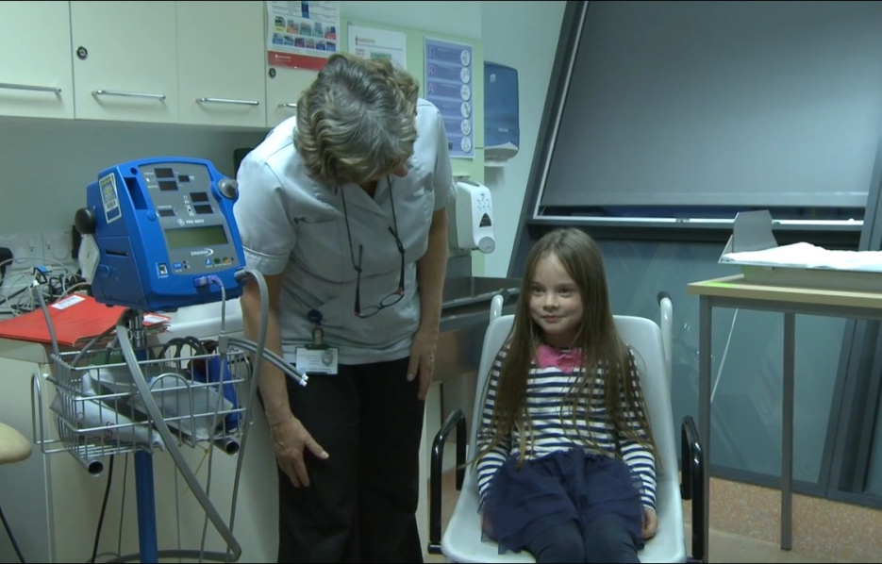

Who does clinical research?
Doctors, nurses, and other people who work in hospitals or clinics
Researchers who work at universities
Scientists who work in laboratories or hospitals

Slide 10
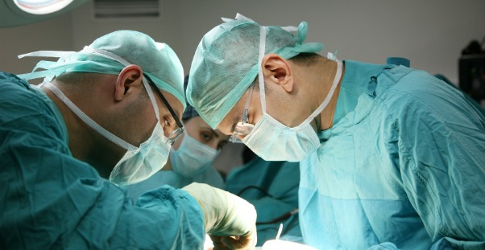
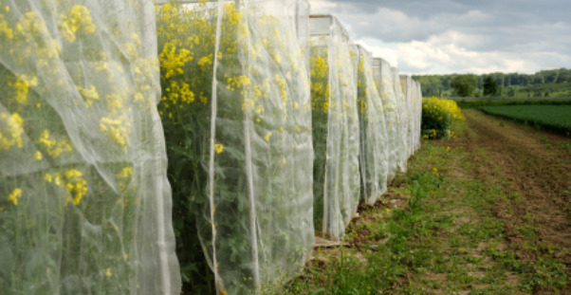
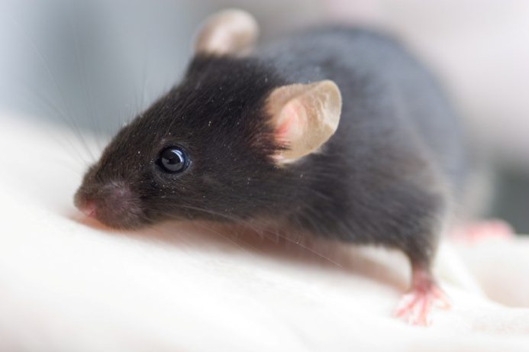
‘Ethics’ and ‘bioethics’
What do they mean?
Ethics: working out the ‘right thing’ to do
Ethical values and principles help us to decide:
  If we should behave in a certain way
  If something is right or wrong
Bioethics: working out the right ways to use biology or medicine
  Helps us to make decisions about how to use biology or medicine
    Should we pay people to donate their organs?
    Should we plant food crops that have been changed by scientists?
    Should animals be tested to help make medicines for people?

Slide 11

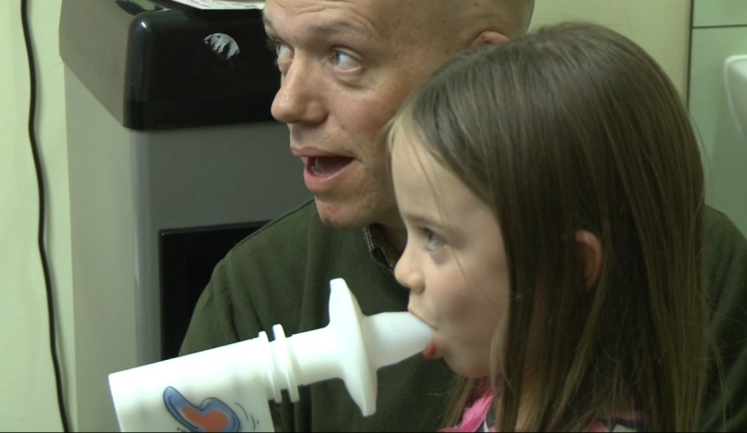
‘Research ethics’?
What are ‘research ethics’?
Values or principles that help researchers ‘work out’ what they can and can’t do
So what would ethical research look like?
Do people know what the research is about?
Do they know enough to decide for themselves whether or not to take part?
Are you sure that people won’t be harmed by the research?
Will the privacy of the people taking part be protected?

Slide 12

What are Research Ethics Committees (RECs)?
Made up of people with different jobs (not just scientists and doctors)
Members will all have different experience

Slide 13
What do RECs do?
Meet to talk about a new study before it goes ahead. They think about:
  What is good or not so good about the study
  Whether taking part in the study could cause problems for those who take part
Decide whether the research is ethical – for example, is it safe? Will it treat the people who take part with respect?
  If it is, then the researchers can go ahead with their study
  If it is not, then researchers may be asked to make changes to their research plans

Slide 14
TASK
How clinical research in the UK is organised - YouTube
https://www.youtube.com/watch?v=VweoGuqejXo
Imagine you are going to start researching a health & social issue.
Chose an issue that affects society – see next slide for ideas!
Where will you get your participants from?
What age range?
What methods could you use? ie – how will you gather information?
Will you collect subjective or objective data? (statistics vs opinions)
What ethical issues should you consider?
Once you’ve gathered your data, how will you analyse it?
What organisations or agencies could you share it with?
How can research help provision?

Slide 15
CHOOSE AN ISSUE TO RESEARCH.
Health or Social? Can you think of any other issues?
HEALTH
CANCER
ASTHMA
STROKES
DEMENTIA
SURGERY
MENTAL HEALTH
SOCIAL
HOUSING
EDUCATION
DISABILITIES
RIGHTS
YOUTH WORK
CRIME

Slide 16
Aims:
You will be able to state reasons for the importance of research in health and social care.
You will learn the difference between “ethics and bioethics”
You will choose a health issue and create an action plan for this research.
Explain why H&SC research is so important?
What is the difference between ethics and bioethics?
Hand in your action plan.
Extension – watch the clip on the next slide, and make notes as you go along. Then answer the following question.
What Makes Good Research? (1 small paragraph).

Slide 17
Unit 4 – Current Research in HSC
Controlled assessment – 3 hours
What does good health and social care research look like?
What does good health and social care research look like? (youtube.com)

Slide 18
Unit 1 – Human Lifespan Development
https://www.youtube.com/watch?v=xd802M7NFJs
-Gross Motor skills
-Fine motor skills
-Piaget
-Chomsky
-Holmes and Rahe (stress scale)

Slide 19
Unit 2 - Working in Health and Social Care
https://www.youtube.com/watch?v=6-8UD6ianik
-Multidisciplinary Teams
-Holistic Care
-Professional Conduct

Slide 20
Unit 5 – Meeting Individual Needs
https://www.youtube.com/watch?v=B2FhY1XPwik
-What is holistic care?
-How can we meet the needs of everyone?

Slide 21
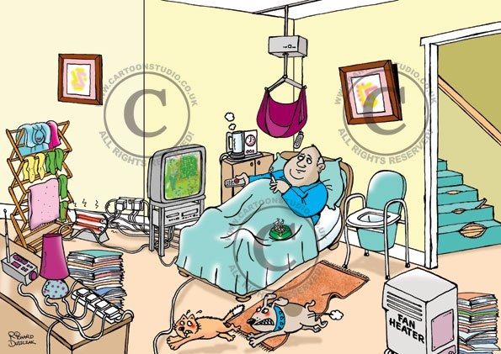
Unit 7 – Safe Practices in HSC Settings.
Spot the hazards.

Slide 22
Unit 7 - Safe Practices in HSC Settings
Assignment – 2 case studies highlighting vulnerable people.
-risk assessments
-hygiene/infection control
-safeguarding procedures
CARE HOME HEALTH AND SAFETY.
https://www.youtube.com/watch?v=oibvuXRmKe0

Slide 23
UNIT 8 – PROMOTING PUBLIC HEALTH
What is Public Health?
https://www.youtube.com/watch?v=oy1CAMObRzc

Slide 24
Unit 14 – Physiological Disorders and their Care.
Cystic Fibrosis – Lauren’s Story.
https://www.youtube.com/watch?v=-a-WHZoTX0E
Alzheimer's
https://www.youtube.com/watch?v=HobxLbPhrMc

Slide 25
Unit 19 – Nutritional Health
https://www.youtube.com/watch?v=qRBFTL4PIZM
What do you eat? How do you burn it (the calories)?

