Slide 1
Fecha: miércoles, 26 de junio de 2024
Título: Spanish A LEVEL taster session
Develop skills of resilience, research-methods and critical thinking that will prepare you for university
Learn how to express yourself fluently about a range of topics
What can I expect as an AS/A LEVEL Spanish student?
Stand out from the crowd with an A Level in a foreign language
Expand your knowledge of the culture and history of the Hispanic world, as well as discovering more about life in the present day.

Slide 2
Course structure
Year 1 topics
Aspects of Hispanic society
Family
Religion
Technological advances
Gender roles / LGBT rights
Artistic culture in the Hispanic world
Influence of Spanish celebrities
Regional identity
Historical sites and architecture
Year 2 topics
Multiculturism in Hispanic society
Immigration
Racism and equality
Integration
Aspects of political life in the Hispanic world
Youth in politics
The Spanish Monarchy
Dictatorships
Popular movements / protests
Builds on knowledge from GCSE
Evolving family structures in the Hispanic world
Impact of technology on society
Popular culture, celebrities, music cinema and regional identity
Expands knowledge of culture and politics
- Hispanic diverse society
Life of marginalised groups
Young people’s voting and political engagement
Monarchies and Dictatorships
Popular movements
Notes:
n 1941, when Paris is occupied by the Nazis, his childhood comes to an end. Never before having known what it means to be a Jew, Joseph is forced to wear a yellow star.

Slide 3
A Spanish novel and film
Novel
Film
Como agua para chocolate
Analysing key characters
Themes
Social and political context in which the book was brought into and what it represents
El Laberinto del Fauno
Analysing key characters
Themes
Social and political context in which the film was brought into and what it represents

Slide 4
Independent research project
In your second year, you will need to prepare your independent research project.
You can research a subject, or a person, or a key question that relates to a country or countries within the Spanish speaking world.
You will need to analyse and summarise your research, including present where you found your information, and discuss these in the speaking assessment at the end of year 13.

Slide 5
Examples of things that you could study
The Spanish football team
Barcelona
The history of the Sagrada familia
The impact of tourists in machu picchu
Gaudi
Pablo Picasso
Shakira and her charity work
Flamenco dancing and its origins
It could really be absolutely anything, as long as it’s about a Spanish country or person, and you are able to find and back up your research

Slide 6
Assessment
3 exams
Paper 1 = listening and reading
(based off of topics from both years)
Paper 2 = writing
(an essay on the book and the film)
Paper 3 = speaking
(stimulus card and discussion + IRP)
Year 12 – no formal assessment
PPEs around May
Year 13 – final exams in June
PPEs around Feb

Slide 7
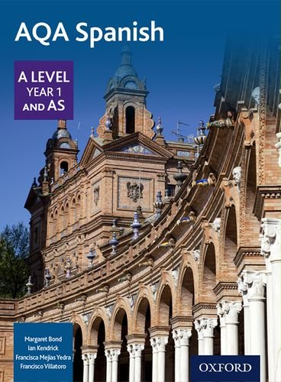
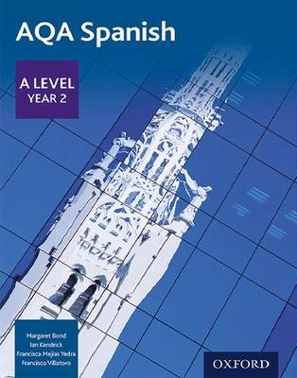

Slide 8
An example piece of work
Read the paragraph about Shakira and Enrique Iglesias
What can you pick out from the vocabulary?
Where are they from? What do they do?
Can you recognise any tenses you have studied before?

Slide 9
Summer work
Conocimiento clave del mundo hispánico.
This booklet contains some key information about the Spanish speaking world.
In GCSE you have learnt how to express yourself in Spanish but the a level will introduce you to many new things about culture, history and the current affairs of not only Spain but the Spanish speaking world.
Work through the translations, read the key information and do some of your own research on the blank pages to discuss when you come back after summer.

