Slide 1
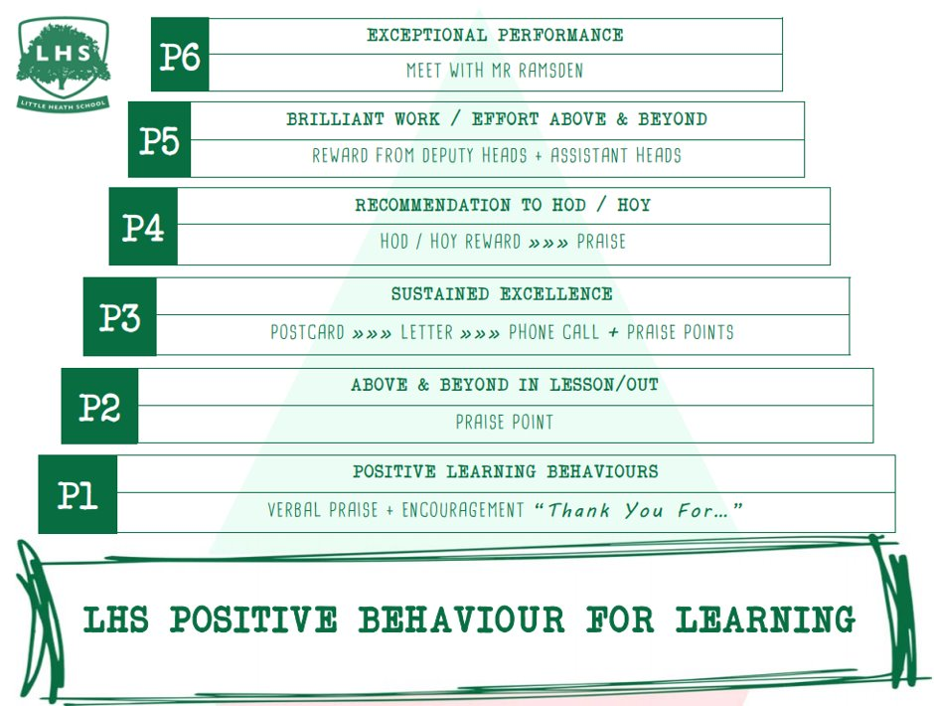
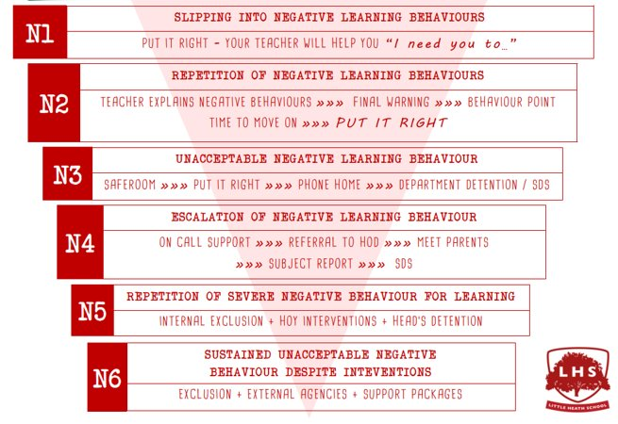


DNA: You are the owner of a hotel in Cornwall. What would be your marketing activities?
Give reasons for your answers
Title: XXXXXXX
Aims:
Understand the outline of the course
Explain the exams
Explain the coursework
Clarify student expectations
Thank you for being ready to learn!

Slide 2

Welcome to Cambridge Technical
Extended Certificate in Business

Slide 3
Introduction
We offer the Extended Certificate course as run by OCR Cambridge Technicals and our chosen pathway is Marketing.
Therefore many aspects of the course relate specifically to marketing.
Cambridge Technical Extended Certificate in Business
Worth 1 A-Level.
60% coursework, 40% examination

Slide 4
Cambridge Technical Extended Certificate in Business
EXAM UNITS
COURSEWORK UNITS
  Unit 1 - The Business Environment (Double weighted)
  Unit 2 - Working in Business
  Unit 4 - Customers & Communication
  Unit 5 - Marketing & Market Research
  Unit 8 - Introduction to Human Resources

Slide 5
The course…
YOU and Cambridge Technical in Business
You would like to develop the knowledge and skills to set up your own business and/or the work in a business.
You are considering studying a business-related subject at university or are thinking about an apprenticeship when you leave school.
You enjoy and hands-on, practical approach to learning.
You work well with others.
You have previously completed the OCR Business course
You prefer to focus on coursework as opposed to examinations.

Slide 6
How to approach the course…
In order to make sure you have the best possible chance of succeeding on this course you must take note of the following:
Stick to deadlines – You will be given very clear deadlines by your teachers in class and via SMHW. You are expected to meet these deadlines without exception. Failure to meet deadlines will lead to the external moderator failing your work and either removal from course, changing of course or reduced level of certification.
Bring your own equipment – Much of what we do will require computers, we provide them. But when it comes to the theory teaching and calculations, you need to be prepared with a pen, a pencil, a calculator and a folder. For your written exams, your folder will be what you revise from.

Slide 7
How to approach the course…
Keep up to date with topical business knowledge – you need to be reading around the subject in your own time and if working whilst studying, show an awareness of this course and the working environment link.
Be organised – this relates to both your written folder and on your computer. Work should be easy to get back to and should all be filed in the appropriately named folder by unit. You will be expected to make regular use of Google Classroom and Google Drive.
Push yourself – you should be aspiring to hit the top criteria but there is no fast track to this. To achieve Merit you need to have a solid Pass as your basis. To achieve Distinction you need to have achieved the Pass and Merit criteria. Read the criteria carefully and ensure you have targeted what it is asking for before you submit.

Slide 8
Cambridge Technical in Business
The coursework assignments for this course are very practical.
You are able to take business concepts and apply them to real-life businesses, while developing essential skills that are required in the workplace.
There is a focus on Marketing in a number of units and this is a topic you will be familiar with.

Slide 9
Task 1 – Marketing
Marketing is the activity, set of institutions, and processes for creating, communicating, delivering, and exchanging offerings that have value for customers, clients, partners, and society at large

Slide 10
Task 1 – Marketing
In pairs/three discuss how has technology changed the way businesses market their products or services?

Slide 11
Task 2 – Customer Service
The customer is always right…Or are they?
Now more than ever, businesses need to be mindful of their customers and try to keep the customer experience as normal as possible.
In your pairs/three, discuss the following:
  Reasons customer service is important
  How has technology changed customer services

Slide 12
Task 3 – Thorpe Park
To bring all our knowledge to life, we need to link this to a business.
Let’s link it to Thorpe Park.
Task: In your pairs/three can you provide a description of the actions taken by Thorpe Park to market their services using technology

Slide 13
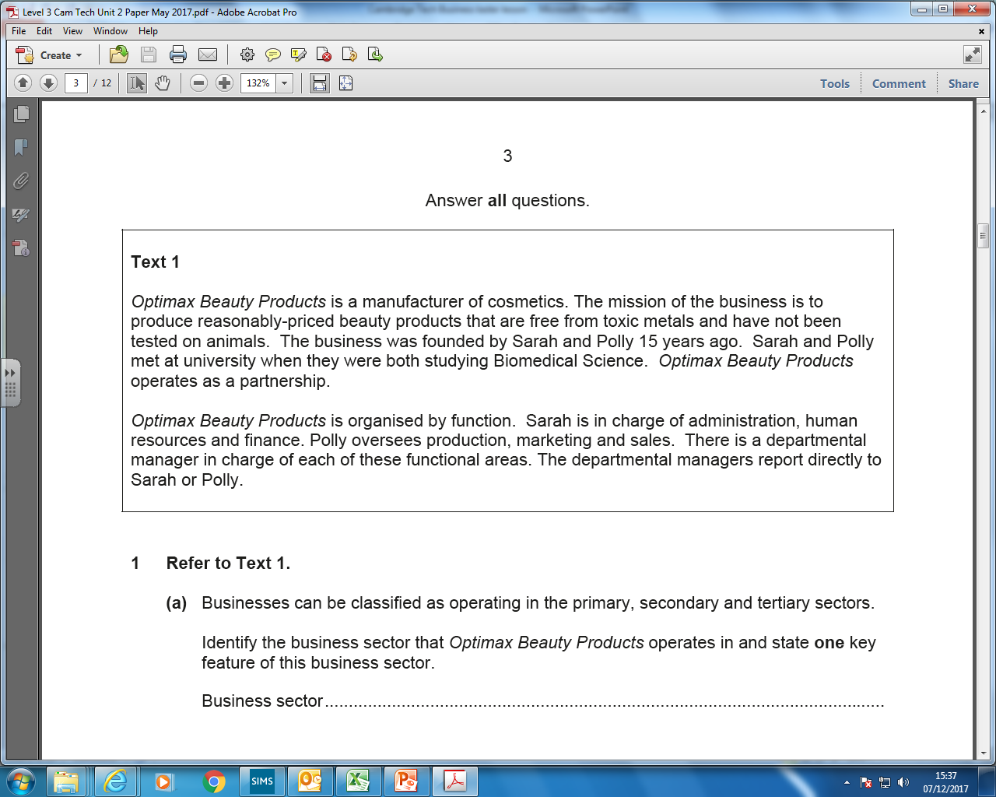

Slide 14
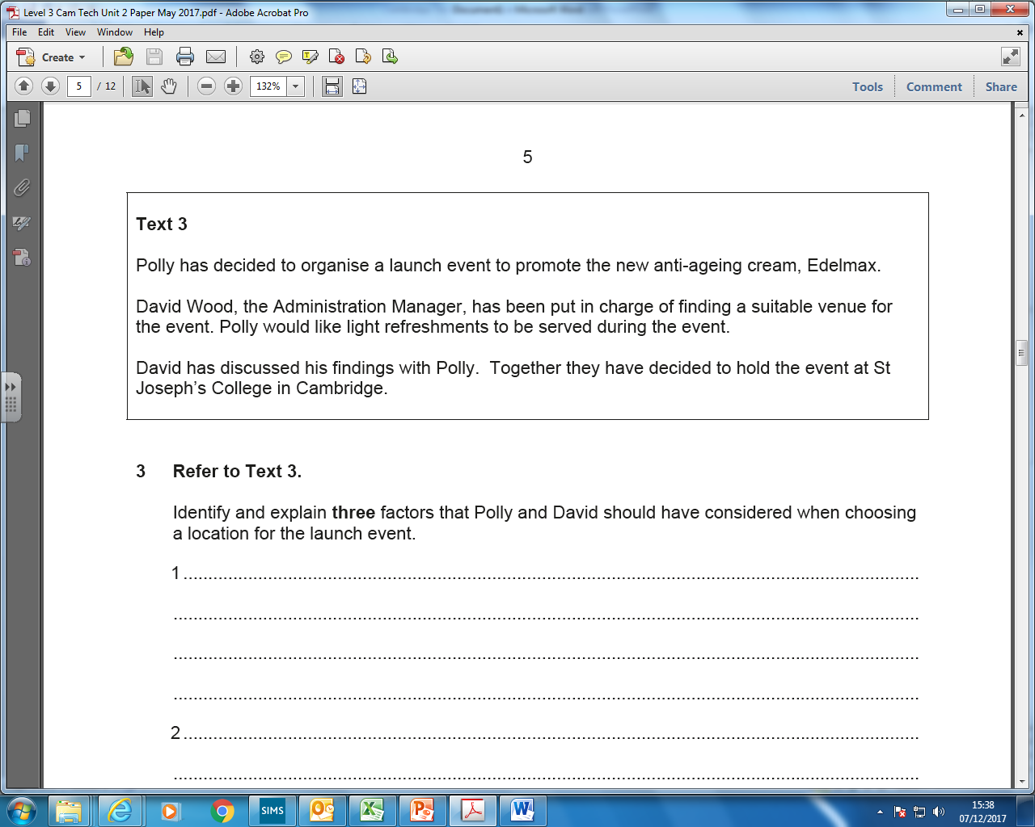

Slide 15
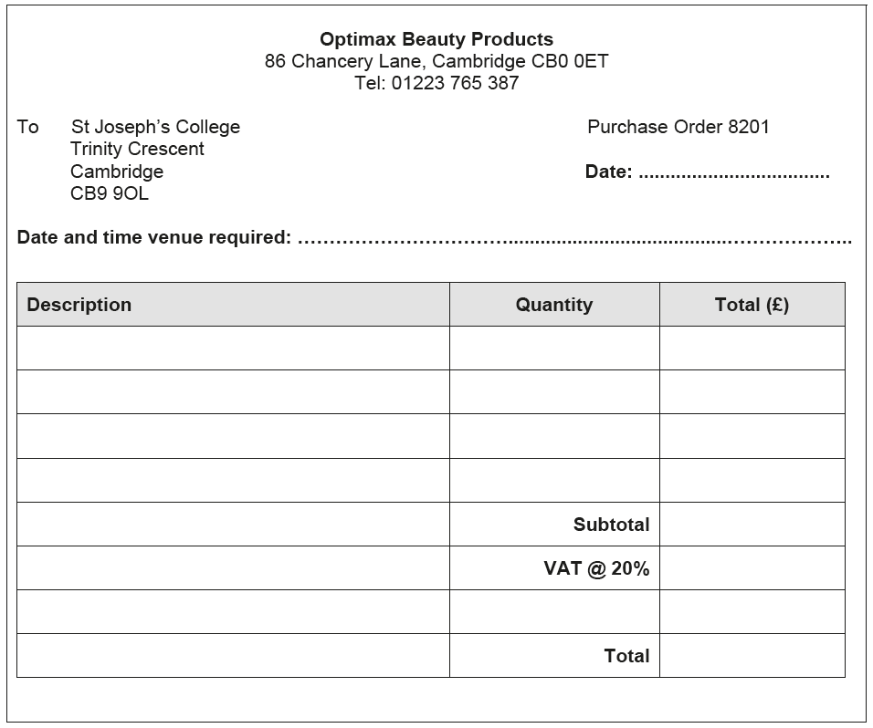
(a) Using information in the brochure, complete the purchase order form below to book a suitable room and buffet menu for 105 participants on the day of the launch event.

Slide 16
Did you spot…
105 people
Laptop rental included in Da Vinci room
Half-day only
VAT
£2000 budget

Slide 17
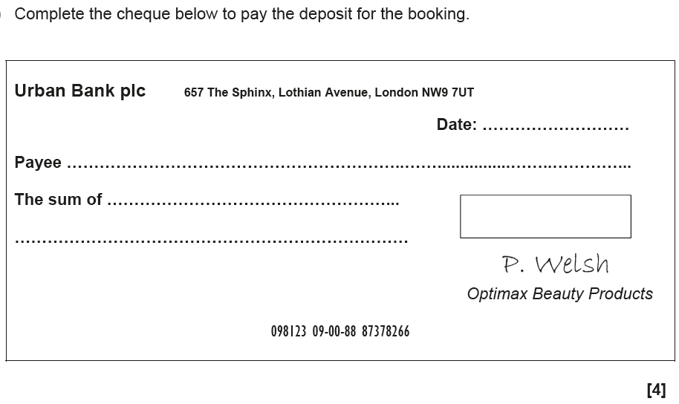

Slide 18
Based on the case we have read, what are the likely impacts on Optimax of David’s failure to pay on time…
Draw a spider diagram with the potential impacts

Slide 19
Potential answers…
unable to secure a suitable room/venue
late booking fee
cancellation of event
might have to spend more time to find alternatives
alternatives might not be as good
alternatives might be more costly
will not be able to send out invites on time
affects reputation of Optimax

Slide 20
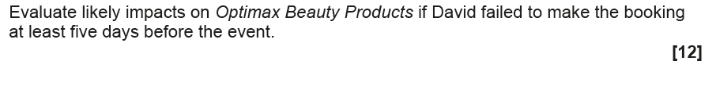
Here is the actual question…

Slide 21
Can you now add to the points you have made using greater detail?
Remember the importance of the word impact!
What will this lead to for the business…

Slide 22
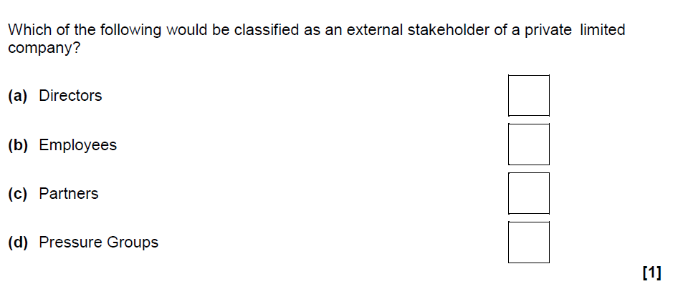
Unit 1 Example Questions…

Slide 23
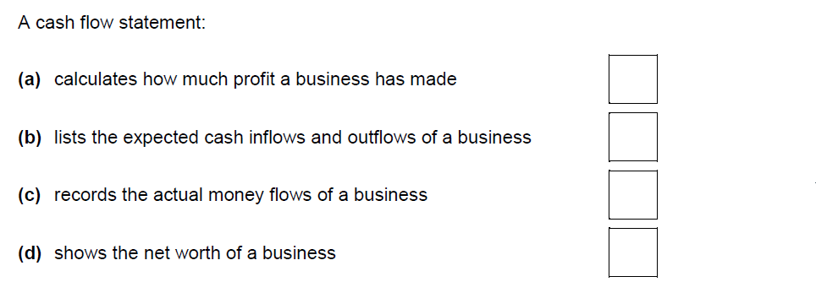
Unit 1 Example Questions…

Slide 24
Any questions?

