Slide 1
A Level Music (AQA)
What can you expect?
What will be expected of you?

Slide 2
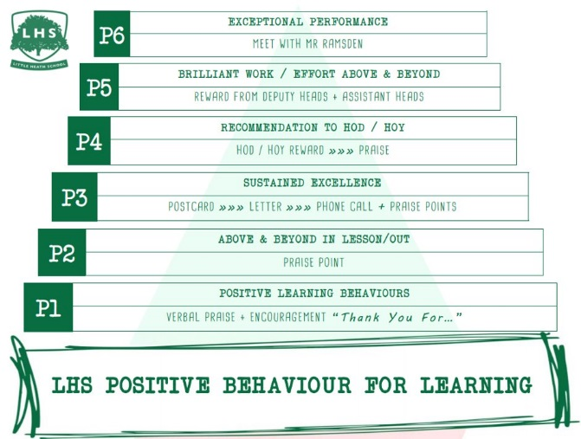
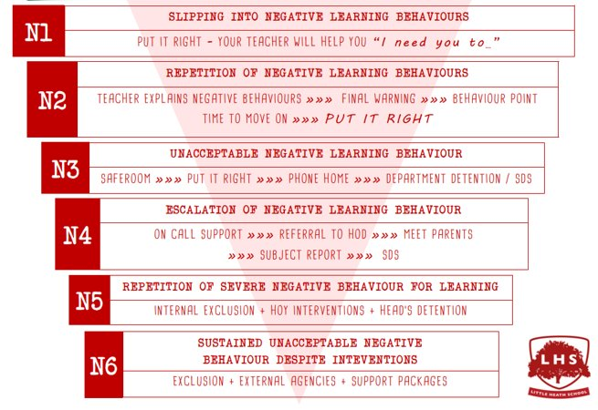


DNA:
Write a list of musical features that must be considered when composing.
Title: Composing to a brief
Aims:
To be able to demonstrate your ability to compose using a brief.
Thank you for being ready to learn!

Slide 3
Why study music?
Studying Music will give you the opportunity to develop your skills in three key areas of the field:
  Listening & Appraising,
  Performance
  Composition.
You will have access to music software, our purpose-built recording studio and will be given the opportunity to develop the skills needed to excel in this exciting field of work. AQA A Level Music provides a solid foundation for musicians who have an interest in different genres of music, either in the spotlight as a performer/composer or behind the scenes as a researcher.

Slide 4
What do you need to study music?
Entry Requirements
Five grade 9-4 GCSEs including a 4 (or above) in Music.
Ability to read notation
Able to show musicianship and musical understanding
Willingness to apply yourself to the course.
Recommended
You will also need to be open to studying music outside of your comfort zone.

Slide 5
Course Breakdown
Appraising Music (40% of your grade)
Performance (35% of your grade)
Composition (25% of your grade)

Slide 6
Appraising Music
Compulsory Unit – AoS1: Western Classical Tradition, 1650 – 1910
  Strand A: The Baroque Solo Concerto (Purcell, Vivaldi and Bach)
  Strand B: The Operas of Mozart (“The Marriage of Figaro”)
  Strand C: The Romantic Piano (Chopin, Brahms and Grieg)

Slide 7
Appraising Music
Additional Unit – AoS2: Pop Music
  Stevie Wonder
  Joni Mitchell
  Muse
  Beyonce
  Daft Punk
  Labrinth

Slide 8
Appraising Music
Additional Unit – AoS3: Music for Media
  Bernard Herrmann
  Hanz Zimmer
  Michael Giacchino
  Thomas Newman
  Nobuo Uematsu

Slide 9
Performance
Minimum of 10 minutes of performing on an instrument of your choice (including voice).
You can perform in any style or genre.
You can perform as a soloist or as part of an ensemble (though ensemble performances have additional requirements to consider).
Your recital will be recorded just before Easter in Year 13.

Slide 10
Composition
Two compositions with a minimum combined total of 4:30.
Free Composition: in any style and for any combination of timbres you choose.
Composition to a Brief: responding to one brief chosen from a set provided by AQA in September of Year 13.

Slide 11
How will I be assessed and examined?
Appraising – 2 and ½ hour exam in the Summer of Year 13, comprising of listening questions based on familiar and unfamiliar music from your studied composers/artists, theory questions and extended answers.
Performance – minimum of 10 minutes of performing, sent to an external examiner.
Composition – two compositions, totalling a minimum of 4:30, sent to an external examiner.

Slide 12
Future Career / education prospects
Studying Music will provide you with a vast array of skills suitable for a range of future courses and careers including performing, freelance composition, music therapy, and teaching to name a few.
In addition, A Level Music develops powers of analysis, listening skills, ICT skills, independence, teamwork and the ability to create music to exact specifications.

Slide 13
What do we expect of you?
On the course you will be expected to:
  Take an active involvement in your education by using your own time to study and listen to different musical styles (including styles that you may not personally like)
  Be willing to use your own time to practice the techniques you learn during the lessons to enable you to complete the course to the best grade possible for you.
  Make yourself available to participate in a number of musical events in school when required (for example, performing in school concerts, productions, Band Nights or helping out backstage).

Slide 14
45-minute task…..
Choose a composition brief from the list.
Consider writing:
  an 8-bar melody on the keyboard
  a melody that suits the given lyrics
  an 8-bar chord sequence
  a short soundscape for the first section of the film clip.
Remember to consider the Elements of Music when you compose!

Slide 15
45-minute task…
Brief 3:
Brief 1:
Compose a piece of music for no more than six instrumentalists / vocalists that represents a story that this picture suggests.
Brief 2:
Brief 4:
Brief 5:
G C | Em D | Am Em | D G
Brief 6:
Compose a piece suggested by the title Passing Storm.
The storm depicted may be on land, at sea or in the air, or it may have a science fiction element, such as passing through an asteroid storm.
Brief 7:
Compose a piece suggested by the title Taking and Instrument for a Walk.
This may involve a walk through various musical styles or genres, instrumental techniques, moods, landscapes or scenery.

Slide 16
Research topics – food for thought…
Area of Study 3: Music for media
The excerpt is taken from a cue entitled 100 Rat Dash from Michael Giacchino’s music for the animated film Ratatouille.
In the scene a large number of rats flee in terror from an old woman armed with a gun.
Explain how the use of musical elements in the excerpt enhances the audience’s experience of this scene. (10 marks)
Area of study 2: Pop music
(Named artists: Stevie Wonder; Joni Mitchell; Muse; Beyoncé; Daft Punk; Labrinth)
The main ingredients of a successful pop song are a strong bass line, good chord progression, rhythmic groove and a memorable melody.
Discuss which of these you have found to be significant, referring to the music of two named artists in detail. (30 marks)

Slide 17
Any Questions?
Feel free to ask any questions you might have about anything we’ve talked about.

