Slide 1
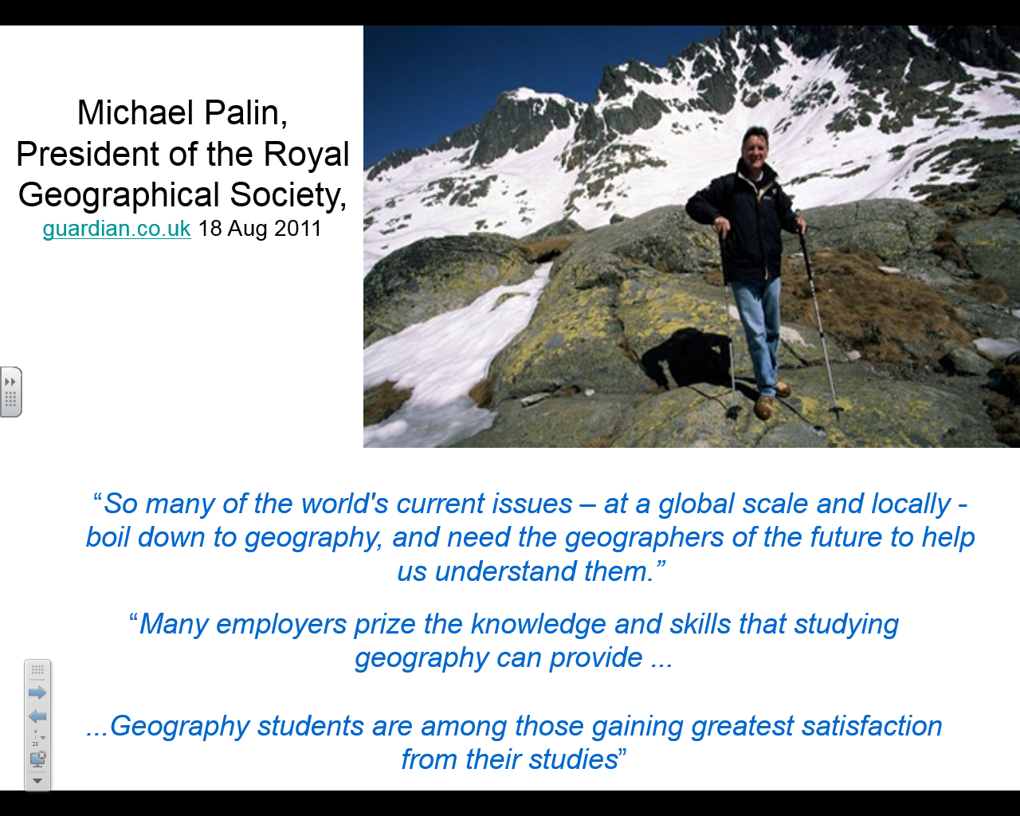

Slide 2
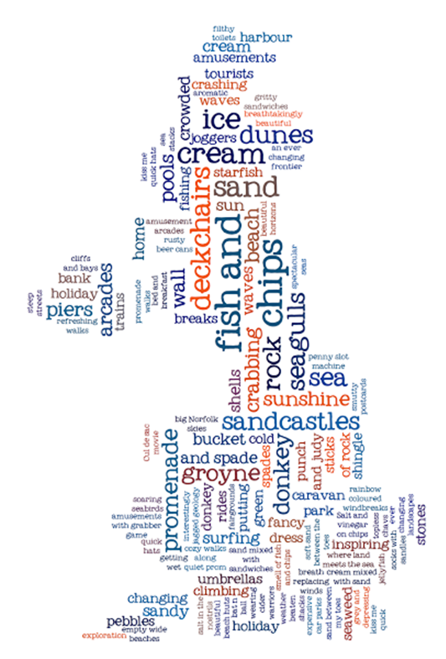
Why Geography?
Geography is everywhere.
Allows you to do lots of different things.
It goes well with everything.
Without geography “we’d be lost”

Slide 3
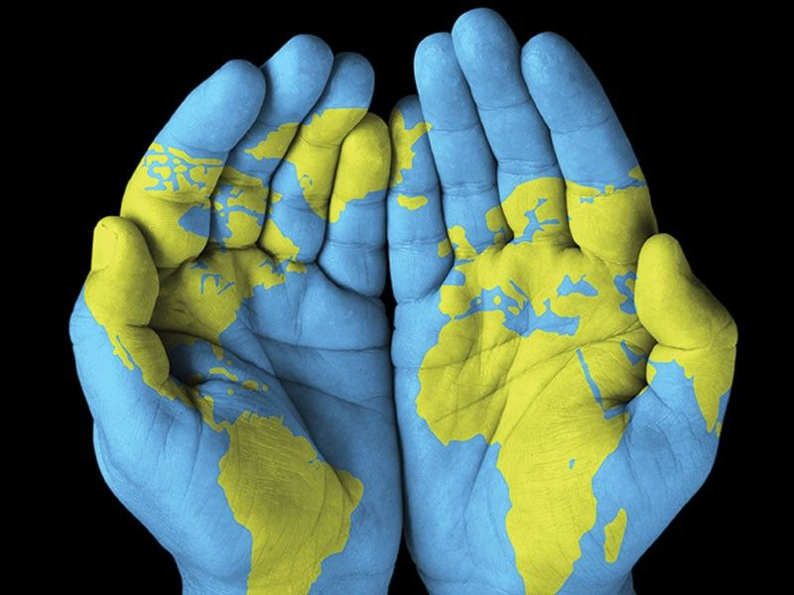

So, why study geography at Little Heath School?

Slide 4

What will I study?

Slide 5
Physical Geography
1. Water and carbon cycles
2. Coastal systems and landscapes
3. Hazards
Worth 40% of your A level grade!

Slide 6
Human Geography
1. Changing Places
2. Global systems and governance
3. Contemporary urban environments.
Worth 40% of your A level grade!

Slide 7
Personal investigation
Students complete an individual investigation which must include data collected in the field. The individual investigation must be based on a question or issue defined and developed by the student relating to any part of the specification content.
Worth 20% of your A level grade!
This can be based on any area of the course you are interested in.

Slide 8

4 days of human and physical geography field work
Reading
Stratford
Chesil Beach
Sulham Woods

Slide 9
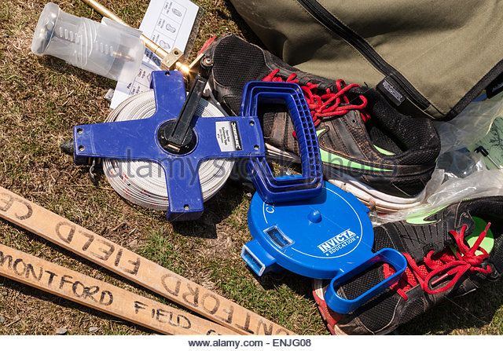
Geography equips you for life in many ways.

Slide 10
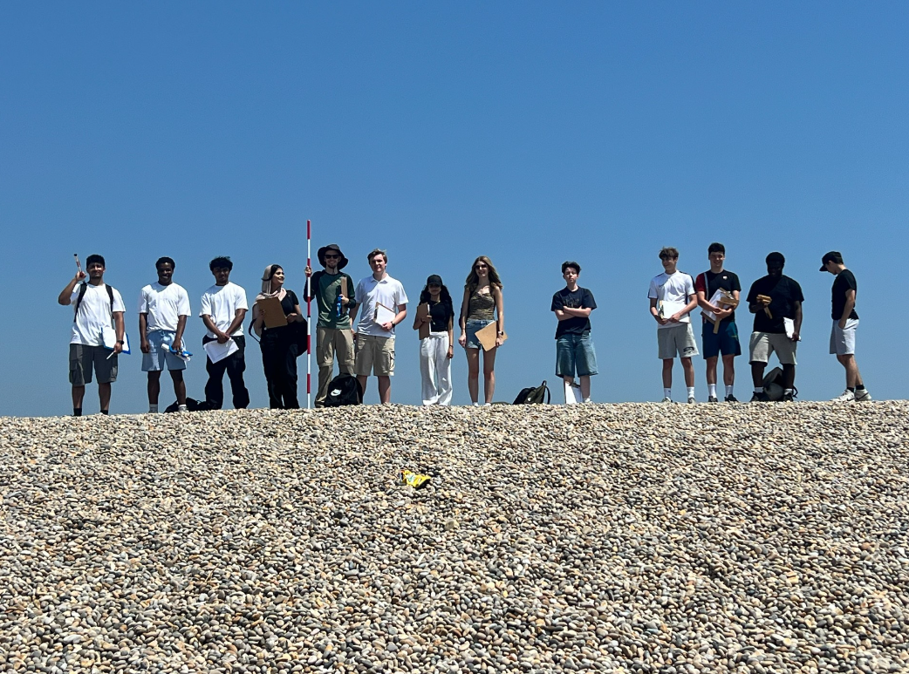
It’s great fun but it also equips you for your future!

Slide 11
What other skills will I learn?
Intellectual skills, such as critically evaluating theories and judging evidence in order to make informed decisions and to develop reasoned arguments.
Research skills, including how to use a range of technical methods for the collection and analysis of spatial and environmental data.
Transferable skills, such as teamwork, problem solving, IT skills, communication skills
  (presentation, writing, debating).
Personal skills, such as time-management, development of responsibility, coping with uncertainty, self-reflection, motivation,
  flexibility, and creativity.

Slide 12

Which jobs does Geography lead to ?

Slide 13

There are no ‘geography jobs’ … there are jobs in all sectors of the economy that geographers do.

Slide 14
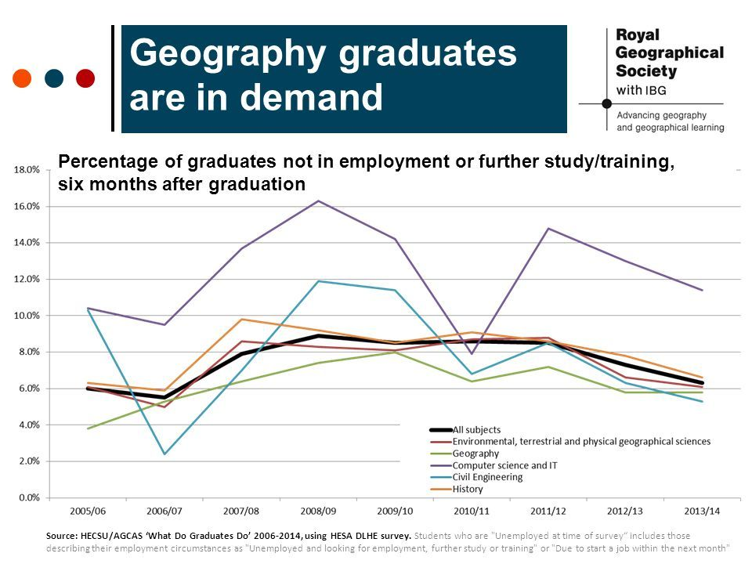

Slide 15
So why should you do Geography?
“Geography helps us understand the world. It gives us the science, the data and the insights to plan for the future”
Nick Crane, RGS-IBG President

Slide 16
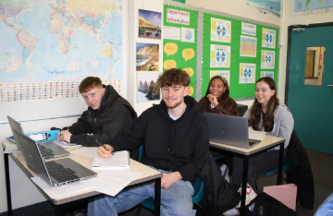
Let’s have a little taste of things to come in your future lessons at Little Heath…

Slide 17
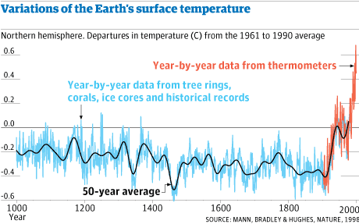
Annotate your graphs to identify what it shows.

Slide 18
How is the global climate changing?
Learning objectives
To suggest solutions to the world climate change dilemma.

Slide 19
What are the impacts of a changing climate?

Slide 20

It's time to educate...
Annotate Donald Trump with the consequences of climate change

Slide 21
Like it or not, the world is facing a dilemma.

Slide 22
An example of a dilemma...
You have been in an unhappy marriage for the past 10 years. Your partner is a workaholic who spends little time at home, and while you have no evidence there are rumours that your partner has been seeing other people.
You are in your mid-30s, with two young children aged 7 and 4. A friend has suggested that after several years of trying to make the relationship work, it is time to move on.
In pairs discuss:
What is a dilemma?
What makes this scenario a dilemma?
What would you do?

Slide 23

A dilemma is a complicated problem with no right or wrong answer.

Slide 24
The Climate Change dilemma.
The World climate is changing.
The world is getting hotter, sea levels are rising.
The population and the economy of the world is at risk
You have been invited to speak at the Climate Change Conference- COP 30 in Brazil in 2025.
Politicians know people do not like to be told bad news, especially if you have to give things up or change the way they live.
You have to give a speech at the Climate Change conference suggesting how countries should work towards halting climate change.
What will you say?

Slide 25
How can you persuade?
https://www.bbc.co.uk/bitesize/guides/zx7cmnb/revision/2
Technique
Examples
Flattery - complimenting your audience.
Opinion - a personal viewpoint often presented as if fact.
Opinion - a personal viewpoint often presented as if fact.
In my view, this is the best thing to have ever happened.
You have 10 minutes to plan your speech!
Hyperbole - exaggerated language used for effect.
It is simply out of this world – stunning!
You are the key to this entire idea succeeding - we will be with you all the way. I can’t thank you enough!
Personal pronouns - ‘I’, ‘you’ and ‘we’.
Imperative command - instructional language.
Get on board and join us!
Triples - three points to support an argument.
Safer streets means comfort, reassurance and peace of mind for you, your family and your friends.
Emotive language - vocabulary to make the audience/reader feel a particular emotion.
There are thousands of animals at the mercy of our selfishness and disregard for kindness.
Statistics and figures - factual data used in a persuasive way.
80% of people agreed that this would change their community for the better.
Rhetorical question - a question which implies its own answer.
Who doesn’t want success?

