Slide 1
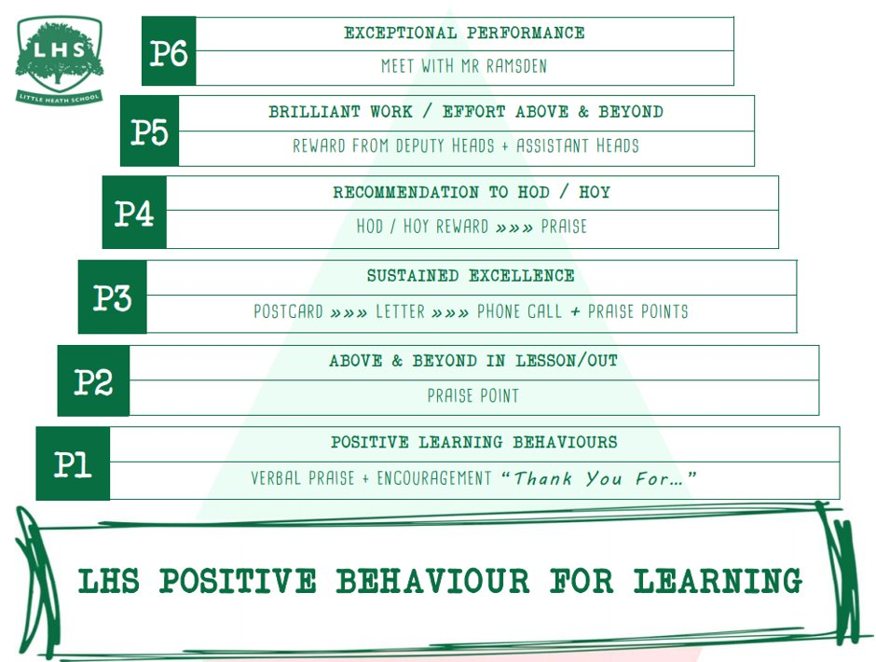
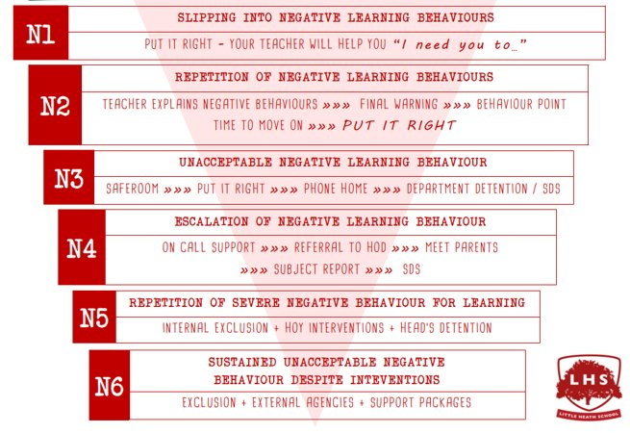
DNA: Get logged on
Title:Cambridge Tech IT
Aims:
Understand the course structure and expectations
Introduction to Hardware
Thank you for being ready to learn!

Slide 2
Today’s Activities
Overview of qualification
Outline of curriculum plan
Resources
Mini lesson

Slide 3
Overview of qualification
Cambridge Technicals are vocational qualifications aimed specifically at students aged 16+.
They are an ideal foundation for students entering the workplace
They providing a theoretical background reinforced with practical skills that transfer into the modern workplace.
They also carry UCAS points and can be used to gain entry for further study at university.

Slide 4
Outline of curriculum plan
The Cambridge Technical is assessed using course work and exams
Completing 2 exam units (in year 12) will lead to OCR Level 3 Cambridge Technical Certificate in IT – equivalent UCAS points to AS
Completing 3 coursework units (in year 13) will lead to OCR Level 3 Cambridge Technical Introductory Diploma in IT equivalent to A Level

Slide 5
Outline of curriculum plan
Year 12: two compulsory units, both of which are assessed by written exam
Fundamentals of IT
Information systems
Year 13: optional (coursework-based) such as:
project planning (taught)
application development (taught)
website production (taught)
mobile technologies (app development), and
games design and prototyping
Some students have opted for the written examination unit in cybersecurity.

Slide 6
Resources
Cambridge Technicals Level 3 IT Paperback – 5 Sept. 2016
CSNewbs
https://www.csnewbs.com/

Slide 7
Mini lesson
OCR CTech IT | Unit 1 | 1.1 - Computer Hardware | CSNewbs
WS Computer Hardware
Other:
Demo of google classroom
Exam techniques

Slide 8
Questions
pbailey@littleheath.org.uk

