Slide 1
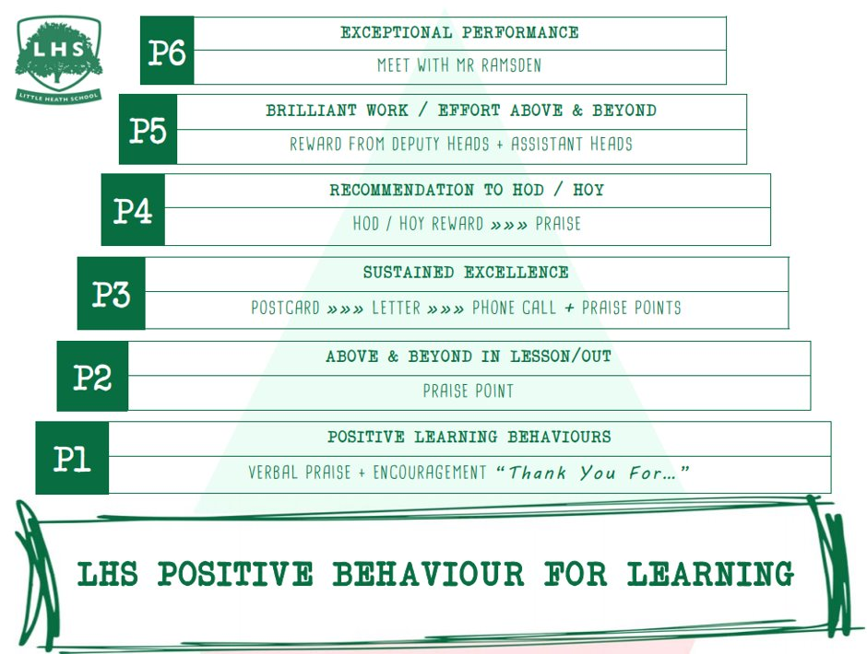
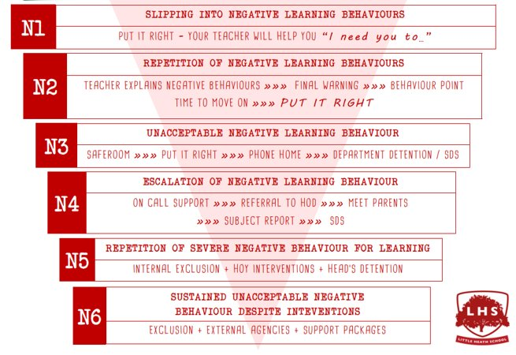


A LEVEL MATHEMATICS:
Exploring the Quadratic Function and its Graph
DNA:
Solving Same-ish, Yet Slightly Different
Equations
Aims:
Linking f(x)=ax²+bx+c to:
Factorising
Completing the square
Vertex
Intercept points
And the Graph
Thank you for being ready to learn!

Slide 2
DNA:
Solve these SAME-ish, yet slightly different equations:

Slide 3
SUMMER WORK
Work through joining instruction steps on separate ppt.
ALL students to have created an Integral account for the transition materials before the end of the session.
Course certificate of completion to be brought into school during the first week or emailed to their class teacher as evidence.

Slide 4
Post-16 Mathematics options
(AS)/A level Mathematics
AS/A level Further Mathematics
Just Mathematics? Tempted by FMA as a bonus?

Slide 5
What are the options?
(AS)/A level Mathematics
  Extends GCSE Maths and introduces new ideas
AS/A level Further Mathematics
An additional AS or A level to add breadth & depth
If you are great at GCSE maths
Love mathematics, solving problems, algebra …
And want to do more maths, even for just 1-year & get an AS qualification
Think about picking FMA as a 4th subject
You can even try it for 4-6 weeks!

Slide 6
What is in (AS)/A level Mathematics?
All of the content in the AS/A level Mathematics qualification is compulsory and is the same for all examination boards.
Pure Mathematics
66%
Statistics
17%
Mechanics
17%

Slide 7
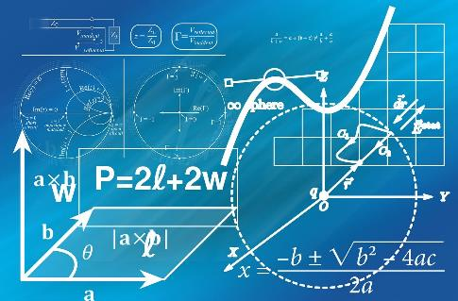
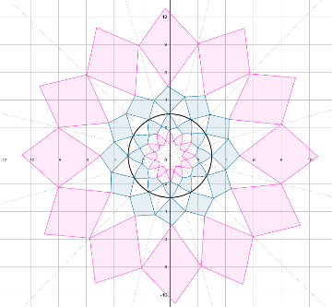
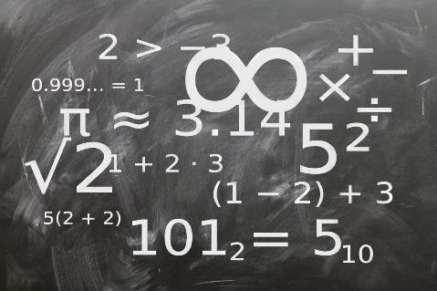
What is Pure Mathematics?
Methods and techniques which underpin the study of all other areas of mathematics, such as, proof, algebra, trigonometry, calculus, and vectors

Slide 8
What is Pure Mathematics?
Methods and techniques which underpin the study of all other areas of mathematics, such as, proof, algebra, trigonometry, calculus, and vectors
The points A and B have coordinates (4,-2) and (10,6) respectively.
Find the equation of the circle that
has AB as a diameter.

Slide 9
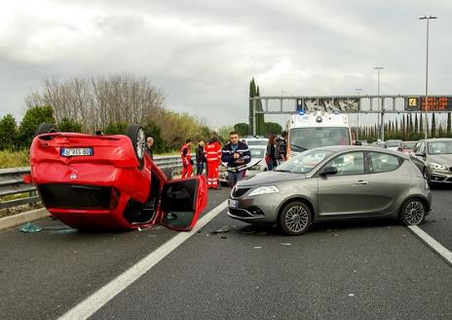
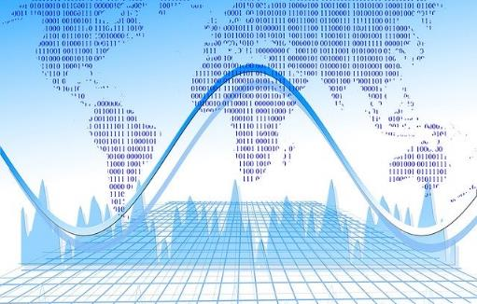
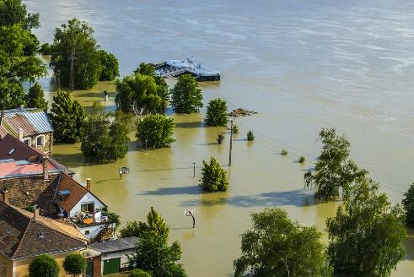
What is Statistics?
Reaching conclusions from data and calculating the likelihood of an event occurring.
Notes:
Images: https://pixabay.com/en/flood-danube-sandbag-park-139000/
Https://pixabay.com/photos/car-accident-clash-rome-highway-2165210/
https://pixabay.com/illustrations/analysis-statistics-chart-graphic-810025/

Slide 10
What is Statistics?
Reaching conclusions from data and calculating the likelihood of an event occurring.
What is the probability of two ‘100 year floods’ happening within the space of 5 years?
What assumptions have you made?
Notes:
Images: https://pixabay.com/en/flood-danube-sandbag-park-139000/
Https://pixabay.com/photos/car-accident-clash-rome-highway-2165210/
https://pixabay.com/illustrations/analysis-statistics-chart-graphic-810025/

Slide 11
What is Statistics?
“The majority of private sector organisations believe the use of data analytics will the most important factor in increasing growth in UK businesses”
Professor Sir Adrian Smith
What is the probability of two ‘100 year floods’ happening within the space of 5 years?
What assumptions have you made?
Source: https://assets.publishing.service.gov.uk/government/uploads/system/uploads/attachment_data/file/630488/AS_review_report.pdf
Notes:
Images: https://pixabay.com/en/flood-danube-sandbag-park-139000/
Https://pixabay.com/photos/car-accident-clash-rome-highway-2165210/
https://pixabay.com/illustrations/analysis-statistics-chart-graphic-810025/

Slide 12
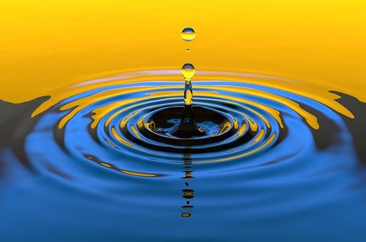
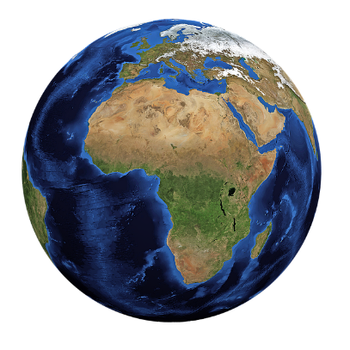
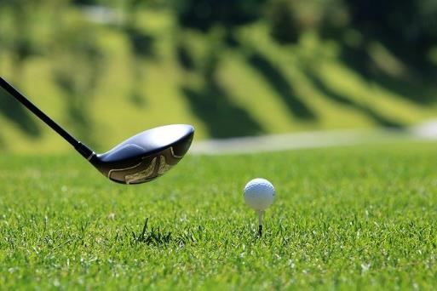
What is Mechanics?
The modelling of the world around us, the motion of objects and the forces acting on them.
Particularly useful for careers in physics or engineering
Notes:
https://pixabay.com/photos/water-drop-liquid-splash-wet-1759703/
https://pixabay.com/illustrations/world-globe-earth-planet-blue-1303628/
https://pixabay.com/photos/golf-golf-course-grass-sport-green-3685616/

Slide 13
What is Mechanics?
The modelling of the world around us, the motion of objects and the forces acting on them.
A golfer drives their ball from a tee on horizontal ground so that it has an initial velocity of 50ms⁻¹ at an angle of 40 degrees above the horizontal.
How far down the fairway will the ball land?
Notes:
https://pixabay.com/photos/water-drop-liquid-splash-wet-1759703/
https://pixabay.com/illustrations/world-globe-earth-planet-blue-1303628/
https://pixabay.com/photos/golf-golf-course-grass-sport-green-3685616/

Slide 14
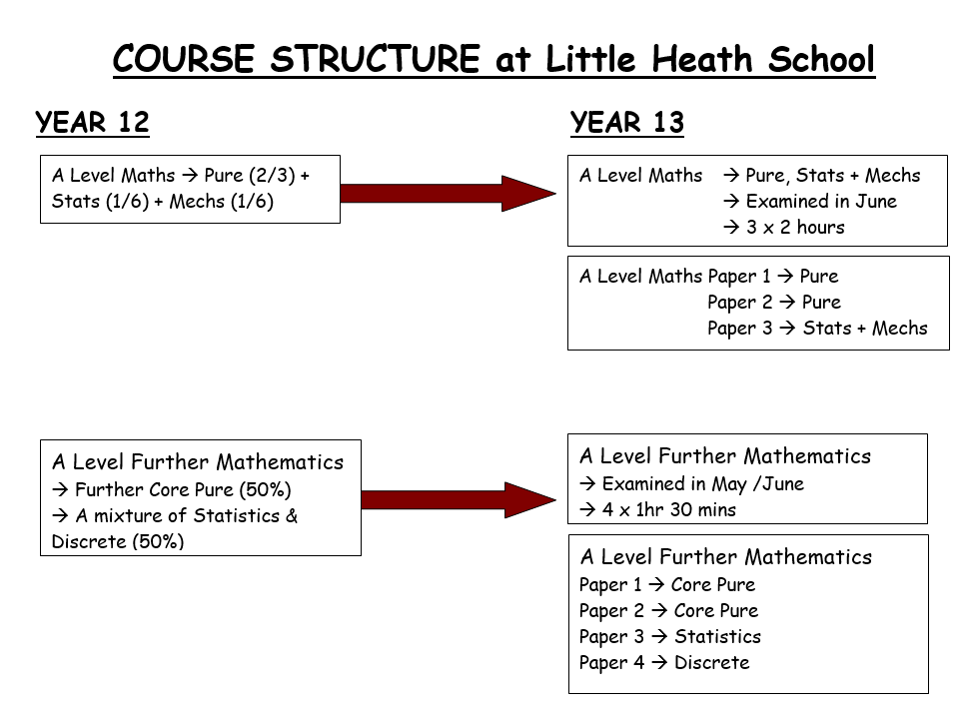

Slide 15
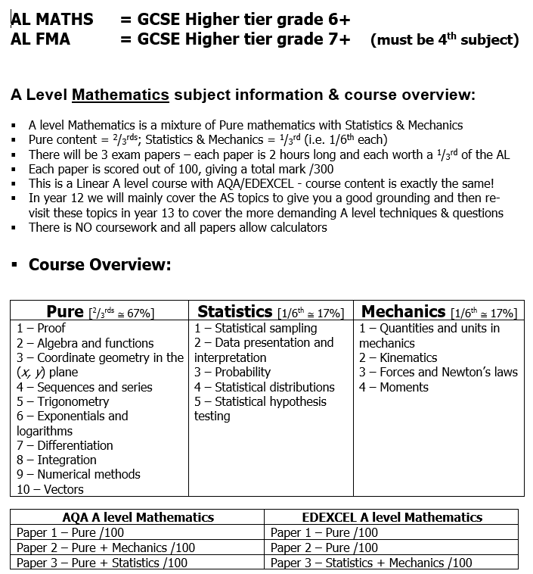

Slide 16
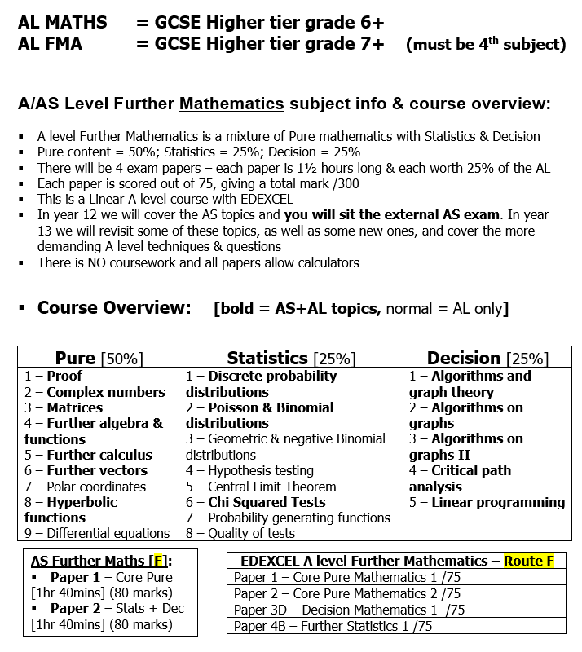

Slide 17
Small Group Activity
→ DO NOT write on the cards
Orange cards – factorise, THEN …
Now match to Yellow cards – what is the importance of this?
Using the Orange Cards - complete the square, THEN …
Now match to Pink cards
Now match to the Green cards (Max / Min) – why can we do this now? What helps us?
What do the Red & Blue cards tell you? What are they called?
You can now put it altogether to match them to a graph. Job done!

Slide 19
STOP
Answers are next

Slide 20
Card Sort Answers

Slide 21
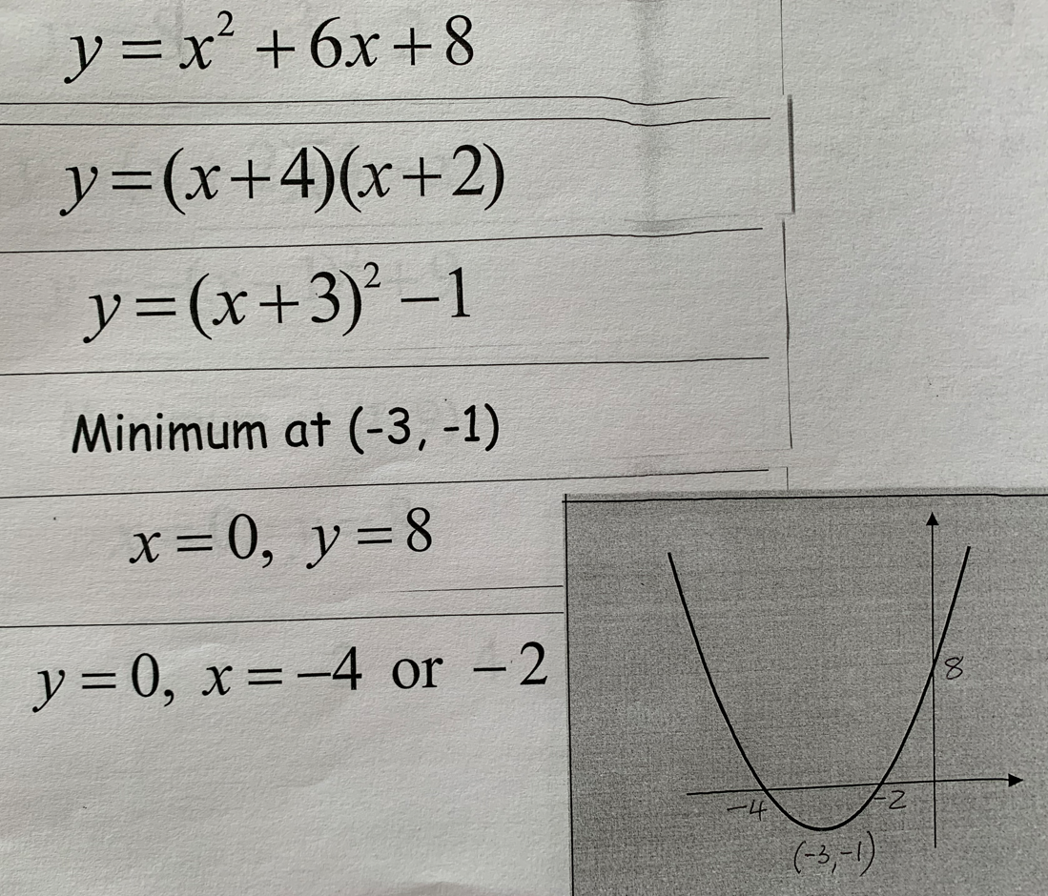
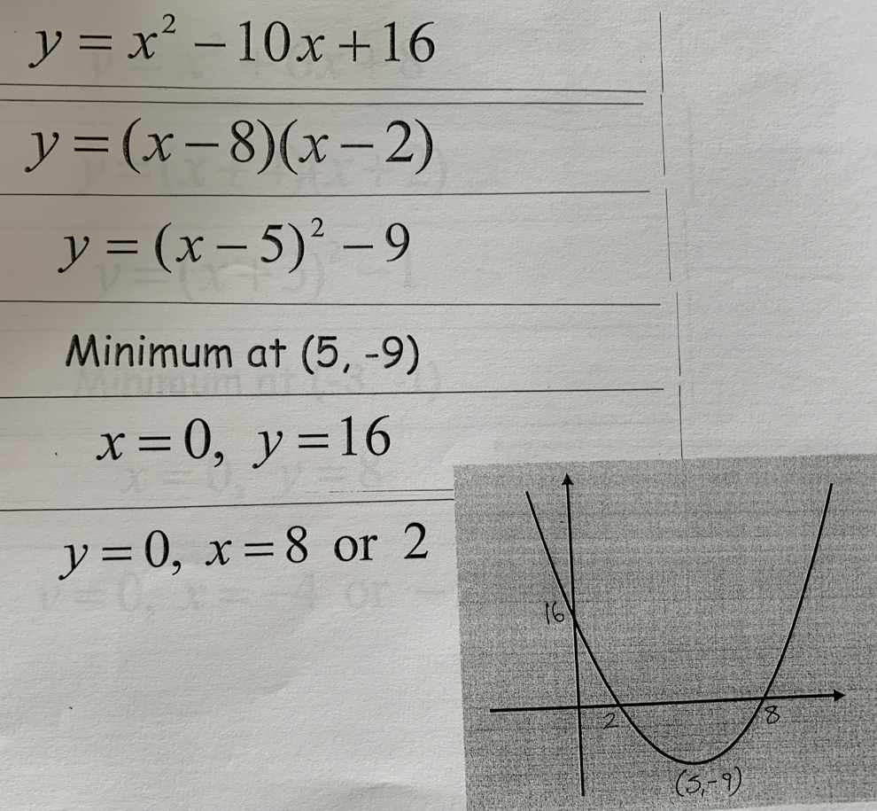

Slide 22
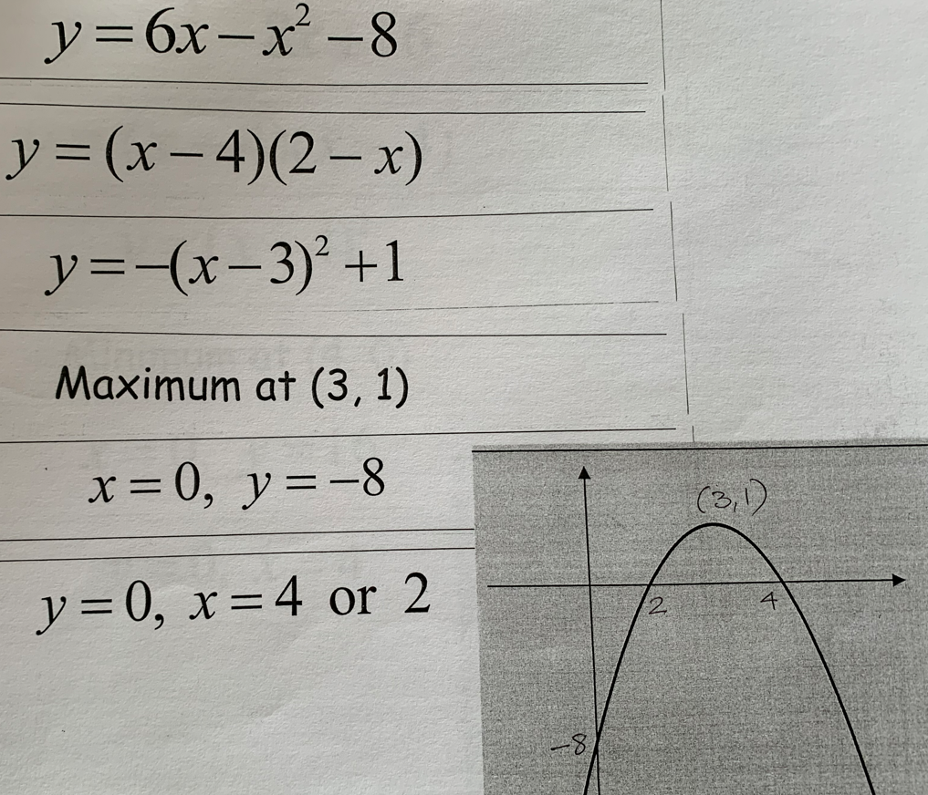
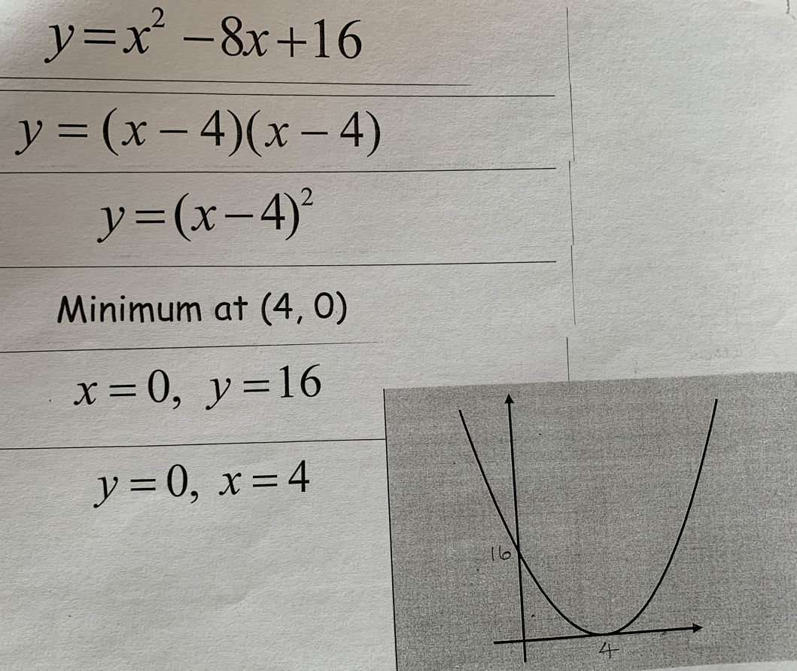

Slide 23
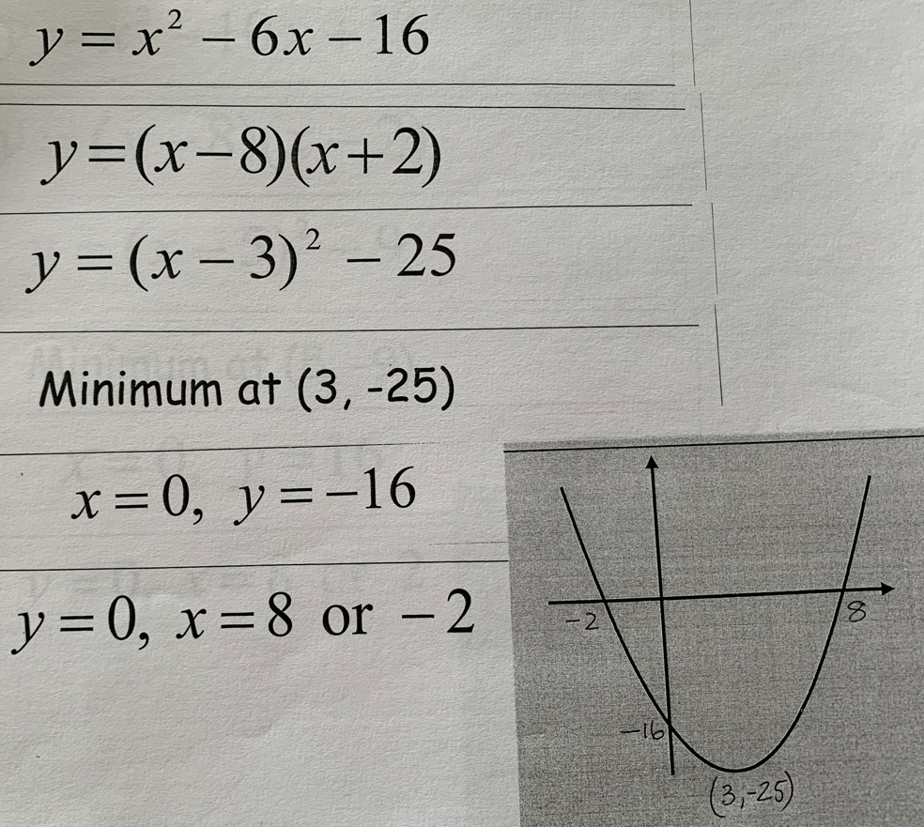

Slide 24
Why Mr. Rayner isn’t Very Good at Maths
Part One →Indices

Slide 25
1. 6.
2. 7.
3. 8.
4. 9.
5. 10.

Slide 26
☹
☹
Pathetic
☹
☹

Slide 27
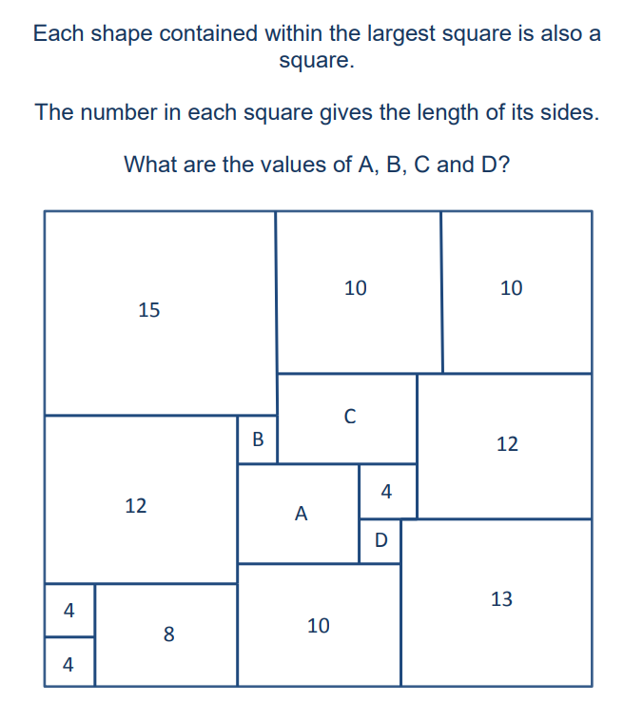
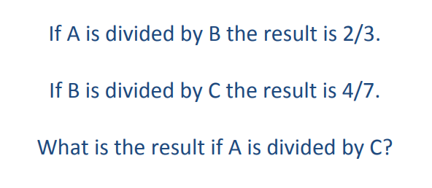
Plenary

Slide 28
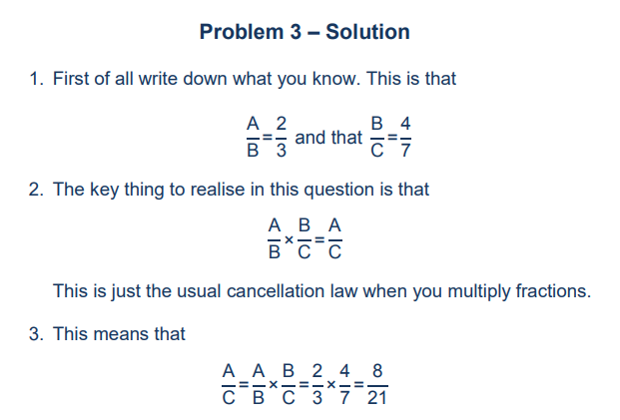
Solution

Slide 29
