Slide 1
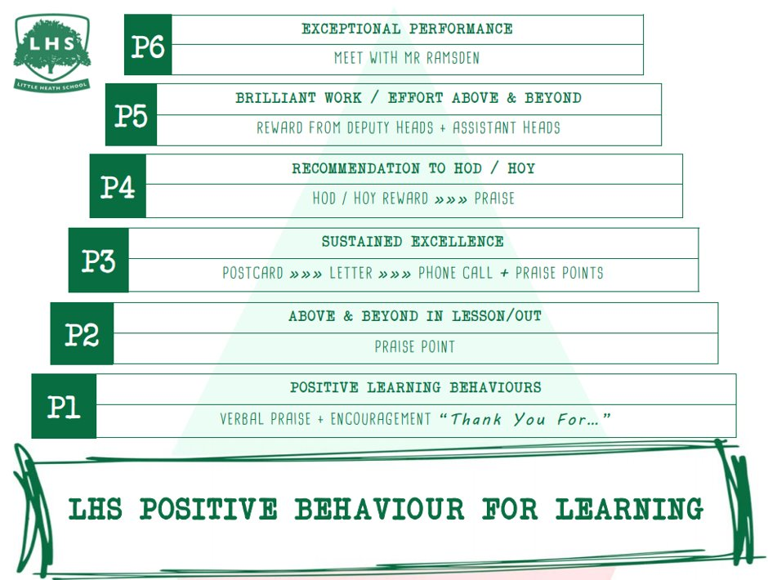
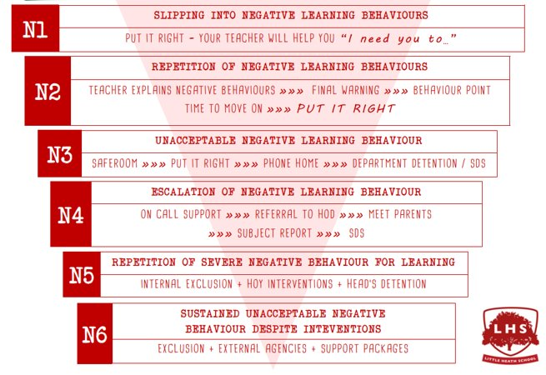


Title: Art Textiles Taster Session
DNA:
Why have to picked to study Art Textiles A-Level?
Did you do Textiles or Art at GCSE?
Aims:
To gain further knowledge of what Art Textiles A-Level is
To understand how the course is run
To hopefully inspire you to take our subject!
Thank you for being ready to learn!

Slide 2

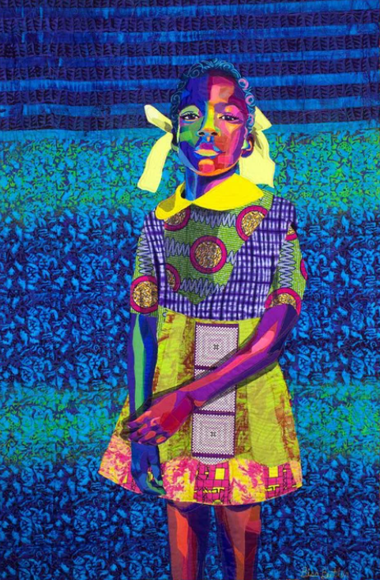

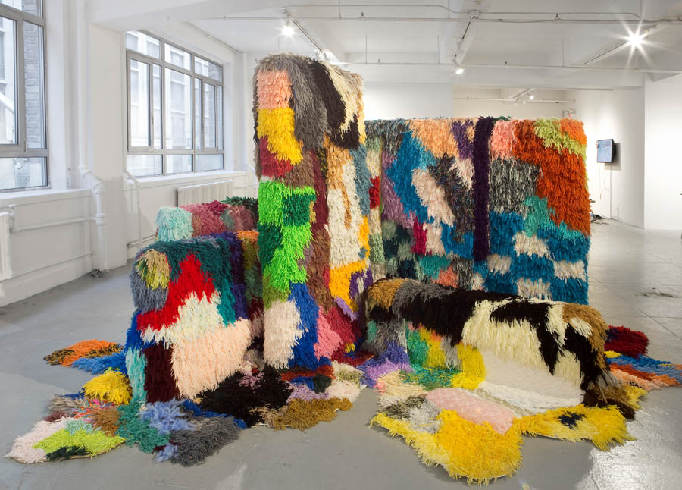

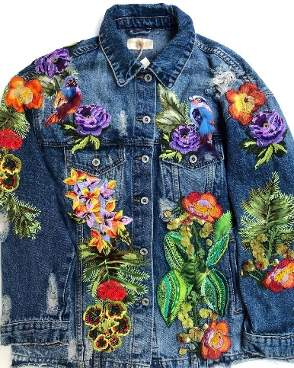
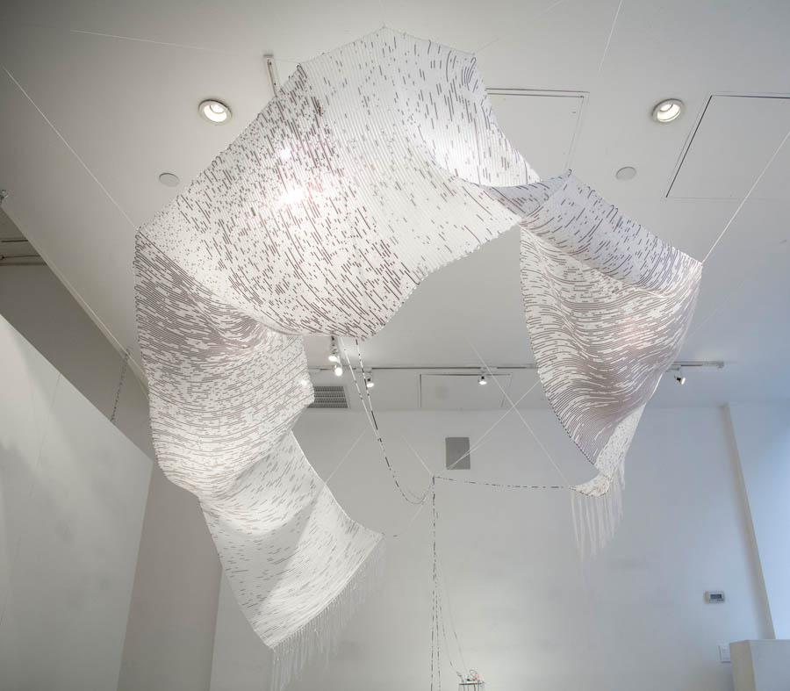


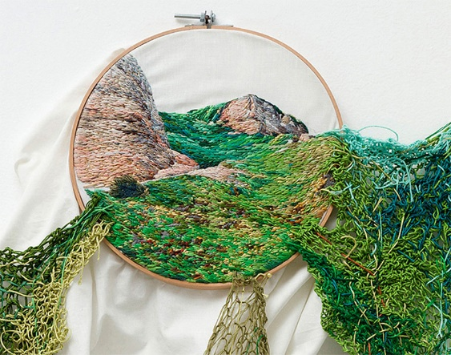
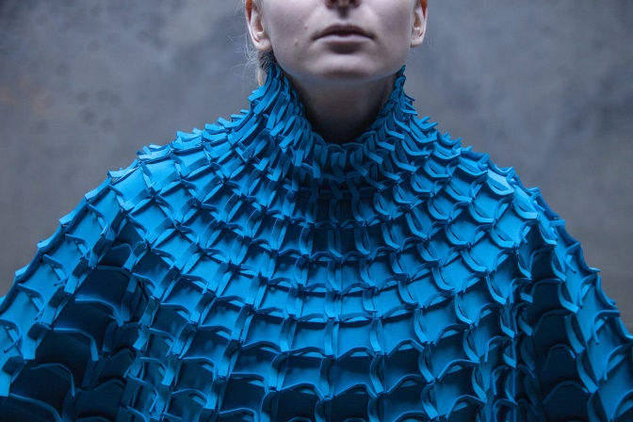
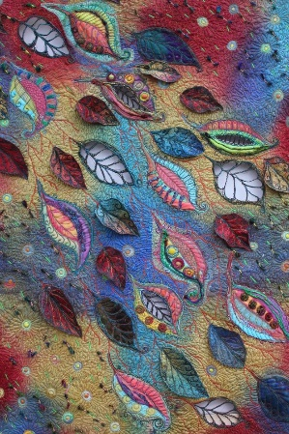
A Level Art and design Textiles taster lesson
What is Art and Design Textiles ?

Slide 3
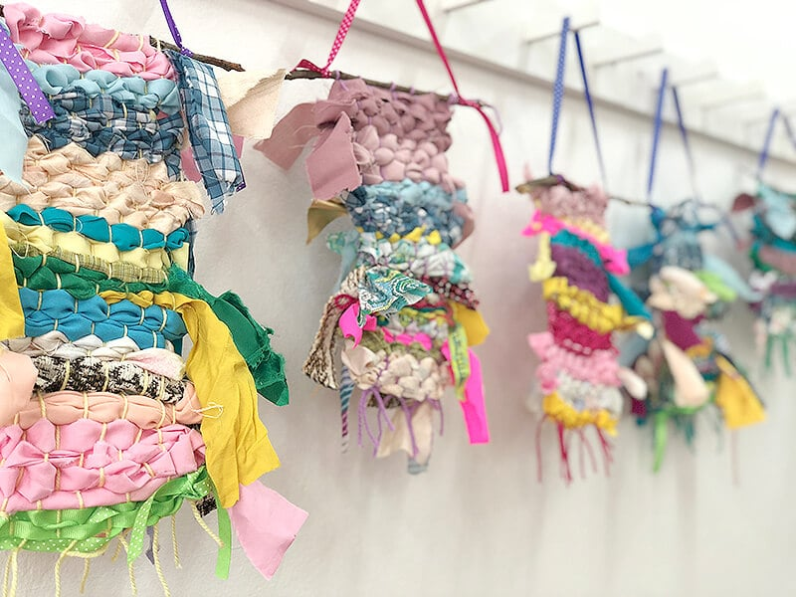
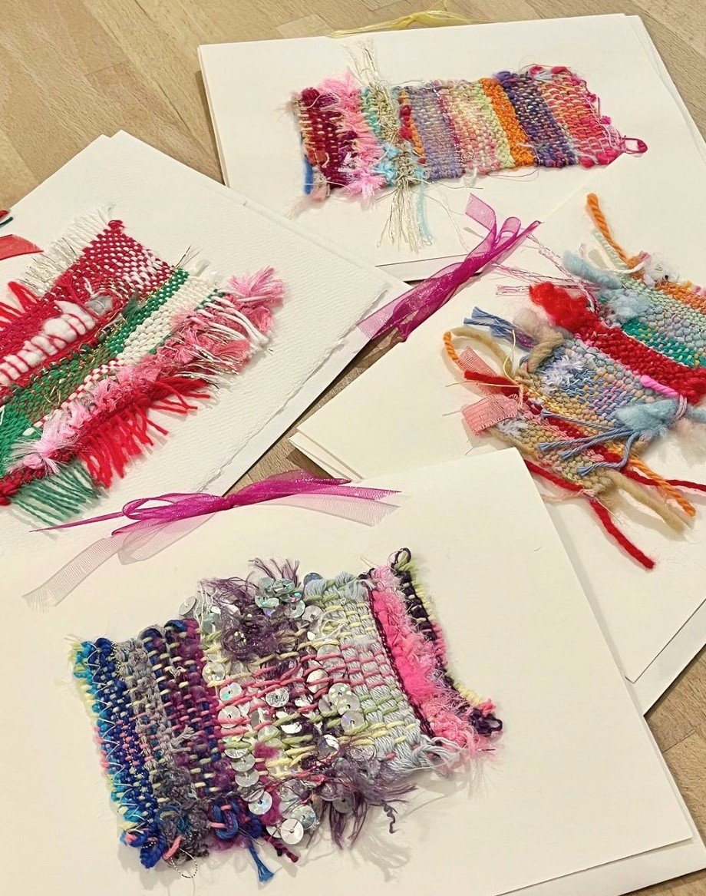
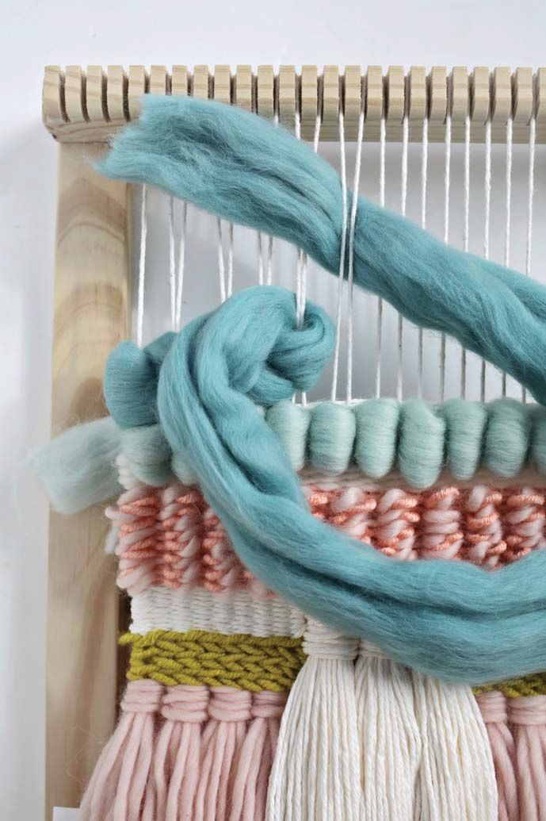
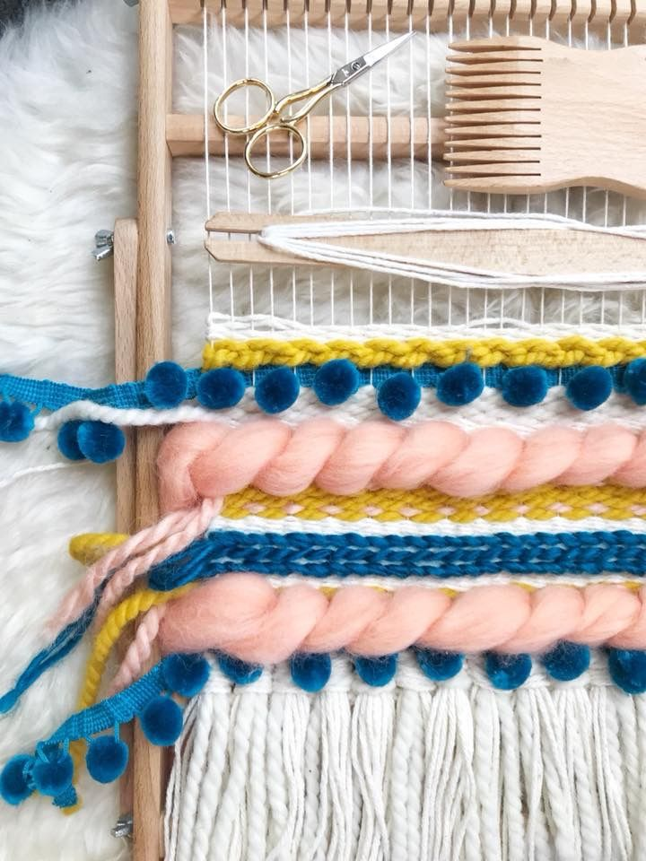
Task
To have a go at creating a woven wall hanging using a mixture of different materials including plastic bags, bubble wrap and wool.

Slide 4
Summer Work
First project – Up close/textures working in Monochrome
Create a title page in your sketchbook.
Over the summer please take some photos of textures/up close. Present these photos on a double page spread in your sketchbook.
Have a go at some paper manipulation techniques.

