Slide 1
Welcome to Food science and nutrition
Friday 28th June 2024
Teachers- Miss S Rose and Miss T Bell
8 lessons

Slide 2
Overview of course
WJEC Level 3 Certificate in Food Science and Nutrition
Unit number | Unit title | structure | Assessment
1 (Year 12) | Meeting nutritional needs of specific groups | Mandatory | Internal and external
2 (Year 13) | Ensuring food is safe to eat | Mandatory | External
3 (Year 13) | Experimenting to solve food production problems | Optional | Internal
4 | Current issues in food science and nutrition | Optional | Internal
Notes:
The highlighted subjects are the units that are covered in year 12 and year 13.
Exams content- unit 1 exam is all about meeting nutritional needs which you will learn about from September to May. In November we introduce the coursework brief. Students will then complete 3 ½ hour practical exam in February. All coursework is submitted in May with the exam taking place in June- students will be given the option to resit the exam content in Yr13.
Grades
Students target grades are a P, M, D. in order to gain the certificate students will need to pass coursework and pass exam.

Slide 3
Overview of year 12
Unit 1: meeting nutritional needs of specific groups
Explore the functions of nutrients and why they are needed by the body
Look at nutritional requirements for different life stages
Develop practical skills to plan and prepare nutritionally balanced dishes
Identify and demonstrating the importance of food safety

Slide 4
Overview of year 13
Unit 2: Ensuring food is safe to eat
You will look at the hazards and risks in relation to storage, preparation and cooking of food in different environments
Understand what control measures need to be put into place
Unit 3: experimenting to solve food production problems
You will develop skills to plan and carry out experiments to address food production issues

Slide 5
Job opportunities
This course is designed for those wanting to progress to university but also to those wanting to pursue careers or learning in related areas such as:
Food industry
Hospitality and Catering
Teacher
Dietician
Nutritionist
Food scientist
Chef
Research and development officer.

Slide 6
University courses
By studying for this certificate at A level, you will gain the required knowledge to use the qualification to support entry to higher education courses such as
BSc Human Nutrition
BSc (Hons) Public Health Nutrition
BSc (Hons) Food with nutrition
BSc (Hons) Food Science and Technology

Slide 7
Food production investigation
Notes:
This is an example brief set for Yr13 coursework; candidates have been given a range of comments identified by customers regarding a new product. Students task is to investigate each comment and identify how the product can be improved.

Slide 8
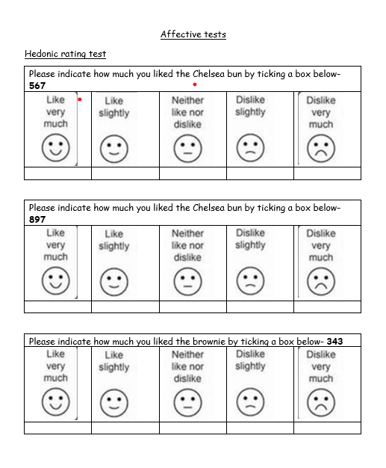
Task 1- improving the product
As part of your investigation you will taste test similar products to help find the best Chelsea bun
In today’s lesson you will be test tasting different Chelsea buns
For eachbun that you try you will need to complete a sensory analysis.

Slide 9
Experiment aim 1-
Investigation 1- changing the fruit
Investigation 2- flavourings
Not enough flavor and variety of fruit
Unit 3 coursework for year 13 is very similar to Yr11 NEA1.
Instead of doing 1-2 mini investigations you will be tasked with completing 3-4 investigations.
Around you mind-map we have come up with 4 investigations for the comment.
What types of ingredients could we do for each investigation?
How will we keep it a fair test?
Investigation 3- different quantities of fruit
Investigation 4- different types of sugar
Notes:
How can you improve the dish based on what

Slide 10
Any questions

Slide 11
Sensory star diagram

