Slide 1
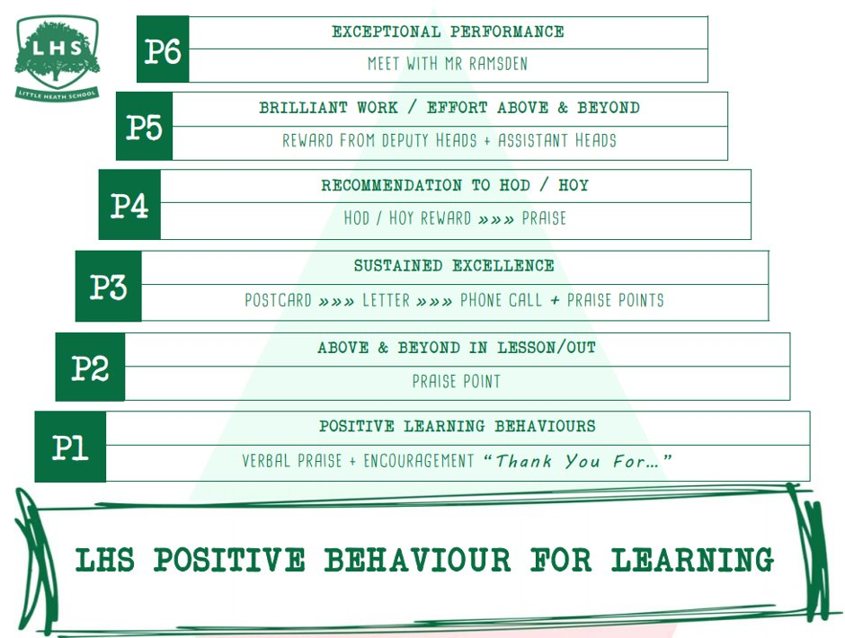
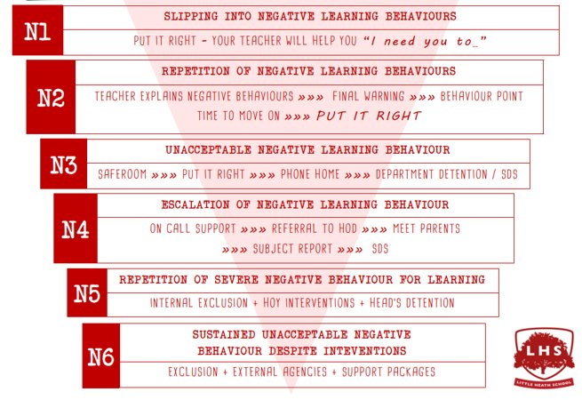
Title: Computer Science
DNA:
Get your notebook out and something to write with.
Aims:
1 A level Computer Science Course structure and content
2 A means “Advanced” - more and “harder” work - think differently
3 Number Systems
Thank you for being ready to learn!

Slide 2
Teachers - course delivery
Mrs P Bailey - Head of KS5/Computer Science
Theory focused Y13
Programming Focused Y12
We use Google Classroom for resources.

Slide 3
OCR A Level course structure H446
Paper 1 40% 2.5 hrs written exam
Paper 2 40% 2.5 hrs written exam
NEA (Project) 20%
Specification
https://www.ocr.org.uk/Images/170844-specification-accredited-a-level-gce-computer-science-h446.pdf
Notes:
There is a strong focus on programming, not an easy subject

Slide 4
Class challenges
Mixed abilities:
New to programming to A* at GCSE
v
A level focused (extending programming skills)
Required: Independent working students who can support each other

Slide 5
A means “Advanced” - more and “harder” work - think differently
For all A levels, it is about thinking at a higher level (as well as more work)
Introduce/Revise data types
Introduce numbers in binary

Slide 6
Primitive data types
A primitive data type is one which is provided by a programming language
They include:
integer a whole number such as 34, 0, -1, 567432
real/float a number with a fractional part such as: 3.142, 7.0, -67.5
Usually, a composite data type such as an array is not considered to be a primitive data type
Can you think of some more primitive data types?

Slide 7
Primitive data types
A primitive data type is one which is provided by a programming language
They include:
integer a whole number such as 34, 0, -1, 567432
real/float a number with a fractional part such as 3.142, -67.5
Boolean can only take the value True or False
character a letter, number or special symbol such as “a”, “A”, “6”, “&”, %”
string anything enclosed in quote marks, for example “Jason”, “01798 158794”, “This is a string”

Slide 8
How are different data types held?
All data types are held in binary
Without knowing what the data type is, it is not possible to say what a particular bit pattern represents
00101000 111110001 01010111 00100100
This could be one integer, 4 integers, a real number, a string, 4 characters,…
or even a sound, a pixel or a tiny piece of a graphic

Slide 9
Binary number system
The binary number system uses only two digits, 0 and 1
To understand how this works, it is helpful to look first at the fundamentals of the denary or decimal system, which uses digits 0..9

Slide 10
Number symbols
The denary number system uses a combination of just ten symbols to represent any number
Number systems are referred to by their base; that is, the number of symbols used to construct values
Denary is base 10 and the base may be referred to as a subscript
In denary the number 11, for example, may be written as 11₁₀
In binary, it would be written as 11₂ and in hexadecimal as 11₁₆
11₁₀, 11₂ and 11₁₆ all represent different values

Slide 11
Base 2
Numbers which use base 2 are commonly referred to as binary numbers
Can you see a pattern in the binary values?
Denary | Binary
1 | 1
2 | 10
3 | 11
4 | 100
5 | 101
6 | 110
7 | 111
8 | 1000
9 | 1001
10 | 1010
11 | 1011

Slide 12
Place value
In any counting system, the position of the value determines its contribution to the overall total
Therefore 183₁₀ represents the value of one hundred, eight tens and three units
Base^{position} | 10² | 10¹ | 10⁰
Place value | 100 | 10 | 1
Number | 1 | 8 | 3
Digit value | 100x1 | 10x8 | 1x3

Slide 13
The binary system
Binary works the same way, except the base used is 2 instead of 10
Therefore 1 0 1 1 0 1 1 1₂ represents 128 + 32 + 16 + 4 + 2 + 1 which is equivalent to 183₁₀
Base^{position} | 2⁷ | 2⁶ | 2⁵ | 2⁴ | 2³ | 2² | 2¹ | 2⁰
Place value | 128 | 64 | 32 | 16 | 8 | 4 | 2 | 1
Number | 1 | 0 | 1 | 1 | 0 | 1 | 1 | 1
Digit value | 128x1 | 0 | 32x1 | 16x1 | 0 | 4x1 | 2x1 | 1x1

Slide 14
Converting from denary
The place value table is useful to aid conversion from denary to binary
Convert 159₁₀ to binary
Place value | 128 | 64 | 32 | 16 | 8 | 4 | 2 | 1
Number | 1 | 0 | 0 | 1 | 1 | 1 | 1 | 1
1. Can 128 be used to make some of 159?
2. If it can, use it by setting bit value to 1, (0 if not)
3. If value used subtract from starting value, eg. 159 – 128 = 31
4. Repeat using value from step 3 until nothing left

Slide 15
Activity
Complete Task 1 in Worksheet 1

Slide 16
Hexadecimal – Base 16
Number systems with bases above 10 often still use 0 to 9 but require extra symbols for values past 9
An example of this is base 16 which is referred to as the hexadecimal number system
Hexadecimal uses letters for the values 10 to 15
0 | 1 | 2 | 3 | 4 | 5 | 6 | 7 | 8 | 9 | 10 | 11 | 12 | 13 | 14 | 15
0 | 1 | 2 | 3 | 4 | 5 | 6 | 7 | 8 | 9 | A | B | C | D | E | F

Slide 17
Hexadecimal values
The rules of place value work in the same way:
Therefore the equivalent of 3F5₁₆ in denary is (256x3) + (16x15) + 5 = 768 + 240 + 5 = 1013₁₀
What is A3₁₆ in denary?
Base^{position} | 16² | 16¹ | 16⁰
Place value | 256 | 16 | 1
Number | 3 | F (or 15) | 5
Digit value | 256 x 3 | 16 x 15 | 1 x 5

Slide 18
Denary to hex conversion
Converting to two-digit hexadecimal numbers
Divide the number by 16, and add the remainder
What is 27₁₀ in hexadecimal?
43 | ÷ | 16 | = | 2 remainder 11
11 |  |  | = | B
 |  |  | = | 2B

Slide 19
Significant powers
Work out the following powers of 2:
Why is the answer to 2⁴ significant?
2⁰ =
2¹ =
2² =
2³ =
2⁴ =

Slide 20
Significant powers
Work out the following powers of 2:
Why is the answer to 2⁴ significant?
2⁰ = 1
2¹ = 2
2² = 4
2³ = 8
2⁴ = 16

Slide 21
Significance of 16
16 is the fourth power of 2
This means that base 16 numbers can be translated from 4 consecutive bits of a binary value
This makes it simple to translate binary numbers into hexadecimal values and back again
 |  | 8 | 4 | 2 | 1 | 8 | 4 | 2 | 1
216 | = | 1 | 1 | 0 | 1 | 1 | 0 | 0 | 0
 | = | D |  |  |  | 8

Slide 22
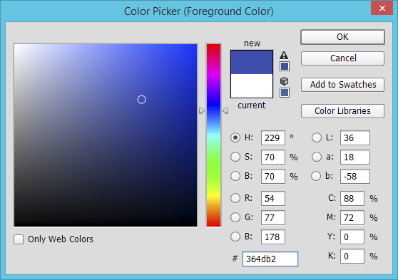
Hex colour codes
The hex code for this colour is 36 4D B2
What does this mean?
How can you increase the amount of red, using the hex code?

Slide 23
Activity
Complete Task 2 on Worksheet 1

Slide 24
Why use hex?
A hexadecimal value is much easier to read and remember than a string of binary digits
It is quicker to write or type, since a hex digit takes up only one character, not four
There is less chance of making an error when typing hex characters than a string of 1s and 0s
It is used to define colours, in MAC addresses, in assembly languages and machine code
It is very easy to convert to and from binary

Slide 25
Plenary
Denary numbers are easy to understand but they are not easy to use in electronics
Binary is simple to use with circuitry but is difficult to read by humans
Hexadecimal makes binary easier to read and easier to transcribe (copy) accurately

Slide 26
Upgrading…
Look over your marked mid-topic tests. Complete the following tasks:
Write out spelling errors correctly three times on the green sheet.
Address / answer questions / prompts in the annotations about your work.
Action your EBI
AO1:
- Highlight all pieces of linguistic terminology
Correct the terminology errors
If you have used quotations and not labelled them linguistically, do so now!
AO3:
- With a purple pen, make a note in the margin of which CONTEXTUAL areas you have linked to in your analysis (genre, formality, stereotypes, text producer, text receiver, tone, discourse, perspective, representation.) Make sure you link your analysis to these areas, as opposed to just commenting on the connotations of language.
TRACKERS:
Complete trackers with marks attained so far.

