Slide 1
A Level Music Technology
What you should expect and what will be expected of you.

Slide 2




Title: Recording a
guitar part and
adding effects
DNA:
Write down a list of effects that can be added to a guitar part.
Extension:
Write down how they sound and / or how the sound is created.
Aims:
To be able to add a variety of different effects to a guitar part.
To understand the differences between recording techniques and the sound they create.
Thank you for being ready to learn!

Slide 3
Why study music Technology?
Studying Music Technology gives you the opportunity to develop your skills in three key areas – recording and production techniques, the principles of sound and audio technology and the development of recording and production.
You will have access to our purpose-built recording studio and will be given the opportunity to develop the technical skills needed to excel in this exciting field of work.
This subject provides a solid foundation for musicians whose interests lie in contemporary music, either behind the scenes as an engineer/producer, or in the spotlight as a performer/composer.

Slide 4
Entry Requirements
5 GCSE’s 4-9.
‘4 or above’ Grade in GCSE Music.
We will also consider students who haven't taken GCSE Music but who can play an instrument and/or have a genuine in studio and creation
The ability to play ideas on a keyboard is also highly beneficial
Willingness to take part in extended listening and use the facilities to further your own development alongside the course content.

Slide 5
A Level Course
Component one: Recording
You will be required to submit a 3 to 3 ½ minute multi-track recording, chosen from a list of 10 songs supplied by the exam board.
It must consist of a minimum of five compulsory instruments and two additional instruments.
Component two: Technology-based composition
Submit a 3- minute composition based on a brief set by the exam board. (Students will have a choice of three briefs.)
Synthesis, sampling/audio manipulation and creative effects must be included.
Component three: Listening and analysing
In this exam, students will be required to demonstrate their understanding of recording and production techniques and principles when listening to unfamiliar recordings.
This exam comprises of two sections. In the first, Section A, they will be asked to answer four sets of shorter questions about separate pieces of unfamiliar music and in Section B, students will be required to provide two extended written responses. The first a comparison question and the second based on one unfamiliar commercial recording.
Component four: Producing and analysing
In this exam, students will be required to demonstrate their knowledge and understanding of editing, mixing and production techniques to unfamiliar materials. Students will be given audio and MIDI materials in the practical element of the exam.
Students will also be required to demonstrate their understanding of specific signal processes, effects or music technology hardware units in a written response.
This exam comprises of two sections: Section A and Section B. In Section A, students will be required to provide practical and written responses to five questions relating to the audio and MIDI materials. In Section B, students will need to provide an extended written response.

Slide 6
What do we learn and how?
Most of your learning will take place through a balance of theory based knowledge demonstrated through practical application leading to practice tasks.
Sampling
Taking a short audio clip and manipulating it into something else
Synthesis
Using software to design and create your own instruments and sounds
Recording and mixing Techniques
How to record instruments including drums, guitars and vocals including how to mix and balance them.
Effects and how they alter soundwaves
How does each process alter the sound and which effects are linked?

Slide 7
How will I be assessed and examined?
AS and A Level Music Technology qualifications have a very similar content however the content in the A Level qualification is at a higher level and requires a more developed understanding and knowledge.
Components 1 and 2 at AS and A Level, are non-examined assessments. Students will complete these tasks in school and these will be submitted and marked externally. Components 3 and 4 are examinations which will be sat in the examination period in the Summer Term.

Slide 8
Future Courses and Possible Careers
Studying Music Technology will provide you with a vast array of skills suitable for a range of future courses and careers, including sound engineer, record producer, musician, teacher. It can also open up the world of Film / TV / Video game production.
In addition to all of these A level Music Technology develops powers of analysis, listening, composing, literacy and the ability to work to specific briefs and specifications.

Slide 9
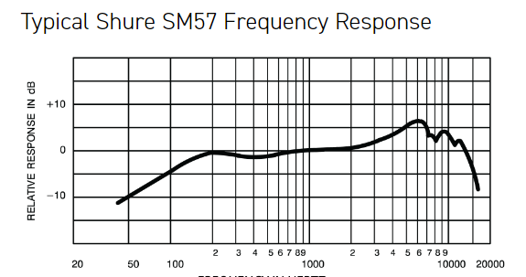
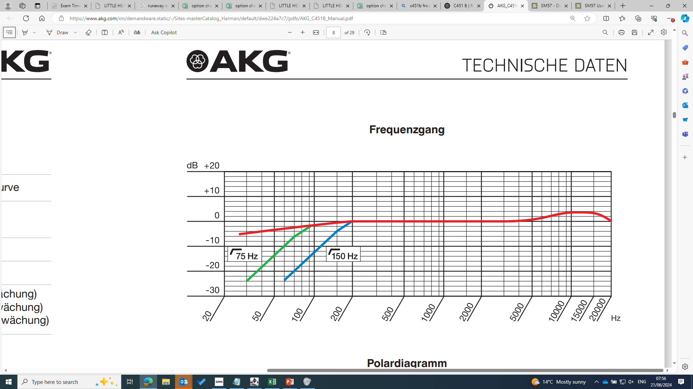
Recording Guitar
In the session today, we are going to be looking at the different microphone types and how their placement impacts on the frequency and balance of the recorded audio.
Dynamic Microphones
Good for live sound, very robust and
average range of frequencies recorded.
Condenser Microphones
More sensitive than dynamic making them less
suitable for live sound but provide much more
clarity and high frequency detail then a
dynamic microphone.

Slide 10
Microphone Placement
When we record an acoustic guitar, the placement of microphone makes a huge difference to the overall sound as we will discover today.
Sound Hole – Main area the sound comes out of, consider that the closer you get the more low end / bass frequencies you will get alongside increased noise from strumming.
Fretboard – Not where you would think but a really nice sound to blend with the other parts, closer / straight at the fretboard will give you increased finger noise.

