Slide 1
Human Papillomavirus(HPV)
and the HPV Vaccine

Slide 2
An Overview of the HPV Vaccination
Berkshire Immunisation Team

Slide 3
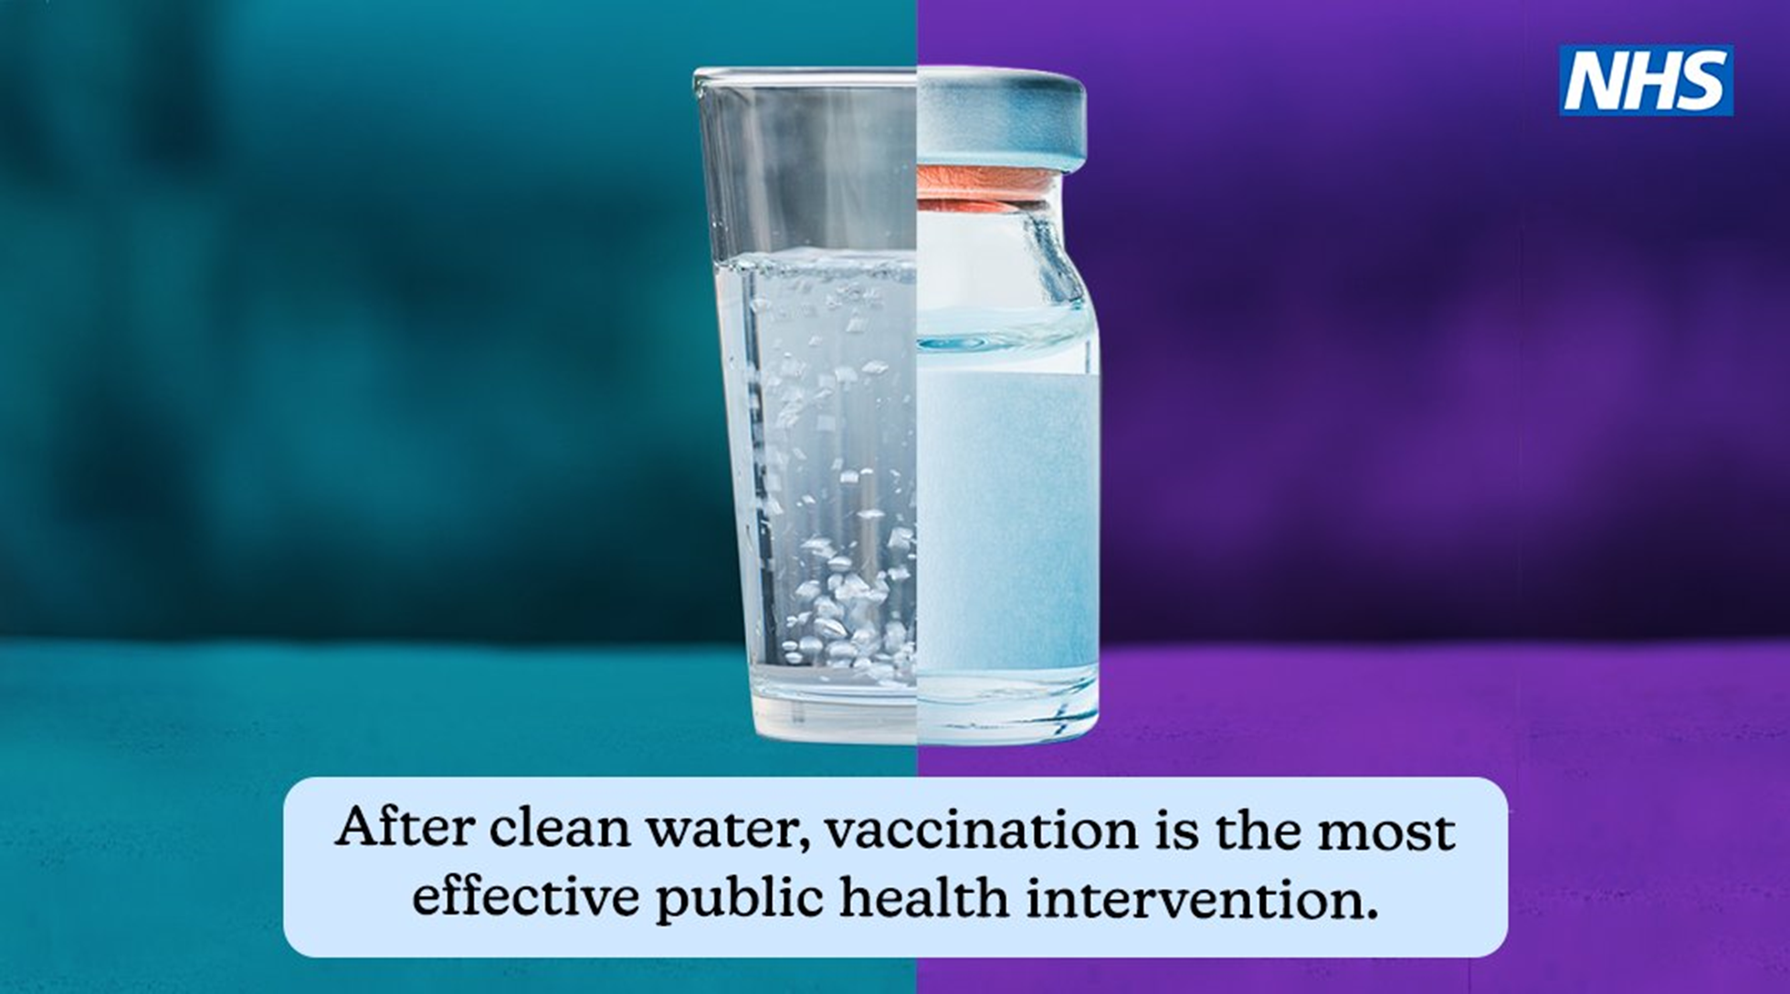

Slide 4


Slide 5
Aim
Explain
What the HPV vaccine is
Identify challenges
Looking at Challenges and myths regarding the HPV vaccine
Describe & Look
What happens when someone receives the HPV vaccine.
How HPV can provide protection
Look at how a school session runs

Slide 6

What is Human Papillomavirus (HPV)
HPV or Human Papillomavirus is the name for a group of viruses.
There are over 200 types of Human Papillomavirus.
Around 40 types can affect the genital and anal area.
It is spread by skin-to-skin contact.
Usually, HPV leaves the body naturally but can lead to HPV related cancers.

Slide 7
How common is the HPV virus?
HPV is a common virus that can affect both boys and girls.
More than 70% of unvaccinated people will get it.
HPV is often symptomless, and the body will usually fight it off itself. However, this is not always the case.
While some HPV types are harmless, other types can cause damage to cells.
It is passed on via skin-to-skin contact and is often found on fingers, hands, mouth and genitals.

Slide 8
Why do you need the HPV Vaccine?
As a teenager, your immune system is geared up and ready to fight. Your risk of having had HPV is also much lower than when you are older.
Getting vaccinated now means you could reduce your risk of genital warts or certain head, neck and genital cancers caused by HPV.
The HPV vaccine is most effective when given before any exposure to HPV viruses, so it is first offered to 12–13-year-olds (school year 8).
HPV vaccines help prevent HPV related infections.
Being vaccinated can reduce the spread of HPV to others.

Slide 9
What does the HPV Vaccine protect against?
Gives protection against the most high-risk strains of the Human Papillomavirus (HPV), which can cause mouth, throat, cervical and genital cancers.
Cervical cancer is the most common cause of cancer in women under the age of 35.
It also gives you 90% protection against cases of genital warts.

Slide 10
How effective is the HPV vaccine?
In clinical trials, the HPV vaccine was over 99% effective at preventing pre-cancer caused by HPV types 16 or 18 in young women, which are linked to 70% of cervical cancers.

Slide 11
HPV Vaccine myth busting
Can I be vaccinated during Ramadan?
The majority of Islamic Scholars are of the opinion that taking the vaccine by injection into your muscle does not invalidate your fast.
I might feel dizzy
Sometimes you can feel dizzy after a vaccination, this can be normal.
Needle stays in my arm
The needle is always removed after vaccination
Will I get ill?
Sometimes you can feel unwell after a vaccine, but we are on hand to help you.
Is it against my religion?
Discuss this with your nurse and families, most religions believe in all vaccinations.
Is it vegan/vegetarian?
HPV has no animal products in it.

Slide 12
How to prepare for the vaccine
Make sure you have breakfast and/ or a snack before your planned vaccination.
Wear a short sleeve school shirt/ top if possible.
Talk to your teacher if you are worried about the vaccinations and we can vaccinate you privately or at the beginning of the session.
Bring your water bottle with you.
Relax…

Slide 13
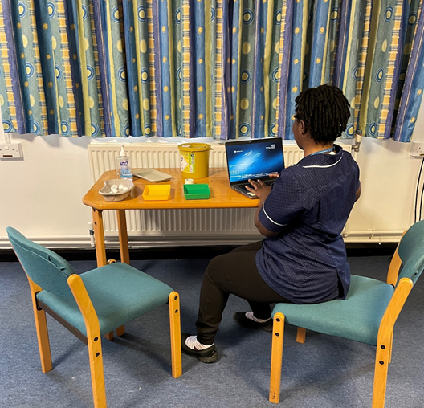
What to expect on the day
The table will be set up like this at your school.
The nurse will call you to the table. They will then ask you some questions to check that they have the correct form.
They will explain the vaccination and give you the opportunity to ask questions or discuss any worries you may have.
The nurse will check you are ready for the vaccination, and then you will receive your HPV vaccination.
We may ask for feedback about the care you received.

Slide 14
What we would like from you.
Respect everyone at the session
Keep the noise levels low
Listen to what is being asked
Let us know if you have any questions or any worries you would like to discuss
REMEMBER – We are here to make your experience as pleasant as possible

Slide 15
What to do next…
Speak to your families about vaccination.
Encourage them to complete the online consent form whether they would like you to be given vaccination or not.
If the consent form is not completed, we then contact your family as we need to ensure we offer the vaccine to every student.

Slide 16
Feedback from students after vaccination.
Really nice, helped me through the process as I was scared.
It was a better experience as the vaccinator was really kind.
They where patient and caring, listened and gave time
All staff gave a good welcoming smile
They where very nice and helped me understand what sort of injections I was getting.
Very kind and friendly and explained everything clearly. Such a lovely relaxed experience and amazing Nurse

Slide 17

Thank you
Questions…?
www.berkshirehealthcare.nhs.uk

