Slide 1

A-LEVEL

Slide 2
This A-level Business course introduces you to all you need to know about working in business, providing a solid foundation for further study.
With a focus on helping you to become a good decision maker, you’ll learn essential managerial skills, alongside techniques to help you become an analytical problem solver. These skills are all highly sought after and valued in a wide range of careers.

Slide 3
Further study and career opportunities
If you’d like to study business, finance or management at university, A-level Business provides an excellent foundation. The skills you learn are also transferable across a broad range of subjects and careers.
Whatever you choose to do in the future, you’ll find that the things you learn in this course will help. For example, you’ll probably work with lots of different people, so knowledge of motivational theory will help you to work well with others and help them achieve their potential.
You might have ambitious plans to start your own business. If that’s the case, you’ll find the marketing and finance topics particularly useful.

Slide 4
Units covered…
1. What is business?
2. Managers, leadership and decision making
3. Decision making to improve marketing performance
4. Decision making to improve operational performance.
5. Decision making to improve financial performance
6. Decision making to improve human resource performance

Slide 5
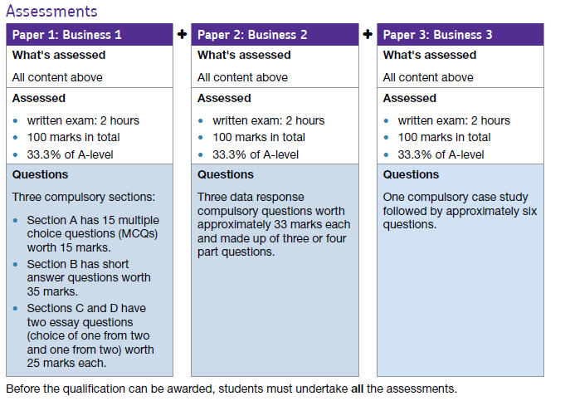
How is the Course Structured?

Slide 6
How to approach the course
Be organised – Bring you own equipment, be prepared for note taking etc
Keep Up to date with topical knowledge – Read about Business and be aware that the business world is always changing
Build a Business Dictionary – Ensure you have a glossary of key terms
Complete homework and in class exercises – Try to do them to the best of your ability.

Slide 7
Keeping Organised
Have a file for each teacher or a large file for the subject.
Use file dividers – these can be provided
Ensure that you have a filing session every week!
Keep your digital PLC up to date

Slide 8

Why do businesses exist?
Think about this question…

Slide 9
What do businesses bring to the UK/World?
Discuss this question with the person next to you.
Be prepared to defend your answers.

Slide 10
Let’s imagine it is March 2020…
Which businesses had to make major changes to their operations?
List some businesses that were:
Worse off due to the pandemic/lockdown and why
Better off due to the pandemic/lockdown and why
Little difference to operations due to the pandemic/lockdown and why

Slide 11
Let’s imagine it is March 2020…
Can you think of any businesses or products that now exist, since the crisis?

Slide 12
Paired Task
You will be given a card with a business on it. For that business, you have to write down the following…
Name of Business
What the business does – more than just two words
Why/how were they impacted?
How did they react? Did they do anything differently?
Anything topical or extra that is interesting about this firm

Slide 13
Example…
Primark
Name of Business - Primark
What the business does – They sell budget clothes and footwear, plus some homewares
Why/how were they impacted? – They do not use e-commerce so were heavily impacted in the early stages. They were then able to be open as an ‘essential’ retailer. The had extended periods of lockdown entirely closed, generating zero revenue.
How did they react? Did they do anything differently? – They remained in store only, despite the growth in online clothes sales. They may be better off once lockdown lifts if people are financially worse off and require cheaper alternatives.
Anything topical or extra that is interesting about this firm – they paid back the government furlough loans, voluntarily

Slide 14
Death of the high street…
What do we mean when we say ‘Death of the high street’?

Slide 15
Death of the high street…
“Clicks vs. Bricks”
Topshop/Topman – Arcadia group
Debenhams – Going into administration before lockdown hit and then shut down completely.

Slide 16
Death of the high street…
In pairs or three, discuss and mind map what can be done to solve the death of the high street issues faced around the country…

Slide 17
What does the primary, secondary and tertiary sector mean?

Slide 18
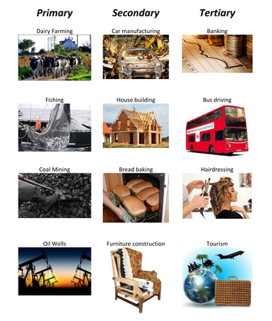

Slide 19
In the UK, the tertiary sector has become the main economic sector in recent decades.
Briefly explain two reasons why this has occurred.

Slide 20


Slide 21
Service sector markets have grown fastest in recent times
UK firms have developed competitive advantage in service industries which they have been able to export overseas
Consumers/households increasingly demand services rather than goods
UK manufacturing has become less competitive compared with overseas

