Slide 1




Welcome to A Level Physics. Over the next two years you're going to learn how the universe works, from atoms smaller than you can imagine to galaxies larger than you can comprehend.
Thank you for being ready to learn!

Slide 2
Why did you choose Physics ?
Thank you for being ready to learn!

Slide 3
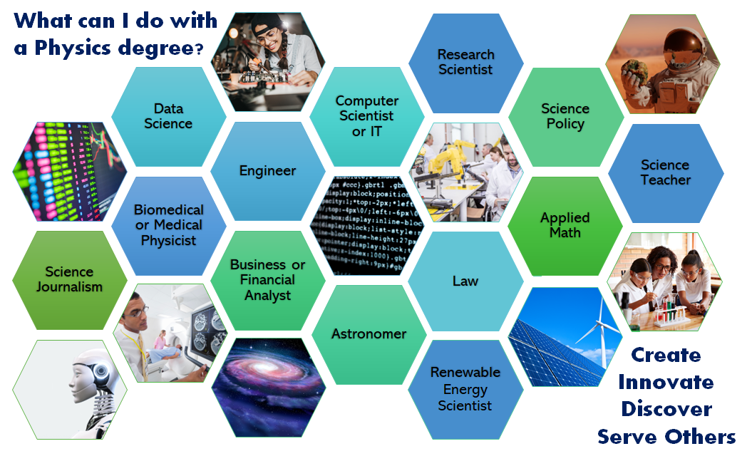
Where Can A-Level Physics Takes You?

Slide 4


Slide 5
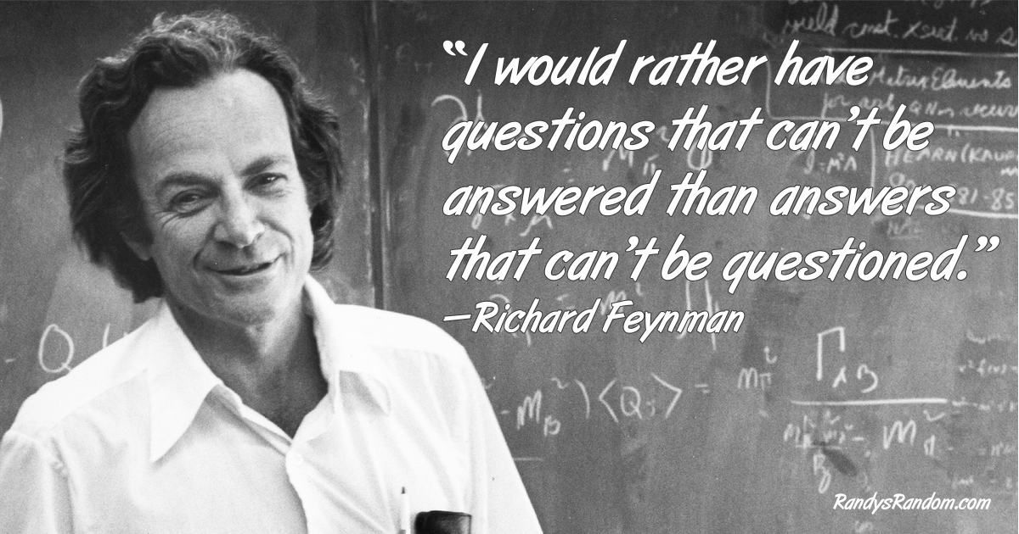

Slide 6
Topics Covered in Post-16 Physics
Year 12
Year 13
(1) Practical Skills
(3) Forces and Motion
(5) Newtonian World and Astrophysics
(2) Foundations of Physics
(4) Electrons, Waves and photons
(6) Particle and Medical Physics

Slide 7

Development of Practical Skills in Physics
Physics is a practical subject, and experimental work provides you with important skills, as well as enhancing your understanding of physical theory.
You will complete 12 teacher assessed practical activities in lesson. If you demonstrate the desired skills required in each practical you will be awarded a Practical Endorsement as part of your A level qualification.
In the written examination at least 15% of the marks will be awarded for questions assessing practical skills.
Areas tested: Planning, Implementation, Analysing, Evaluating.

Slide 8
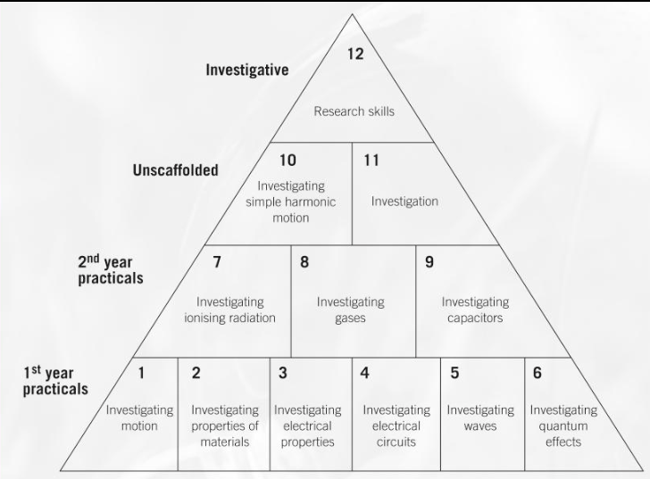
Development of Practical Skills in Physics
The Teacher Assessed Practical Activities

Slide 9
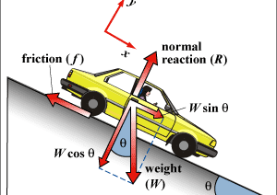
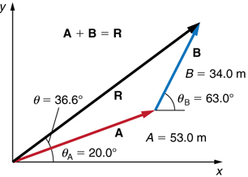
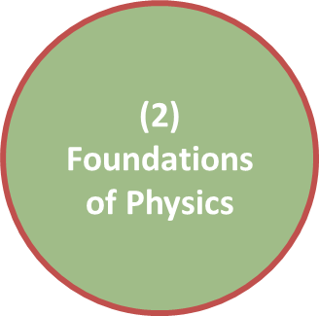
Foundations of Physics
Physics is not only a collection of concepts encompassing subatomic particles up to the entire universe it is also includes ways of thinking about the physical world we find ourselves in.
Foundations of physics focuses upon the key mathematical and physical areas which are necessary to develop into a competent physics student.
Quantities and units
Derived Units
Scalars and Vectors
Adding and Resolving Vectors

Slide 10
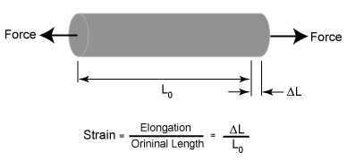

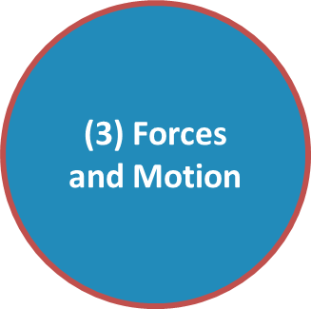
Forces and Motion
Forces and motion form a central part of every physicist’s understanding of the Universe. You will explore the key ideas of motion described by Newton, the work-energy principle, how certain materials are characterised with their properties, and you will develop an utilise conservation laws to solve problems.
Motion
Forces in Action
Work, Energy and Power
Material Science
Laws of Motion and Momentum

Slide 11
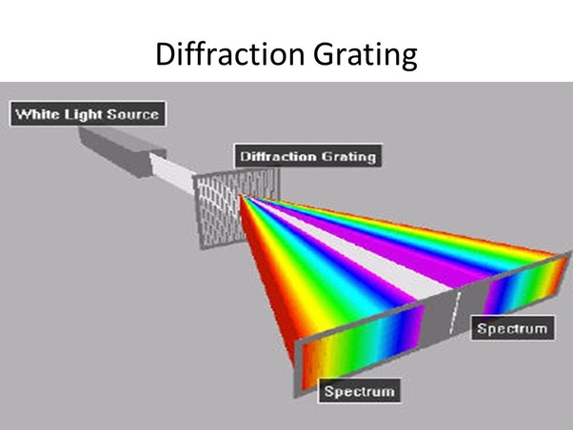
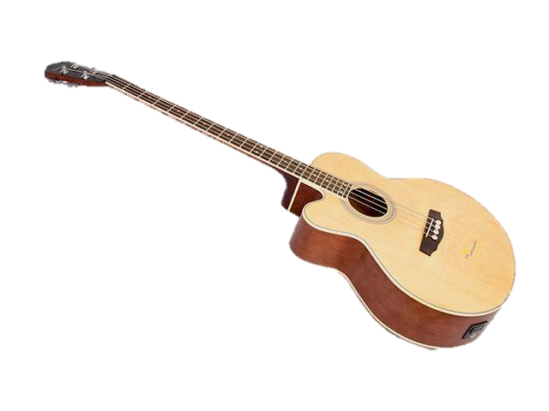
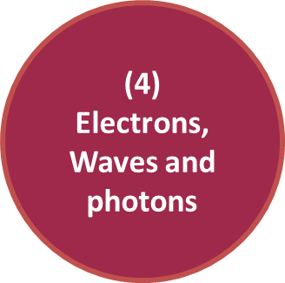
Electrons, Waves and Photons
Quantum physics is a perhaps one of humankinds greatest achievements. It allows us to make incredibly exact predictions on scales far smaller than a single atom. In order to understand these key ideas this is preparatory module which will guide you towards wave-particle duality, the photoelectric affect, and electron diffraction.
Charge and Current
Energy Power and Resistance
Electrical Circuits
Waves 1
Waves 2
Quantum Physics

Slide 12
A Level Examinations
You will sit three external examinations at the end of Y13.
Multiple Choice
Total Marks
Time
Modelling Physics
15
100
2 hrs 15 min
Exploring Physics
15
100
2 hrs 15 min
Unified Physics
0
70
1 hr 30 min

Slide 13
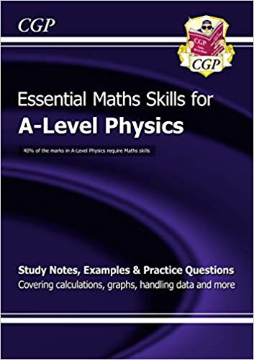
How to Succeed in A- level Physics
Key Skills :
Rearranging equations
Standard Form
Scientific notation and Prefixes
Graphs and data analysis
Trigonometry
Clearly mathematical working

Slide 14
Expectations
You must notify the teacher if you will not be present and ask for work to catch up on.
You will be expected to complete 6 additional hours a week of work outside of lessons completing practice questions and preparing revision material.
Each lesson will come with a homework. You will have one week to complete this homework and self-mark your work from the provided answers.

Slide 15
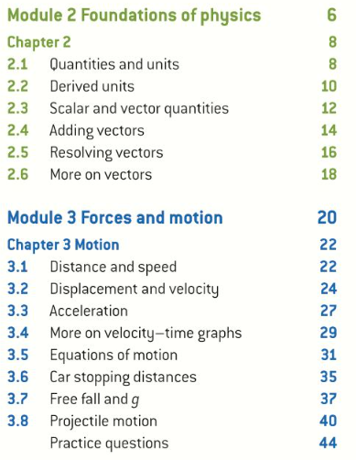
Your Physics Timetable
Paper 1 will be taught by one teacher.(Module2,3,5
Paper 2 will be taught by another teacher. Module 4,6)
You will have topic tests at the end of each chapter.

Slide 16




Outcomes
Convert prefixes into standard form and vice-versa.
State what each prefix means in standard form.
State the units for the seven base units.

Slide 17
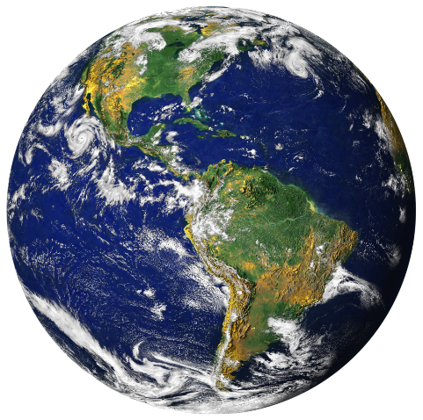
A problem of language
Science is a human endeavour which spans countries and continents. Therefore, we need a language to communicate with and, in the main, that is English at the present moment.
English hasn't always been the most common language in science and research. A little over 100 years ago, at the start of the 20th century, the dominant language for science was indeed German. And even before that, Latin.
Discussion: Why has the dominant language of science changed over time?

Slide 18
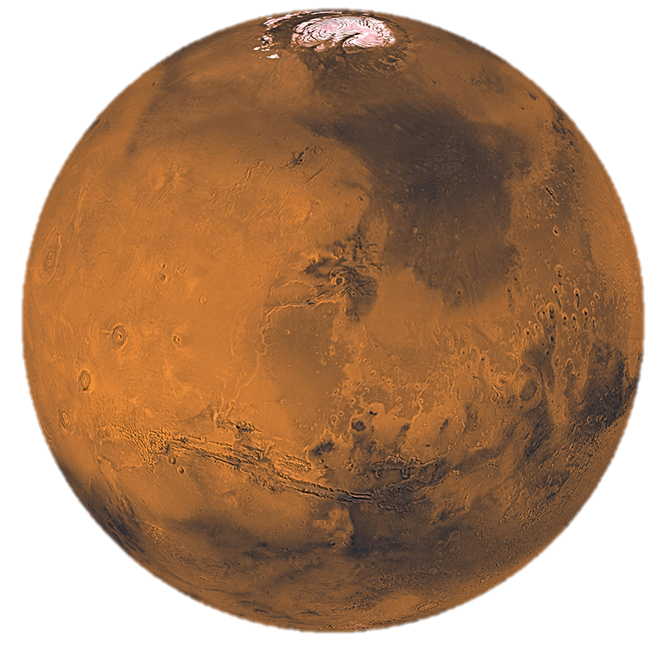
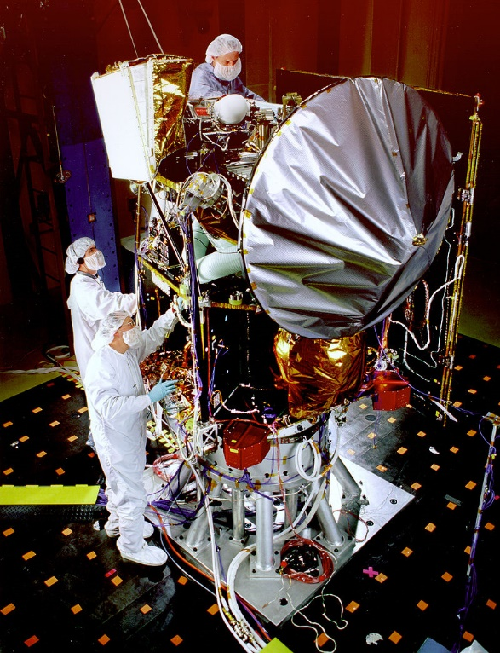
A Problem of Units
As you may be aware there are different units that represent the same quantities. For example, for length we have cm, m, km, inches, feet, and miles.
It is important that scientists have a common language and understand which units are using or it could be disastrous.
In 1999 NASAs £195 million Mars Climate Orbiter burnt up in Mars’ upper atmosphere.
A piece of the orbiter was made by Lockheed Martin and they used imperial units not SI!

Slide 19

International System of Units
All the units we will use are based upon SI.
Quantity | Base Unit | Unit Symbol
Length
Mass
Time
Electric Current
Temperature
Amount of substance
meter
kilogram
second
ampère
kelvin
mole
m
kg
s
A
K
mol

Slide 20


Mini-Plenary
Please close your books and
pick up your whiteboards.

Slide 21
The SI of Units
State the missing units and symbols on your whiteboards.
Quantity | Base Unit | Unit Symbol
Length
Mass
Time
Electric Current
Temperature
Amount of substance
meter
kilogram
second
ampère
kelvin
mole
m
kg
s
A
K
mol
1)
3)
5)
7)
9)
11)
2)
4)
6)
8)
10)
12)

Slide 22
Prefixes
Prefix Name | Prefix Symbol | Factor
peta | P | x 10¹⁵
tera | T | x 10¹²
giga | G | x 10⁹
mega | M | x 10⁶
kilo | k | x 10³
deci | d | x 10⁻¹
centi | c | x 10⁻²
milli | m | x 10⁻³
micro | μ | x 10⁻⁶
nano | n | x 10⁻⁹
pico | p | x 10⁻¹²
femto | f | x 10⁻¹⁵
SI uses prefixes where pre means before.
For example, km stands for kilometre where the prefix is kilo.
1 km = 1 x 10³ m = 1000 m.
You need to be able to convert between a prefixed unit to base SI. You need to learn all these prefixes.

Slide 23


Making Flash Cards
Now you need to make flash cards of prefixes.
Front
Back
peta (P)
x 10¹⁵
Front
Back
pico (p)
x 10⁻¹²
Notes:
15 minutes

Slide 24

Prefixes: Worked Example
Convert 1.36 kA into A
Convert 259 μK into K
Convert 0.596 s into ms
1.36 kA = 1.36 x 10³ A = 1360 A
259 μK = 259 x 10⁻⁶ K = 2.59 x 10⁻⁴ K
m = 10⁻³ so there are a thousand milliseconds in a second.
0.596 s = 0.596 x 10³ ms = 596 ms

Slide 25
Your turn
Write the following measurements in their base units.
  450 pm
  0.5 Mm
  40 µs
  0.7 mA
Convert from base units into the specified units.
  State 5.34 x 10⁵ m in km.
  State 1,274 x 10⁷ m in Mm
  State 7.0 x 10⁻⁵ m in µm
  State 1.4 x 10⁻⁷ A in nA.

Slide 26
Answers
Do not look at the following slides until you have attempted the homework questions.
You may believe that you are managing to get your work done quickly by cheating and looking.
Yet, in reality you are only cheating yourself.
I can guarantee that you will regret cheating when you open your exam results.

Slide 27
Answers
Write the following measurements in their base units.
  450 pm = 450 x 10⁻¹² m
  0.5 Mm = 0.5 x 10⁶ m
  40 µs = 40 x 10⁻⁶ s
  0.7 mA = 0.7 x 10⁻³ A

Slide 28
Answers
Convert from base units into the specified units.
  State 5.34 x 10⁵ m in km.
  State 1,274 x 10⁷ m in Mm
k = x 10³. Therefore to add a k multiply by x 10⁻³ (divide by 1000).
5.34 x 10⁵ m = 5.34 x 10⁵ x 10⁻³ km = 5.34 x 10⁵⁻³ km
5.34 x 10⁵ m = 5.34 x 10² km = 534 km
M = x 10⁶. Therefore to add a M multiply by x 10⁻⁶ (divide by million).
1,274 x 10⁷ m = 1,274 x 10⁷ x 10⁻⁶ Mm = 1,274 x 10⁷⁻⁶ Mm
1,274 x 10⁷ m = 1,274 x 10¹ Mm = 12 740 Mm

Slide 29
Extension Questions
A student records the following figures in his notes 55 cm and 35 ms.
  Name the two quantities being measured
  Change these measurement into their base units.
a)
Centimetres is a unit of distance.
Milliseconds is a unit of time.
b)
55 cm = 55 x 10⁻² m.
35 ms = 35 x 10⁻³ s

Slide 30
Homework Questions
A student records the following figures in his notes 55 cm and 35 ms.
  Name the two quantities being measured
  Change these measurement into their base units.
A collision between two particles lasts 100 picoseconds. Write this in seconds.
A specific chemical bond is approximately 0.16 nanometres long. Write this length in meters.
The Sun’s core has an estimated temperature of 15.7 megakelvin. Write the temperature in kelvin.

Slide 31
Homework Questions
A collision between two particles lasts 100 picoseconds. Write this in seconds.
100 picoseconds = 100 ps = 100 x 10⁻¹² s.
A specific chemical bond is approximately 0.16 nanometres long. Write this length in meters.
0.16 nanoseconds = 0.16 ns = 0.16 x 10⁻⁹ s.

Slide 32
Homework Questions
The Sun’s core has an estimated temperature of 15.7 megakelvin. Write the temperature in kelvin.
15.7 megakelvin = 15.7 MK = 15.7 x 10⁶ K.

Slide 33
Homework Questions
Convert from base units into the specified units.
  State 7.0 x 10⁻⁵ m in µm
  State 1.4 x 10⁻⁷ A in nA.
µ = x 10⁻⁶. Therefore to add a µ multiply by x 10⁶ .
7.0 x 10⁻⁵ m = 7.0 x 10⁻⁵ x 10⁶ µm = 7.0 x 10⁻⁵⁺⁶ µm
7.0 x 10⁻⁵ m = 7.0 x 10¹ µm = 70 µm
n = x 10⁻⁹. Therefore to add a n multiply by x 10⁹ .
1.4 x 10⁻⁷ A = 1.4 x 10⁻⁷ x 10⁹ nA = 1.4 x 10⁻⁷⁺⁹ nA
1.4 x 10⁻⁷ A = 1.4 x 10² nA = 140 nA.

