Slide 1




Welcome to Level 3
Health & Social Care (AAQ)
MWB - DNA:
What is the difference between health care and social care?
Can you give 3 examples for each type of care?
What jobs can you get by studying health & social care?
Aim of today's lesson:
To gain knowledge and understanding of the BTEC Health & Social Care qualification we offer at Little Heath School.
Thank you for being ready to learn!
Notes:
Pearson Level 3 Alternative Academic Qualification BTEC National in Health and Social Care (Extended Certificate)
Healthcare is the prevention, diagnosis and treatment of mental and physical ill health, diseases and injury.
Healthcare takes place in hospitals, health centres and in the community.
Examples of healthcare roles include nursing, midwifery and paramedic science.
Social care is the care and support of vulnerable people, usually in the community, and is focused around enabling people to live as independently as possible.
Examples of social care roles include: social work, personal assistance and care home management.
Students will need MWB for the DO NOW Qs

Slide 2

Welcome to BTEC AAQ
Health & Social Care
Today you will:
Meet the Health & Social Care teachers.
Explore what is Health & Social Care.
Receive information about the resources you will need such as folders, dividers, handbook & textbooks.
Be given an outline on our course expectations.
Be given an overview of the course structure & assessments.
Complete some introduction activities.
Notes:
This is the first page on the student handout.

Slide 3
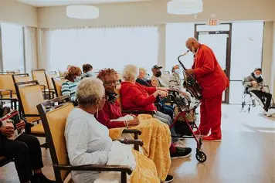

Healthcare is the prevention, diagnosis and treatment of mental and physical ill health, diseases and injury.
Healthcare takes place in hospitals, health centres and in the community.
Examples of healthcare roles include nursing, midwifery and paramedic science.
Social care is the care and support of vulnerable people, usually in the community, and is focused around enabling people to live as independently as possible.
Examples of social care roles include: social work, personal assistance and care home management.
Task: Check your definition, were you correct?
Notes:
This is the page 2 on the student handout.

Slide 4
Health & Social Care teaching team
Mr New: Head of Social Sciences and teacher of Sociology and Health & Social Care.
Mrs Kelly: Second in Social Sciences and teacher of Psychology and Health & Social Care.
Mrs Masih-Targowski: Teacher of Health & Social Care and Y10 Child Development.
Miss Jenkins: Teacher of Health & Social Care, Psychology, Sociology and Y9 Child Development.

Slide 5

What is Health and Social Care?
Health and Social Care includes concepts and knowledge from natural sciences such as Biology and social sciences such as Sociology and Psychology. This gives Health and Social Care broad appeal and something for everyone to enjoy.
It is a fascinating subject, focused on understanding how people live, grow and develop and the factors that affect this.
This provides students with the foundational knowledge required in a large variety of careers.
Notes:
This is Page 3 on the student handout.

Slide 6

Activity: Nurse’s Dilemma – Making Care Decisions
Imagine you are a nurse faced with a real-life health scenario.
You must make decisions about how to respond, considering ethical, practical, and emotional factors.
Working in groups discuss and write down your decisions for each step.
After making choices, you will reflect on the impact of their decisions on patient care.
Reflection questions:
What influenced your choices?
How might different decisions affect patient outcomes?
How do ethics and patient dignity come into play?

Slide 7
Activity: Nurse’s Dilemma – Making Care Decisions
Mrs. Thompson’s Confused Moments
1. Mrs. Thompson asks to leave the ward to “go home.” What do you do?
Let her go, trusting she knows what she’s doing.
Explain gently that she needs to stay for safety, and offer a distraction like a walk around the ward.
Restrain her to the bed to prevent wandering.
Mrs. Thompson is an 82-year-old woman with early-stage dementia.
She has been admitted to the ward after a minor fall at home. She sometimes becomes confused and disoriented.
2. Mrs. Thompson refuses her medication because she doesn’t understand why she needs it. How do you respond?
A) Force the medication to ensure her safety.
B) Explain patiently what the medication does and ask if she has concerns.
C) Leave her for now and come back later.
3. You notice Mrs. Thompson seems sad and withdrawn. What’s your approach?
A) Spend time talking with her and inform the care team.
B) Ignore it because she’s “just old.”
C) Give her extra medication to calm her down.
Notes:
This is page 5 on the student handout.

Slide 8
Reflection questions:
Why did you choose those options?
How did you balance patient autonomy vs. safety?
What ethical principles were involved?
How would your decisions affect Mrs. Thompson’s dignity and wellbeing?
Notes:
Students complete these questions on page 6 of their handout.

Slide 9

Skills Achieved when Studying Health and Social Care
Health and Social Care is the most popular vocational subject in the UK.
It is a subject which requires students to understand the theory of human growth and development but to also be practical in applying classroom knowledge to real world situations.
Students learn to write academic assignments and convincing exam answers, as well as demonstrate their skills in more practical ways, such as through presentations and role plays.

Slide 10

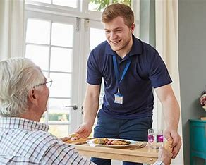
What can Health & Social Care Lead to?
Studying Health and Social Care will be great for you if:
You have broad interests and enjoy variety
You are interested in how the body and mind work.
You are interested in careers where you work with and help people.

Slide 11


Slide 12
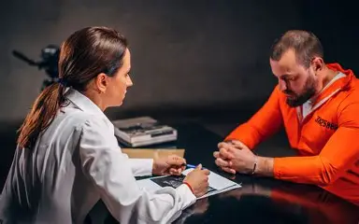

Careers in Health and Social Care
Task match the career name with the correct description.
Start with the yellow cards, these are common careers.
Then move onto blue cards, these are other careers linked to studying health and social care.
Notes:
Give a card pack to pairs of students they then complete the matching activity.

Slide 13
Careers in Health and Social Care
Nurse | Cares for patients by monitoring health, administering medication, and supporting recovery in hospitals, clinics, or community settings.
Social Worker | Supports individuals and families facing challenges like illness, poverty, or abuse, helping them access services and improve wellbeing.
Occupational Therapist | Helps people regain or develop skills needed for daily living and work after injury, illness, or disability.
Healthcare Assistant | Works alongside nurses and other professionals to provide basic care, assist with personal hygiene, and support patient comfort.
Care Manager | Plans and coordinates care services for individuals who need long-term support, ensuring their needs and preferences are met.
Mental Health Support Worker | Works with individuals experiencing mental health issues to provide emotional support, assist with daily activities, and encourage recovery.

Slide 14
Careers in Health and Social Care
Public Health Educator | Creates programs and campaigns to promote healthy lifestyles and prevent illness in communities.
Forensic Psychologist | Works with criminal justice to assess and support individuals with mental health issues involved in legal cases.
Genetic Counsellor | Provides information and support to families about inherited conditions and genetic risks.
Health and Safety Officer | Ensures workplaces meet health and safety regulations to protect employees and the public.
Speech and Language Therapist | Helps people with communication disorders, swallowing difficulties, or speech delays.
Epidemiologist | Studies patterns of diseases and health conditions in populations to inform public health decisions.

Slide 15




Course resources
Course textbook.
Lever arch folder.
Dividers.
Highlighters.
We will give you an exercise book.

Slide 16


Course Structure
Year 12
Unit 1: Human Lifespan and development (External assessment in May 2027) 1.5hr (80 marks)
PIES and factors affecting growth and development, interventions and the different professionals providing care and treatment
Unit 3: Principles of Health and Social Care Practice Education (Pearson Set Assignment – coursework) 15hrs
Core principles, values and legislation that underpin and influence health and social care, and the effect of social determinants on an individual health status

Slide 17
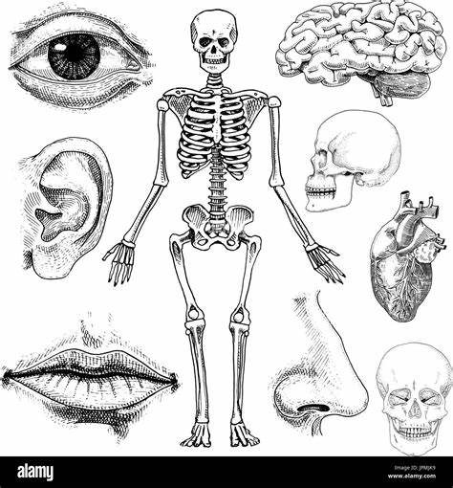
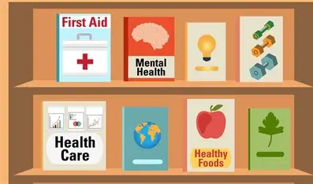
Course Structure
Year 2
Unit 2: Human Biology and Health (External assessment in May 2028) 1.5hrs (80 marks)
Human body structure and systems, normal physiological functioning and the impact of common disorders.
Unit 6: Safe Environments in Health & Social Care (Pearson Set Assignment – coursework) 15hrs
The importance of safe working practices, professional responsibilities and record keeping in maintaining safe environments and quality care in line with national standards in health and social care settings.

Slide 18

Course expectations
Organisation skills (folder, textbook, highlighters, handouts etc)
Excellent attendance & punctuality. (No lower than 95%)
Meeting deadlines (homework & coursework)
No plagiarism or using AI for coursework.
Revision for all assessments.
Active learning (questions/group work)
Respect shown to the learning environment

Slide 19
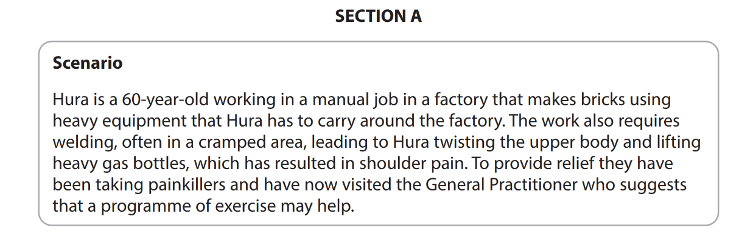
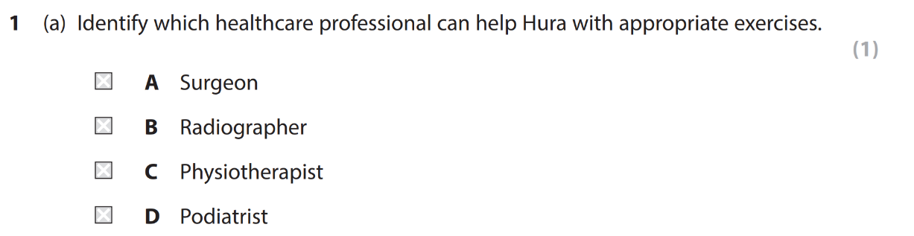
What will your assessments look like?
Unit 1: Human Lifespan and development
Your assessment will include a range of short mark answer questions like this. Along with essay style questions.
v
Task: Read the scenario & highlight key information. Discuss with your partner what you think the answer is.
Notes:
This is page 4 on the student handout.

Slide 20
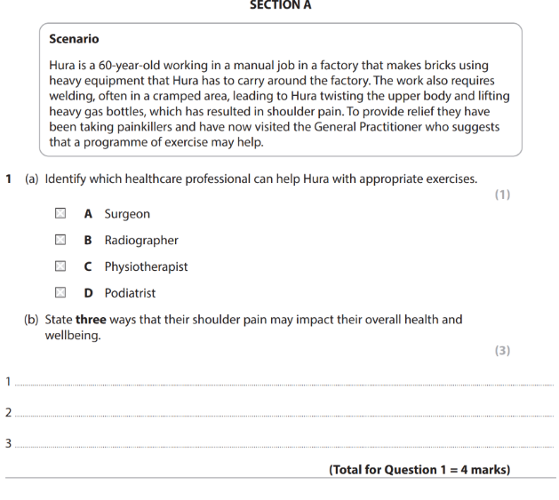
What will your assessments look like?
Answers:
• Poor quality of sleep
• Reduction of social contacts
• Reduced movement in shoulder
• Low mood
• Unable to concentrate
‘pain’ on its on is not accepted
Independently, complete question (b).
This is a ‘State’ question, so be clear and direct in your response.
1 mark is awarded for each correct response.

Slide 21
How are you graded?
Extended Certificate
For Pearson Level 3 Alternative Academic Qualification BTEC National in Health and Social Care (Extended Certificate), your grade is the equivalent to 1 A-Level grade.
What grade would you like to achieve?
DISTINCTION *
DISTINCTION
MERIT
PASS
NEAR PASS

Slide 22

Results we achieved last year!
DISTINCTION *
DISTINCTION
MERIT
PASS
NEAR PASS
20 %
70 %
10 %
0 %
0 %

Slide 23
HEALTH AND SOCIAL CARE
Did you Know?
TRUE OR FALSE
Write on the mini whiteboards to show whether you think the statement is true or false

Slide 24
There are more than 350 careers in the NHS alone

Slide 25
TRUE
There are more than 350 careers in the NHS alone

Slide 26
The NHS is the 12th largest employer in the world

Slide 27
FALSE
The NHS is the 5th largest employer in the world

Slide 28
In 2022 the British public named nursing as the profession making the biggest contribution to society

Slide 29
TRUE
In 2022 the British public named nursing as the profession making the biggest contribution to society

Slide 30
By 2030 up to 2,000 extra social care staff will be required in England to meet demand

Slide 31
FALSE
By 2030 up to 627,000 extra social care staff will be required in England to meet demand

Slide 32

Reflection task
On your post-it note, write down 2 things you would like to achieve as a Health and Social Care student.
Notes:
You might not get this far.

