Slide 1
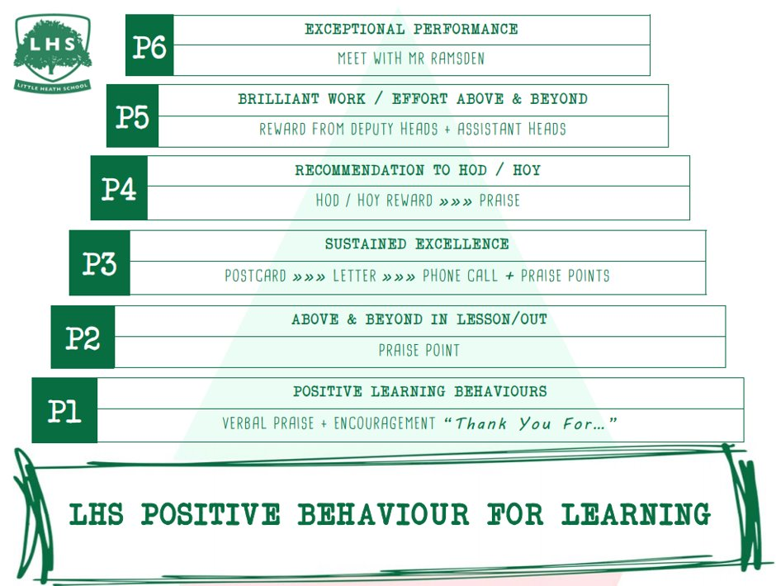
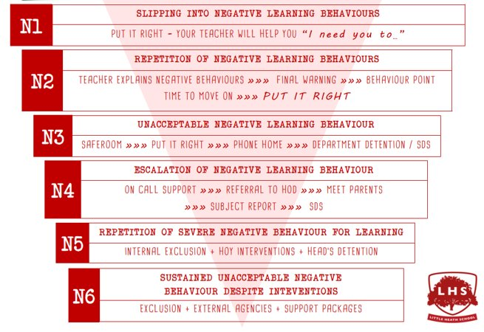


A LEVEL MATHEMATICS:
Exploring the Quadratic Function and its Graph
DNA:
Solving Same-ish, Yet Slightly Different
Equations
Aims:
Linking f(x)=ax²+bx+c to:
Factorising
Completing the square
Vertex
Intercept points
And the Graph
Thank you for being ready to learn!

Slide 2
DNA:
Solve these SAME-ish, yet slightly different equations:

Slide 3
SUMMER WORK
Work through joining instruction steps on separate ppt.
ALL students to have created an Integral account for the transition materials before the end of the session.
Course certificate of completion to be brought into school during the first week or emailed to their class teacher as evidence.

Slide 4
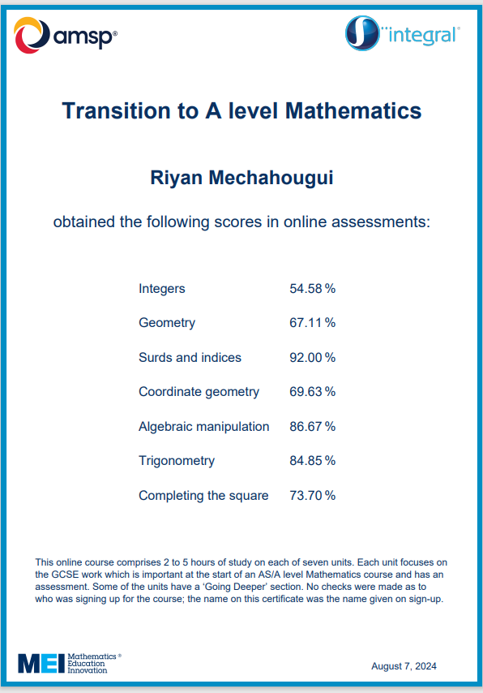
Summer work
Certificate
You need to email this to your teachers by Friday 18th September 2026

Slide 5
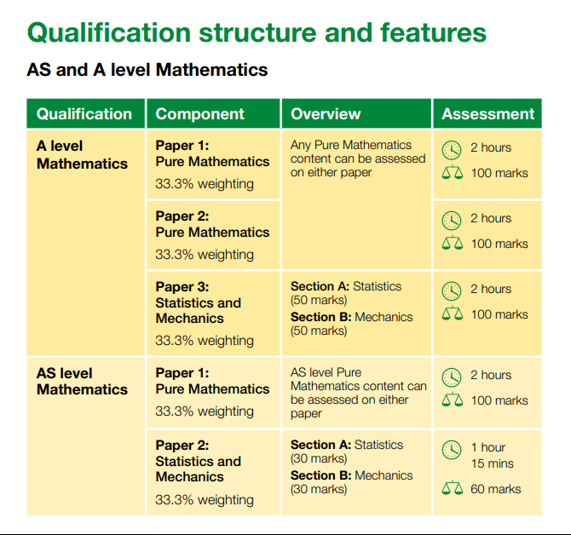
A level maths

Slide 6
What are the options?
(AS)/A level Mathematics
  Extends GCSE Maths and introduces new ideas
AS/A level Further Mathematics
An additional AS or A level to add breadth & depth
If you are great at GCSE maths
Love mathematics, solving problems, algebra …
And want to do more maths, even for just 1-year & get an AS qualification
Think about picking FMA as a 4th subject
You can even try it for 4-6 weeks!

Slide 7
What is in A level Mathematics?
All of the content in the A level Mathematics qualification is compulsory and is the same for all examination boards.
Pure Mathematics
66%
Statistics
17%
Mechanics
17%

Slide 8
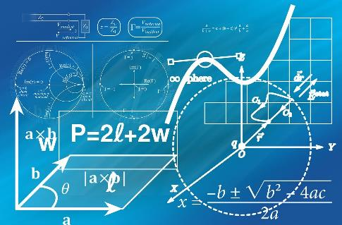
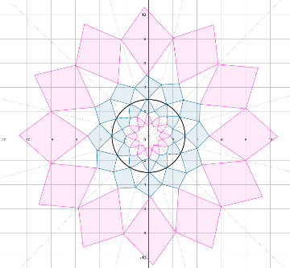
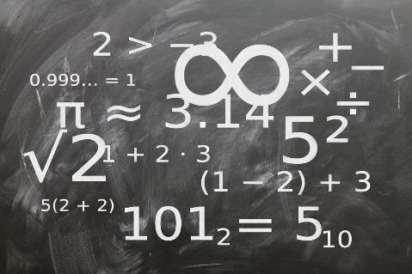
What is Pure Mathematics?
Methods and techniques which underpin the study of all other areas of mathematics, such as, proof, algebra, trigonometry, calculus, and vectors

Slide 9
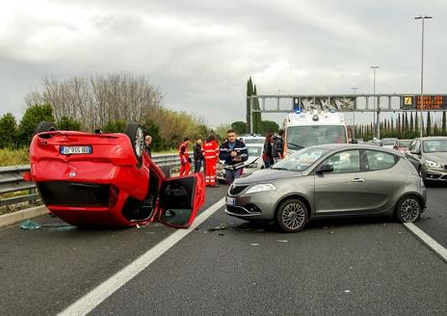

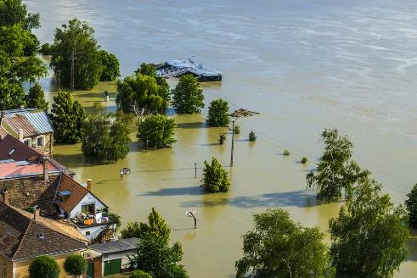
What is Statistics?
Reaching conclusions from data and calculating the likelihood of an event occurring.
Notes:
Images: https://pixabay.com/en/flood-danube-sandbag-park-139000/
Https://pixabay.com/photos/car-accident-clash-rome-highway-2165210/
https://pixabay.com/illustrations/analysis-statistics-chart-graphic-810025/

Slide 10


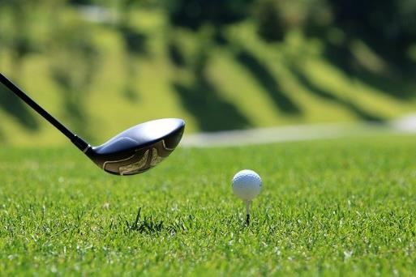
What is Mechanics?
The modelling of the world around us, the motion of objects and the forces acting on them.
Particularly useful for careers in physics or engineering
Notes:
https://pixabay.com/photos/water-drop-liquid-splash-wet-1759703/
https://pixabay.com/illustrations/world-globe-earth-planet-blue-1303628/
https://pixabay.com/photos/golf-golf-course-grass-sport-green-3685616/

Slide 11
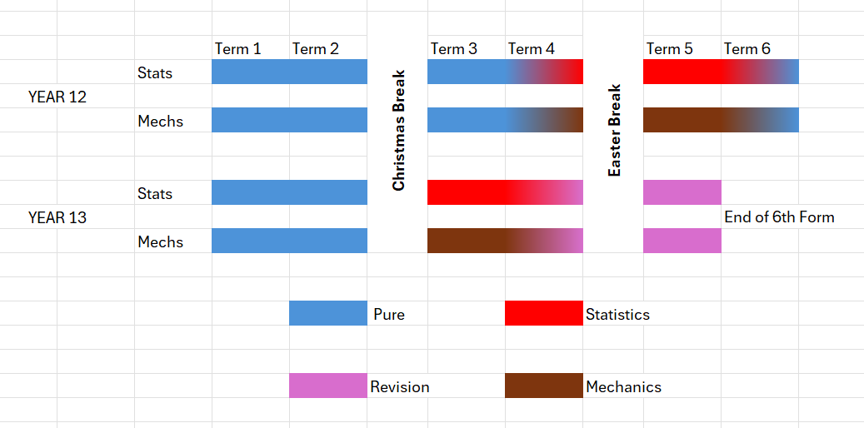
Course Overview

Slide 12
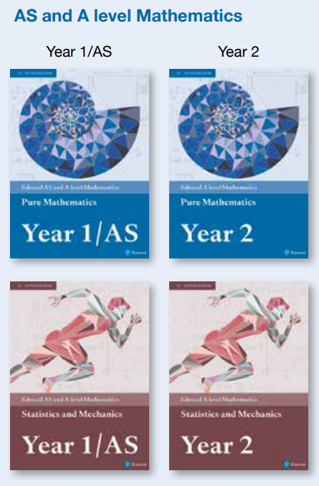
Textbook to buy
Blue Year 1 / AS
After Christmas
Brown Year 1 / AS
Easter 2027
Blue Year 2
September 27
Brown Year 2
Speak to 6th Form team or your teacher if this is a problem.

Slide 13
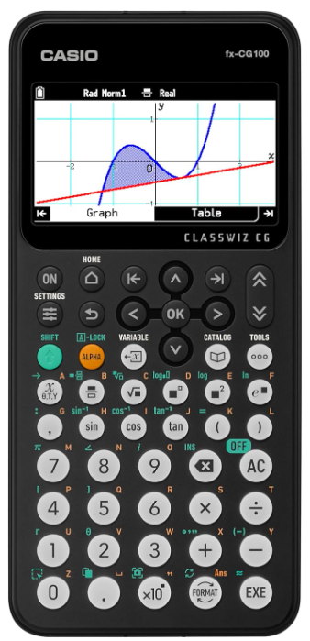
CASIO fx-CG100 Latest model
Graphical calculator with colour screen which is easier to look at. It is much better especially for stats and graphing and with much better graphics. (approx. £120- possible deal through school for £80 if we can get 20+ orders)

Slide 14
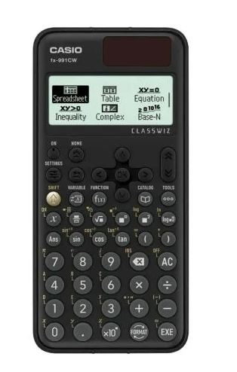
CASIO fx-991CW Classwiz
(gold button approx. £20)
This is the basic model that is essential if you aren’t purchasing the large graphical calculator
You will need this calculator because it has extra functions you will need for the course.
Solves simultaneous equations
Matrices
Normal, Binomial, Poisson distribution
Vectors
Integration
Differentiation

Slide 15



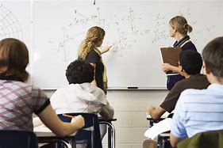

Every taught hour should be matched by an hour of independent practise

Slide 16
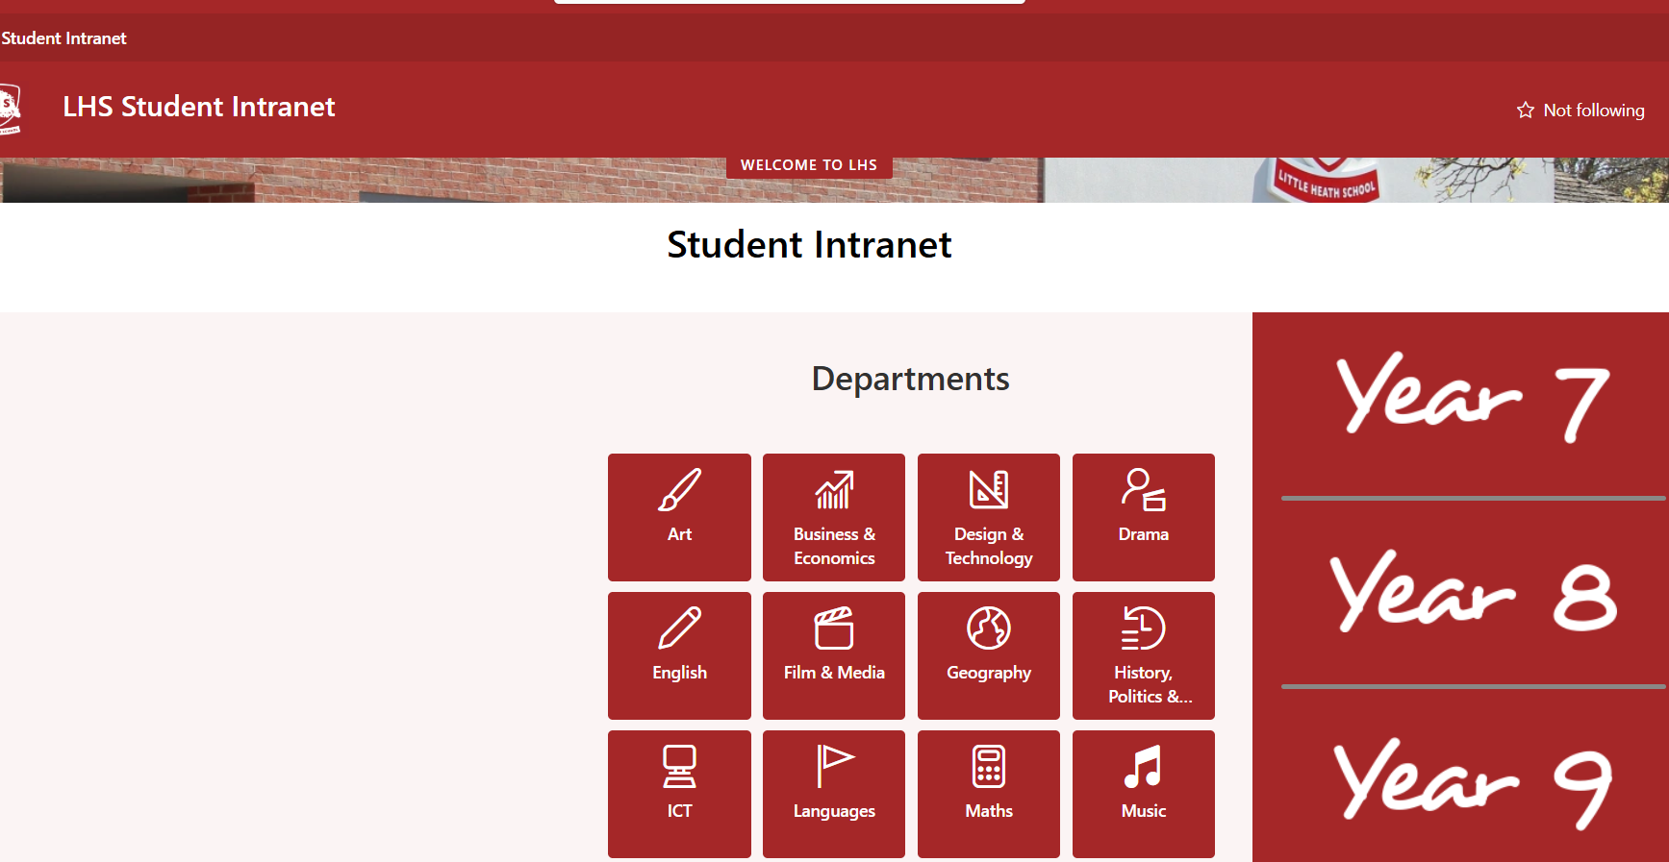


School Intranet: Maths Course Materials

Slide 17
Small Group Activity
→ DO NOT write on the cards
Orange cards – factorise, THEN …
Now match to Yellow cards – what is the importance of this?
Using the Orange Cards - complete the square, THEN …
Now match to Pink cards
Now match to the Green cards (Max / Min) – why can we do this now? What helps us?
What do the Red & Blue cards tell you? What are they called?
You can now put it altogether to match them to a graph. Job done!

Slide 18
STOP
Answers are next

Slide 19
Card Sort Answers

Slide 20
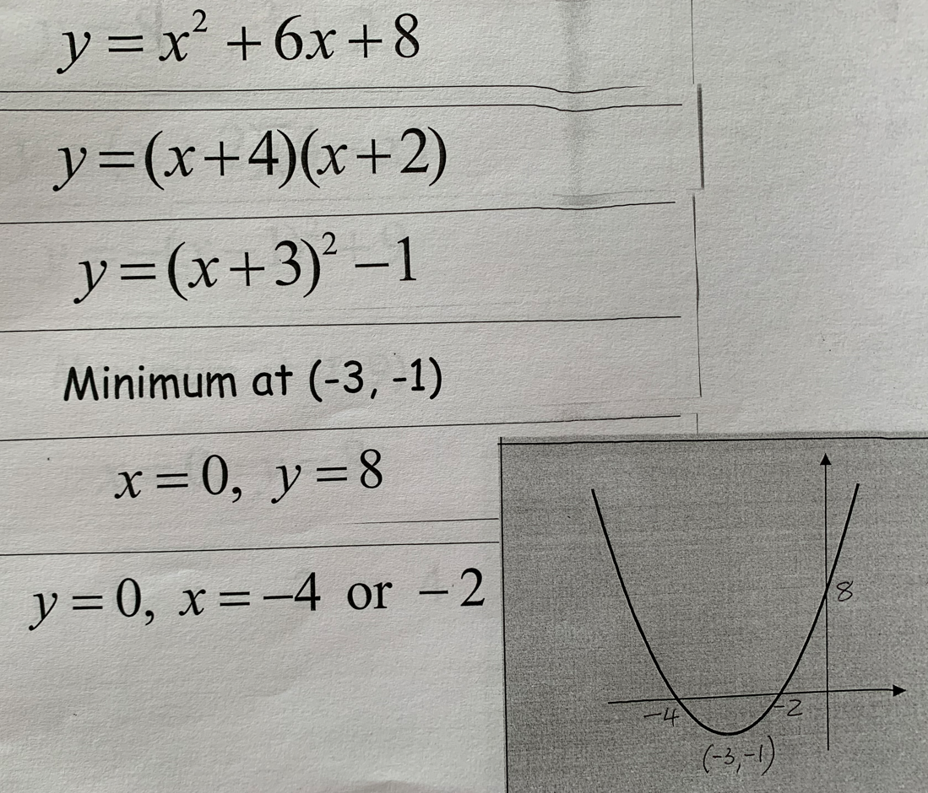
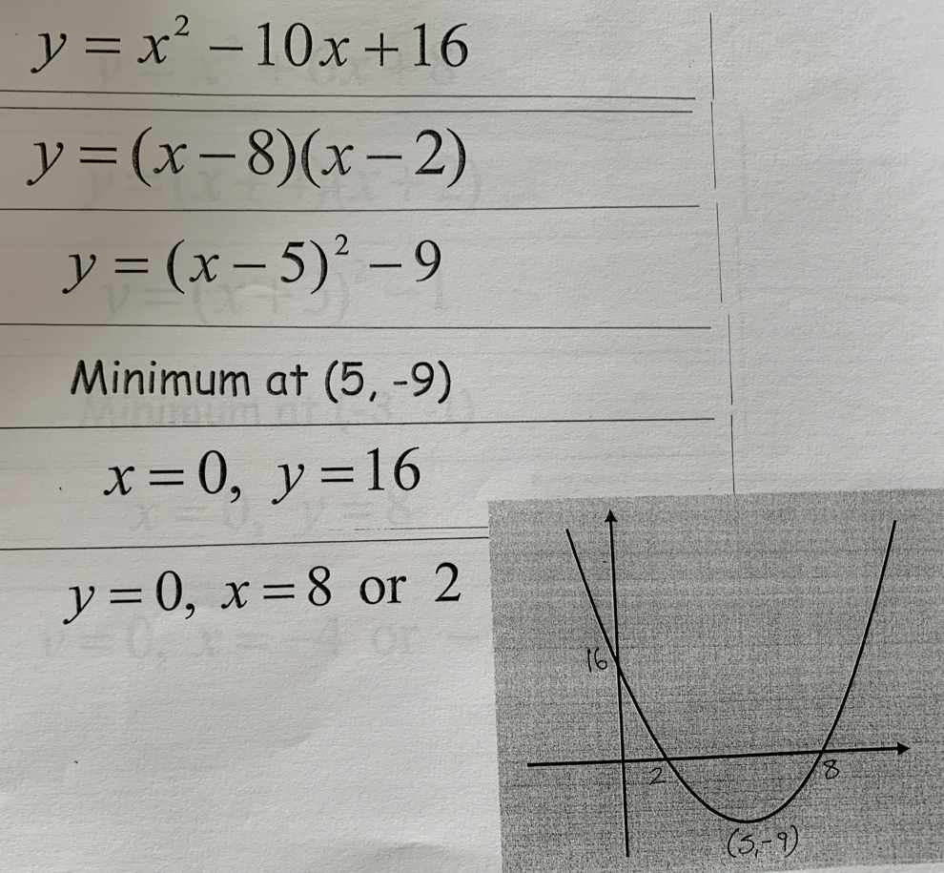

Slide 21
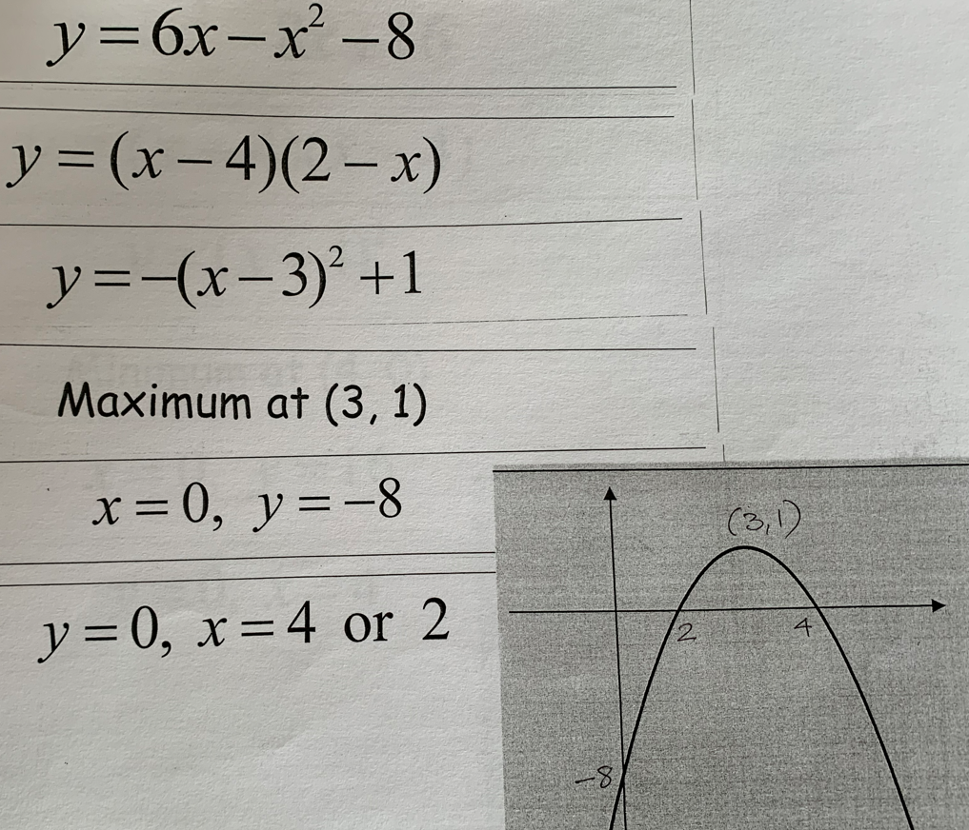
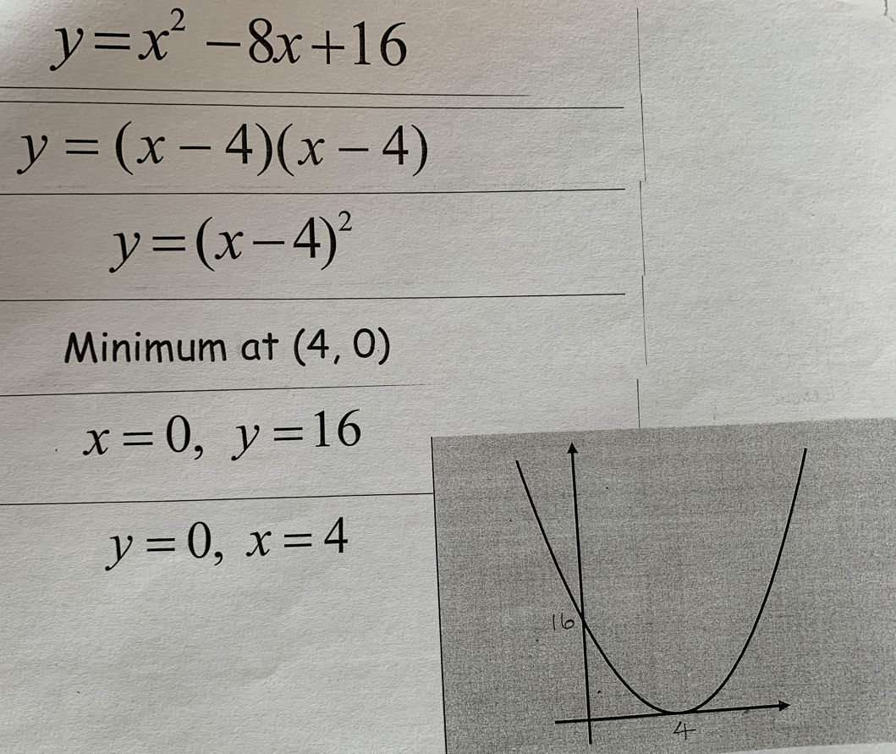

Slide 22
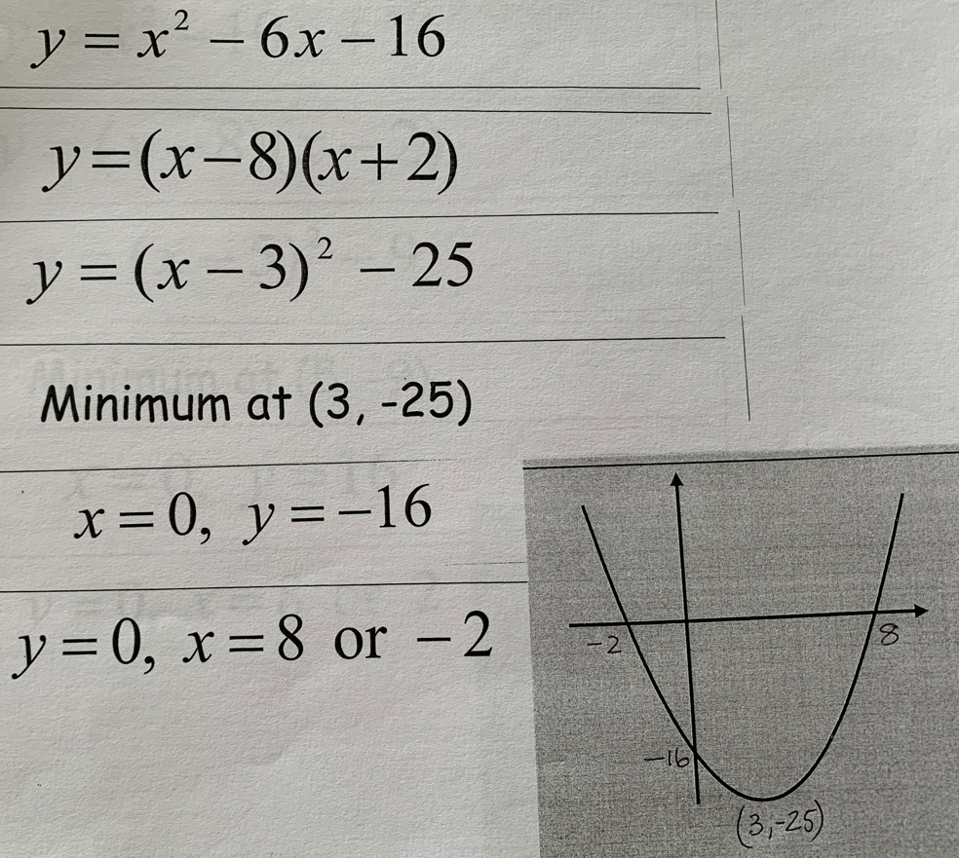

Slide 23
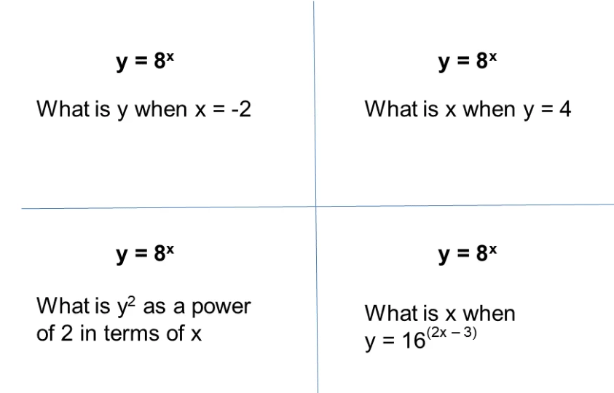

Slide 24
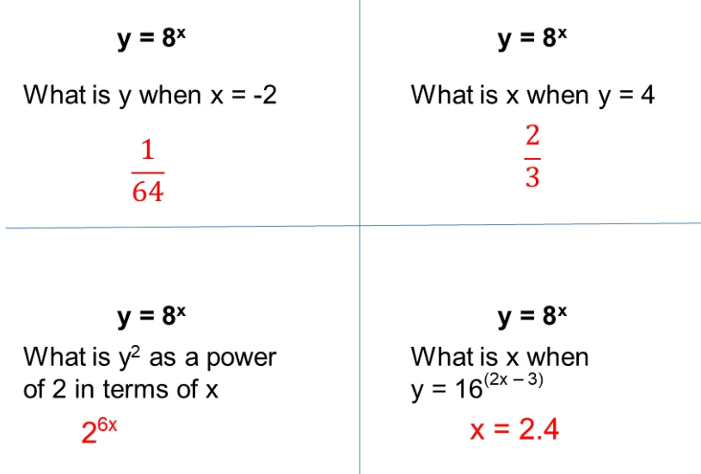

Slide 25
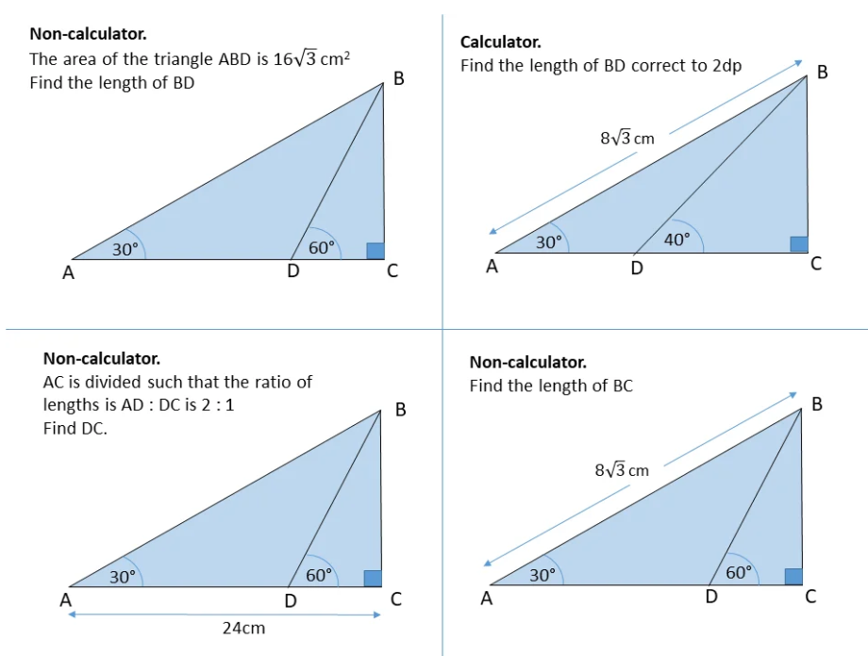

Slide 26
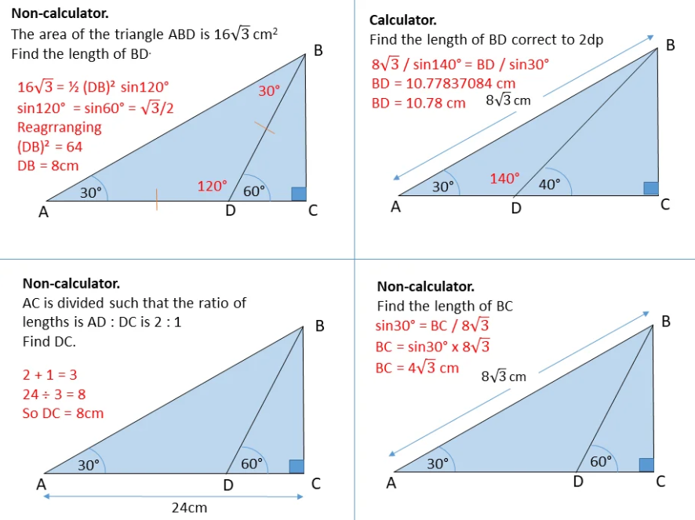

Slide 27
1. 6.
2. 7.
3. 8.
4. 9.
5. 10.

