Slide 1




DNA:
When you hear the word ‘philosophy’ what comes to mind for you? What do you think it is? What do you think it is not? Think and discuss with those around you.
Title: Introduction to Philosophy
(Scepticism)
Aims:
To know what philosophy is and how it differs from Religious Studies
To know a bit about the A Level Philosophy course
To do some philosophy around the question of, ‘What do we know for certain?’
Thank you for being ready to learn!

Slide 2
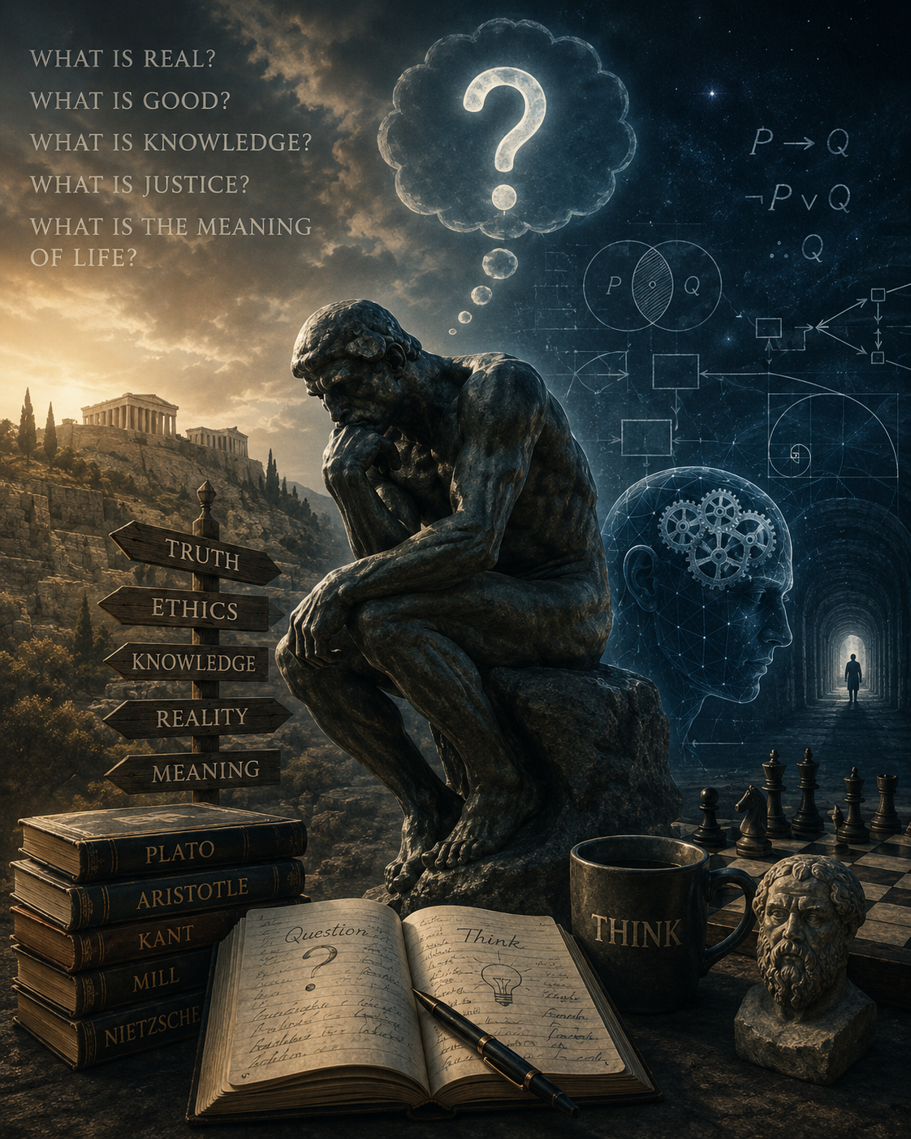
What is Philosophy?

Slide 3
What is Philosophy?
Philosophy literally means love of wisdom (from Ancient Greek ‘philo’: love; and ‘sophia’: wisdom). But this isn’t hugely helpful in understanding what Philosophy is.
It means asking big questions using logical thinking to figure out answers to them.
  This means not just accepting what most others think, or what ‘feels true to me’, but ‘seeing where the argument leads’ (even if it leads to a conclusion that doesn’t suit us).
  Most persuasion in real life is done emotionally; this is because it’s what works. Philosophy aims at being rational and persuading using reasoning, not manipulating and appealing to emotions.

Slide 4
What is Philosophy?
Different to RS, which focuses more on teachings, beliefs, practices and history of specific religions.
  Philosophy doesn’t accept any piece of writing as ‘authoritative’. We study old philosophers and arguments, but we freely criticize them and aren’t required to accept them or their conclusions.
Philosophy is iconoclastic and not highly respectful of tradition or asserted (and fondly held) beliefs. That’s got philosophers into a lot of trouble (e.g. Socrates) and can make it feel uncomfortable to some, but exciting to others.
Do you like thinking about deep questions?

Slide 5
Our Big Questions
The Philosophy course covers these big questions:
What do we know for sure?
What is right and what is wrong?
Is there a God?
What is a mind? Is it the same as a brain or is it the same as a spiritual soul?

Slide 6
How the course is assessed
Two three-hour exams at the end of the two years, covering all content from the two years of the course
  Yes, you read that right, 2 x 3hr exams.
No coursework

Slide 7
TRUE/FALSE
Philosophy is mostly about going ‘Wooah!’ on big thoughts, whether they are well-supported by evidence or not. The more sensational the thought, the better the philosophy.
Philosophy is different to Religious Studies
The more people believe something, the more philosophy says you should believe that
You can expect to find answers to the big questions by doing philosophy A Level

Slide 8
Plato
“How can you prove whether at this moment we are sleeping, and all our thoughts are a dream; or whether we are awake and talking to each other in the waking state.”

Slide 9
Nature of Philosophical Scepticism
What is Philosophical Scepticism? What is it for?

Slide 10
OVERVIEW
What is philosophical scepticism?
Some examples of philosophical scepticism – including the ‘Brain in a Vat’ thought experiment.
What is the role of scepticism for the study of knowledge (epistemology)?

Slide 11
Philosophical Scepticism
Philosophical scepticism is a way of looking closer at our claims of knowing things with certainty. Knowledge requires truth and scepticism shows that however strong our justification for our beliefs being true may be, there is room for doubt about whether they are actually true. These are not ordinary doubts, but doubts that undermine normal methods of justification.

Slide 12
AN EXAMPLE OF PHILOSOPHICAL SCEPTICISM – BRAIN IN A VAT
Suppose you are a brain in a vat. Connected to your brain is a computer (more powerful than you knew was possible) that feeds electronic information to your brain. Remember, the way that scientists understand your senses are of things that change light, sound, chemicals (taste and smell), etc. into electrical signals in your nervous system and carry them to your brain. The computer and electrical connections act as artificial nerves bringing sense ‘signals’ directly to the correct parts of the brain that your eyes, ears, etc. would have done were you to have them.
The electric signals are depicting a complete world, just like this one. I can interact fully with this virtual reality and get sense-experiences back from the computer in perfect real-time depending on my choices. All physical objects and people are part of this virtual reality being fed electronically into my brain in perfect realistic form.
In fact, being a brain in a vat having these electrical signals sent to the brain would be completely indistinguishable from being a human in an external world, where the sense signals from the external world are converted into electric signals to the brain. In other words, a brain in a vat would experience life just like someone who was not a brain in a vat living in a world with external objects, real people, etc.

Slide 13
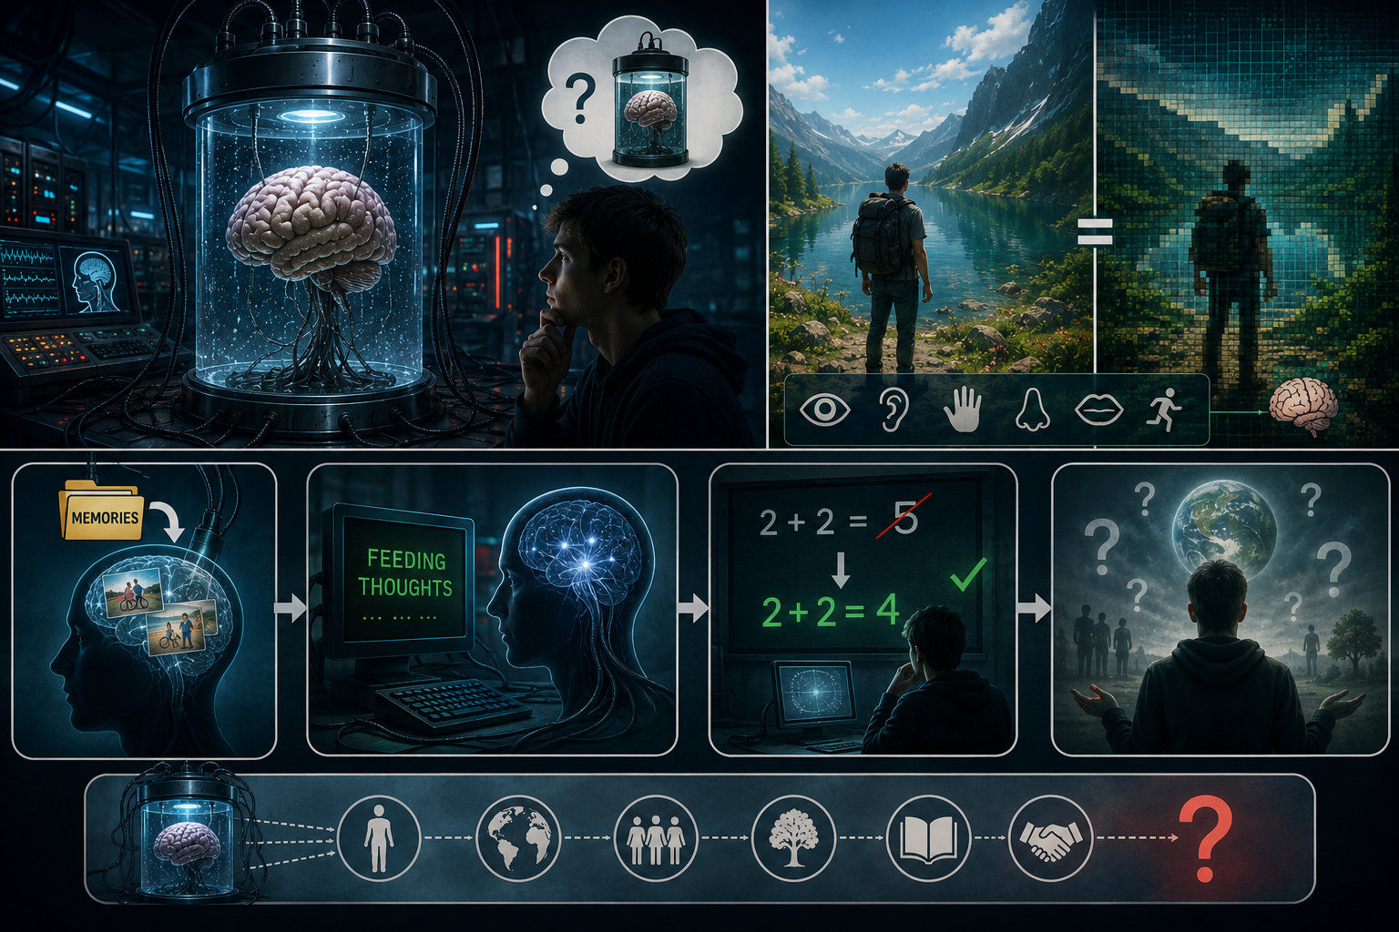

Slide 14
Philosophical issues
The sceptical challenge of this thought experiment, is to ask: how could you know that you are not a brain in a vat?
If you were such a brain in a vat, then your experiences would be identical to those that someone who was not a brain in a vat would have. So how can you be sure you are one or the other? All evidence that you are not a brain in a vat would appear to the brain in the vat as evidence that they were not a brain in vat – the experiences of the brain in the vat is identical to the experience of someone in a ‘real’ world.
If you are a brain in a vat, then all of your beliefs about your body, the world, people, etc. are false. But since you cannot find any good reason that you are not a brain in a vat, then you cannot claim knowledge of your body, the world, other people, etc. because knowledge about these things involves being sure that the external world exists, but the philosophical thought-experiment has shown that you cannot be completely sure.

Slide 15
Brain in a vat extended…
The thought-experiment can go on. Perhaps the memories you have just been installed into your brain by the computer. They have all just been created and have no basis in reality. However, they feel real, but so would memories installed by the computer. Moreover, what happens if the computer was actually feeding thoughts into my head? So what I thought was an obvious truth, like ‘2+2=4’ is actually the result of the computer feeding the ‘4’ into my mind with a feeling of correctness? And the answer is actually 5…

Slide 16
Check your understanding – true/false
You are a brain in a vat.
The experience of someone who was a brain in a vat would not be distinguishable from someone who wasn’t.
You can tell you are not a brain in a vat.
If it is possible that you are a brain in a vat, you don’t know if you are currently in a philosophy taster session with Little Heath School.
This thought experiment can be used to doubt people’s memories and sense of certainty.

Slide 17
Discussion
Are you a brain in a vat? Why/why not?
Is this thought-experiment useful? Why/why not?

Slide 18
A logical argument for scepticism
Premise 1: If we know something, that means we must be certain that it is true.
Premise 2: We can show, using sceptical thought experiments such as the ‘brain in the vat’, that it is possible that all of our ordinary beliefs are not true (in other words, there can be doubt of their truth).
Conclusion 1: It therefore follows that none of our ordinary beliefs can be knowledge, since there is a possibility they are false.
Conclusion 2: Therefore, it follows that we do not know anything.
IS THIS ARGUMENT PERSUASIVE, FOR YOU? WHY OR WHY NOT?

Slide 19
What’s The Point/Role Of Philosophical Scepticism In Epistemology (Philosophical Study Of Knowledge)?
Sceptical arguments aim to completely undercut our usual justifications. Philosophical scepticism is not about believing that we know nothing, but rather is a challenge to the usual ways we understand justification – they help us to think about justification. The sceptic doesn’t believe in the sceptical thought-experiments, rather they are challenging philosophers (including themselves) to show that these thought-experiments are not actually possible. If they are possible, then it appears we cannot be fully justified in our beliefs being true. Perhaps they might change our views on what level of certainty is possible for human beings.

Slide 20
Check your understanding – TRUE/FALSE
Sceptics are trying to persuade us of the sceptical scenarios; for example, that we are brains in a vat.
Philosophers who study knowledge think that sceptical thought-experiments (like the brain in the vat) can help us to think about what knowledge is.
Philosophy can be helpful to thinking about our lives.

Slide 21
Knowledge Check
What is philosophical scepticism?
What is the philosophical thought experiment of the ‘Brain in a Vat’?
Why would the experiences of a brain in a vat be the same as someone who was a human being in an authentic external world?
Why does the ‘Brain in a Vat’ thought experiment raise the problem of you not knowing if you are a brain in a vat?
Why does this mean that you also cannot be said to know if you are in a philosophy classroom in Little Heath School right now? (Or know any of your other ordinary beliefs?)
How could this thought-experiment also lead to doubt in the truth of your memories and thoughts?
What’s the philosophical point of scepticism in the study of knowledge (epistemology)?

