Slide 1




Title: Introduction to ‘A Level Business
DNA:
Why are you considering taking Business as one of your A level choices?
Be prepared to feedback
Aims:
By the end of the session student will:
Understand the course content and assessment methods
Understand what is required to succeed in business at A level
Apply some of the business concepts to a business context
Thank you for being ready to learn!

Slide 2
AQA A-Level Business
We follow the AQA exam board specification.
This A-level Business course introduces you to all you need to know about working in business, providing a solid foundation for further study.
With a focus on helping you to become a good decision maker, you’ll learn essential managerial skills, alongside techniques to help you become an analytical problem solver. These skills are all highly sought after and valued in a wide range of careers.

Slide 3
Further study and career opportunities
If you’d like to study business, finance or management at university, A-level Business provides an excellent foundation. The skills you learn are also transferable across a broad range of subjects and careers.
Whatever you choose to do in the future, you’ll find that the things you learn in this course will help. For example, you’ll probably work with lots of different people, so knowledge of motivational theory will help you to work well with others and help them achieve their potential.
You might have ambitious plans to start your own business. If that’s the case, you’ll find the marketing and finance topics particularly useful.

Slide 4
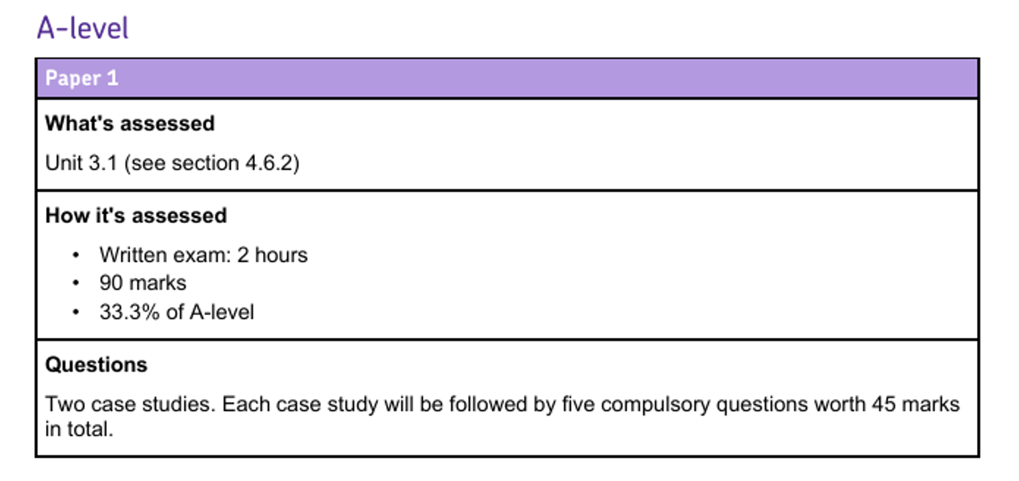
How will the course be assessed ?
There are 3 x 2 hour papers

Slide 5
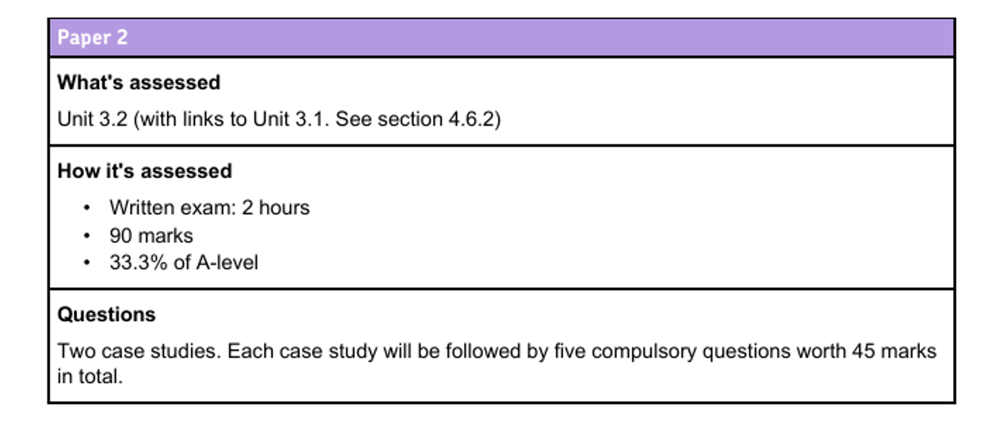
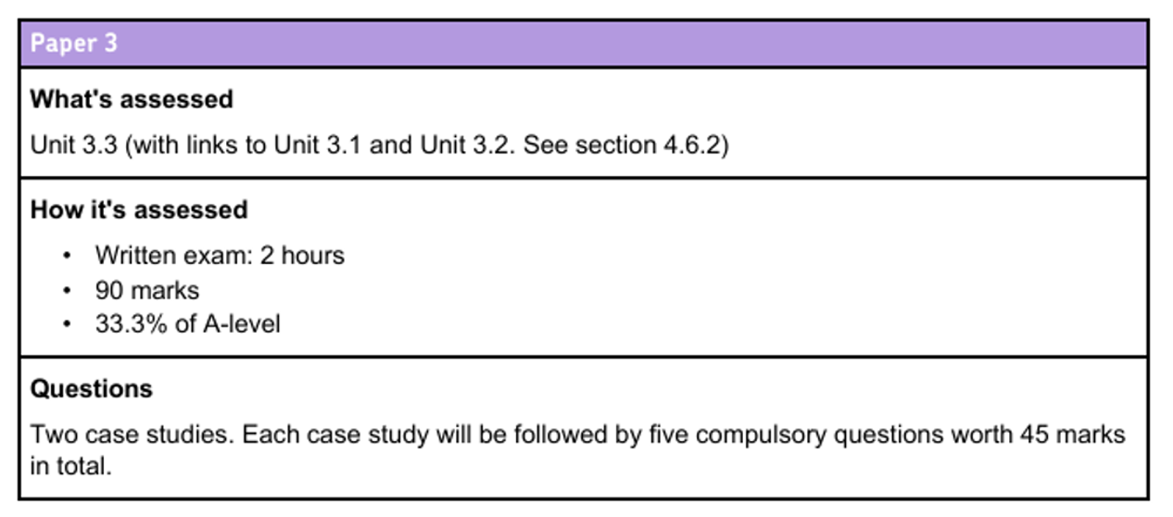

Slide 6
Course content
Unit 3.1 - What is business? Managing marketing and Finance
3.1.1 - Business and objectives
3.1.2 - Forms of business and stakeholders
3.1.3 - Marketing management
3.1.4 - Financial management
Unit 3.2 – Managing people and operations
3.2.1 - People management
3.2.2 - Operations management
3.2.3 - Managing business culture

Slide 7
Course content
Unit 3.3 – Business and society, business and the external, and business strategy
3.3.1 - Business and society
3.3.2 - Business and the external environment
3.3.3 – Strategy
3.3.4 – Change

Slide 8
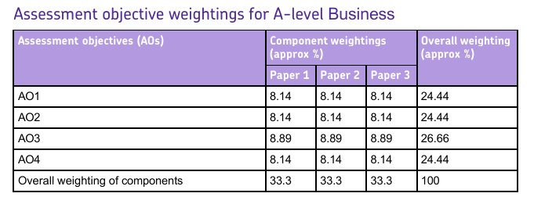
Assessment objectives
AO1 – Knowledge
AO2 – Application
AO3 – Analyse
AO4 – Evaluation

Slide 9
How to approach the Course
Be organised – Own equipment, note taking etc
Keep Up to date – Read about Business and be aware that the business world is always changing -
Build a Business Dictionary – Ensure you have a glossary of key terms - using terminology accurately is key
Complete homework and In class exercises – Try to do them all to the best of your ability.

Slide 10
Keeping Organised
All students are responsible for keeping their notes, hand outs and assessments organised
Have a file for each teacher or a large file for the subject.
Use file dividers
File all notes, completed work and handouts
Ensure that you have a filing session every week!

Slide 11

Why do businesses exist?
Think about this question
Be prepared to feed back

Slide 12
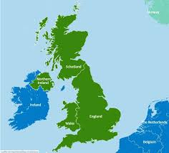
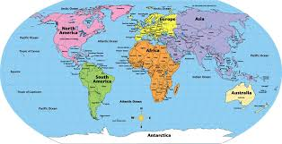
What do businesses bring to the UK/World?
Discuss this question with the person next to you.
Be prepared to explain your answers.

Slide 13

Different Types of Industry
Primary
Secondary
Tertiary
Any ideas what these terms mean?

Slide 14
Different Types of Industry
Primary – The use of raw materials. E.g. Agriculture, forestry, fishing, mining and quarrying, oil and gas extraction.
Secondary – The creation of products. E.g. Manufacturing, construction and the supply of utilities.
Tertiary – The supply of services, for example hotels, retail shops, catering, transport, education and health.
There is a 4th which is part of tertiary - Quaternary - anyone know what this involves?

Slide 15
Different Types of Industry
Quaternary – involves knowledge-based services like information technology, research and development, media, and consulting.

Slide 16
Different Types of Industry
1. Which sector dominates the UK economy ?
2. Why do you think this in the case?
3. What issues may arise for this over reliance on a single sector

Slide 17
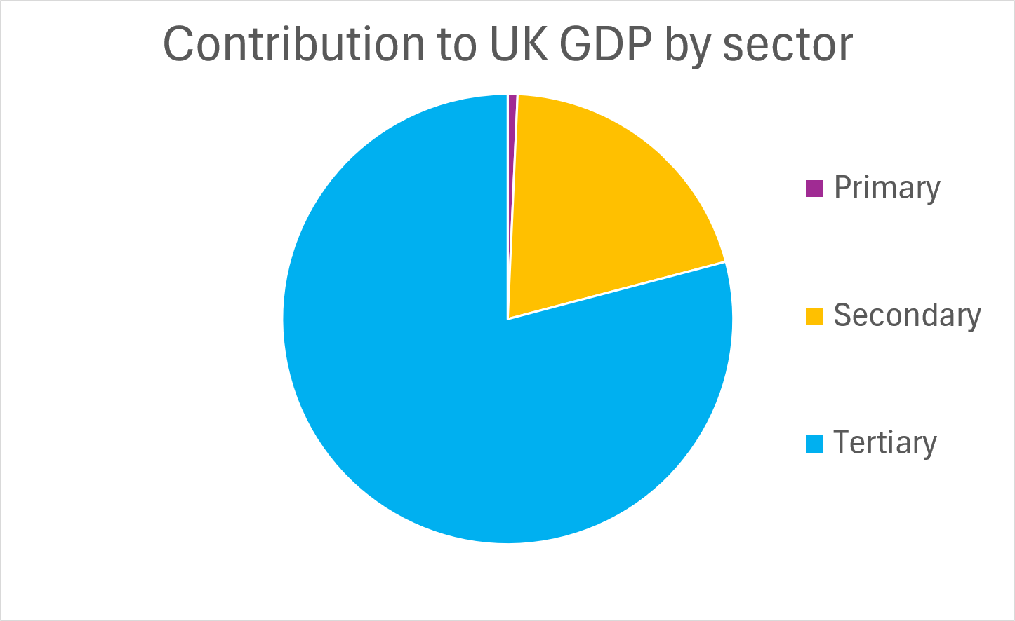
Different Types of Industry
Sector % of GDP
Primary 0.7%
Secondary 20.2%
Tertiary 79.1%

Slide 18
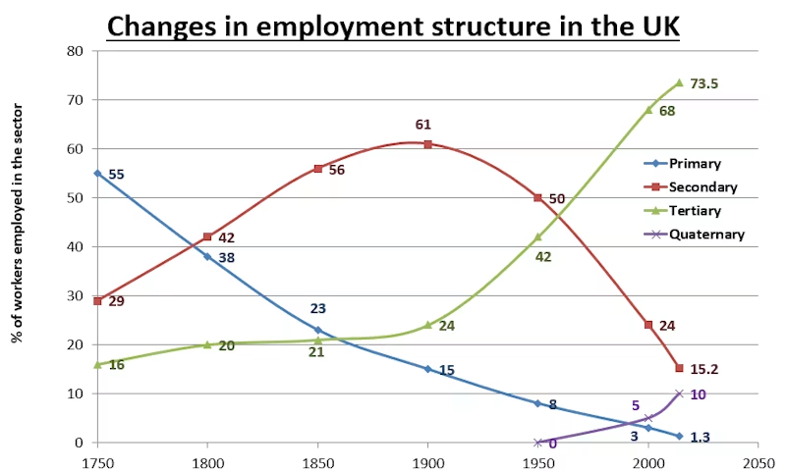

Slide 19
“You’re the Boss: Making Your First Business Decision”
Learning Objectives:
By the end of the activity, students will:
Understand how businesses make decisions based on opportunity and risk
Apply basic business terminology: entrepreneur, market, competition, profit
Explore AQA A Level Business concepts: ownership types, business objectives, stakeholder impact

Slide 20
Scenario: “Pop-Up Café Challenge”
You and your partner have £5,000 to launch a pop-up café at a busy summer market.
Your goals:
✅ Make a profit
✅ Build a strong reputation
You must make 5 key business decisions that will affect your cost, customer appeal, and chance of success.

Slide 21
Business Name & Brand Identity
  A. JavaJump (trendy, modern)
  B. Brew & Bites (cosy, traditional)
  C. The Local Bean (community-focused)
  D. A name and style of your choosing
Menu Focus
  A. Artisan Coffee & Vegan Snacks
  B. Budget Coffees & Hot Dogs
  C. Smoothies, Cakes & Soft Drinks
  D. Other ... please state
Pricing Strategy
  A. Premium Pricing (£4+ per drink)
  B. Competitive Pricing (£2.50–£3)
  C. Discount Strategy (Buy 1 Get 1 Half Off)
Marketing Method
  A. Instagram ads & Influencers
  B. Flyers & Loyalty Cards
  C. Sponsoring Local Events
  D. Other marketing method … please state
Form of Ownership
  A. Sole Trader
  B. Partnership
  C. Ltd Company

Slide 22
Links to AQA themes:
  Business objectives
  Types of ownership
  Stakeholders
  Marketing strategies

Slide 23

Feedback

Slide 24
Debrief & Discussion
“Which theme did you use?” What was your thinking?
“What was the focus of your menu?” Why did you choose this?
“What pricing strategy did you use?” What risk are you taking?
“Which marketing method did you use?” Justify you choice
“Which ownership model did most of you choose—and why?”
“What factors influenced your decisions?”
“How would a new competitor affect your plan?”

