Slide 1
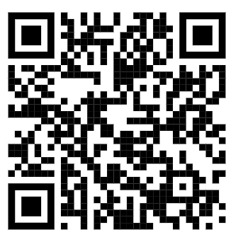
Transition work Introduction video – 3 minutes
https://amsp.org.uk/transition-to-a-level-mathematics-course/

Slide 2
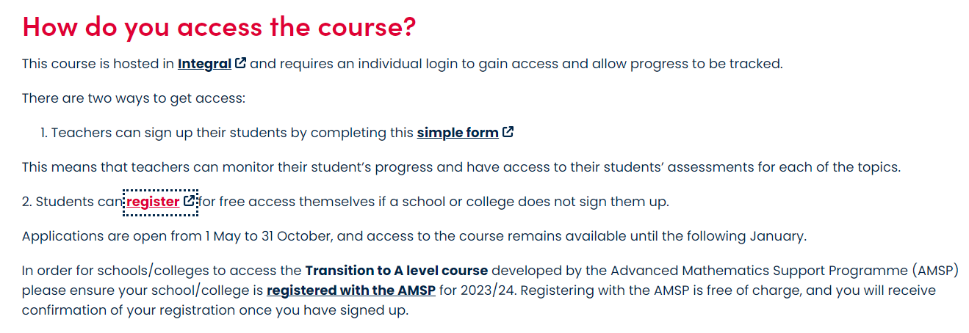

Slide 3
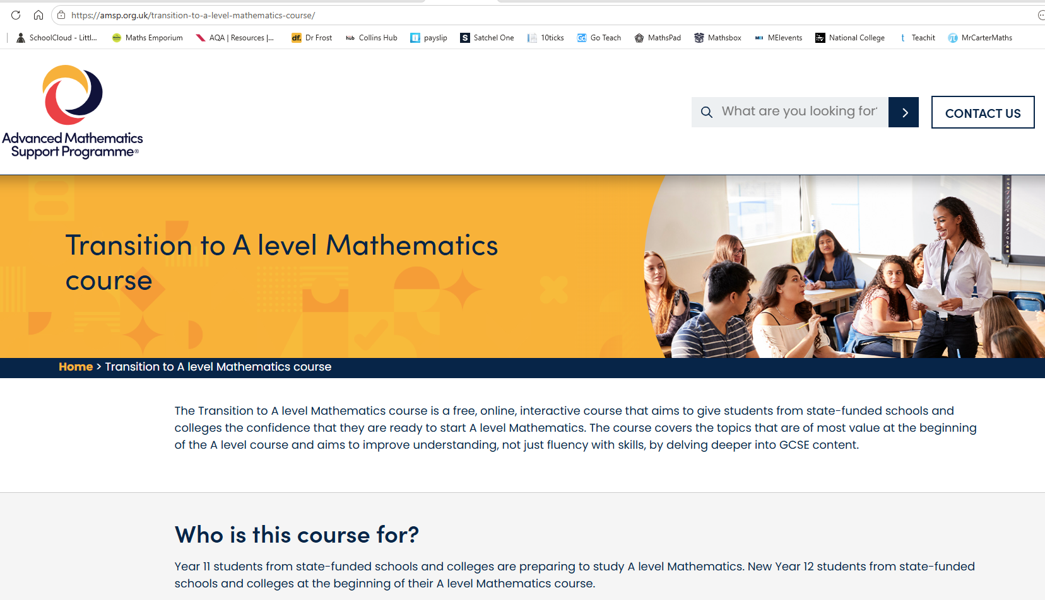
Transition to A level Mathematics course - AMSP
Integral Link to host site once registered via AMSP

Slide 4
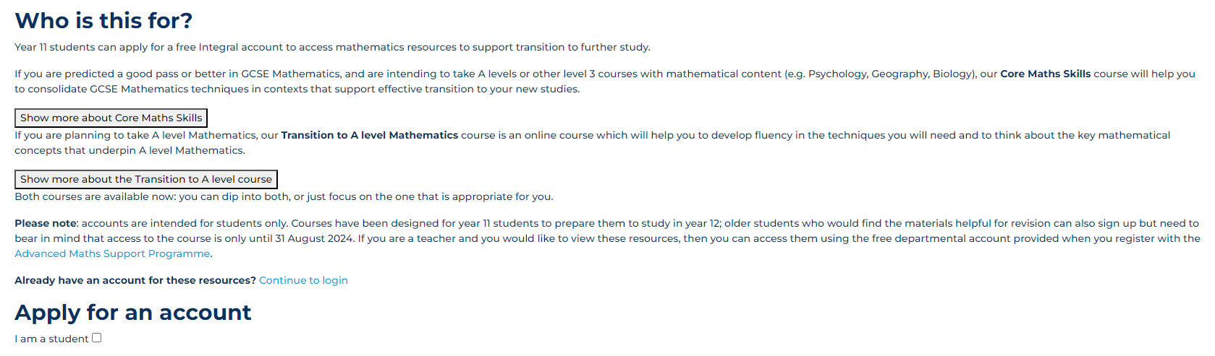
Integral

Slide 5
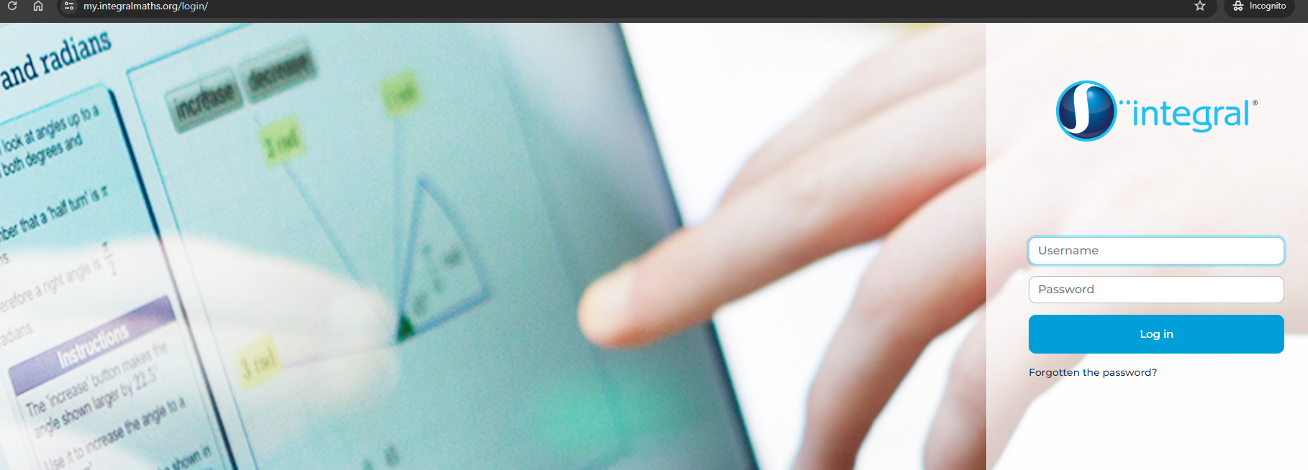
Once registered check your email for your Account username
Your password will arrive in a separate email.
After you have your second email – log in to get started.

Slide 6
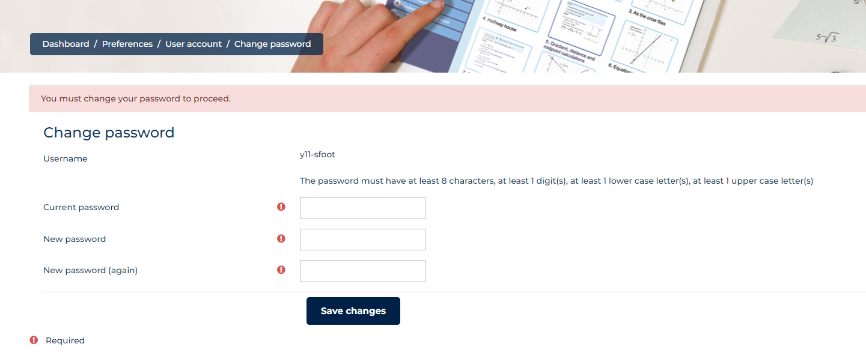
Change your password to continue

Slide 7
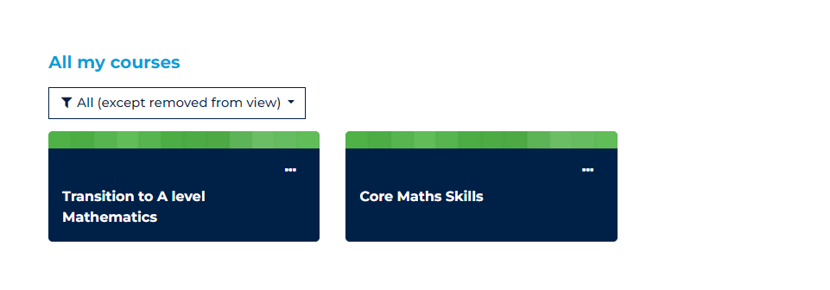
Pick the A level course

Slide 8
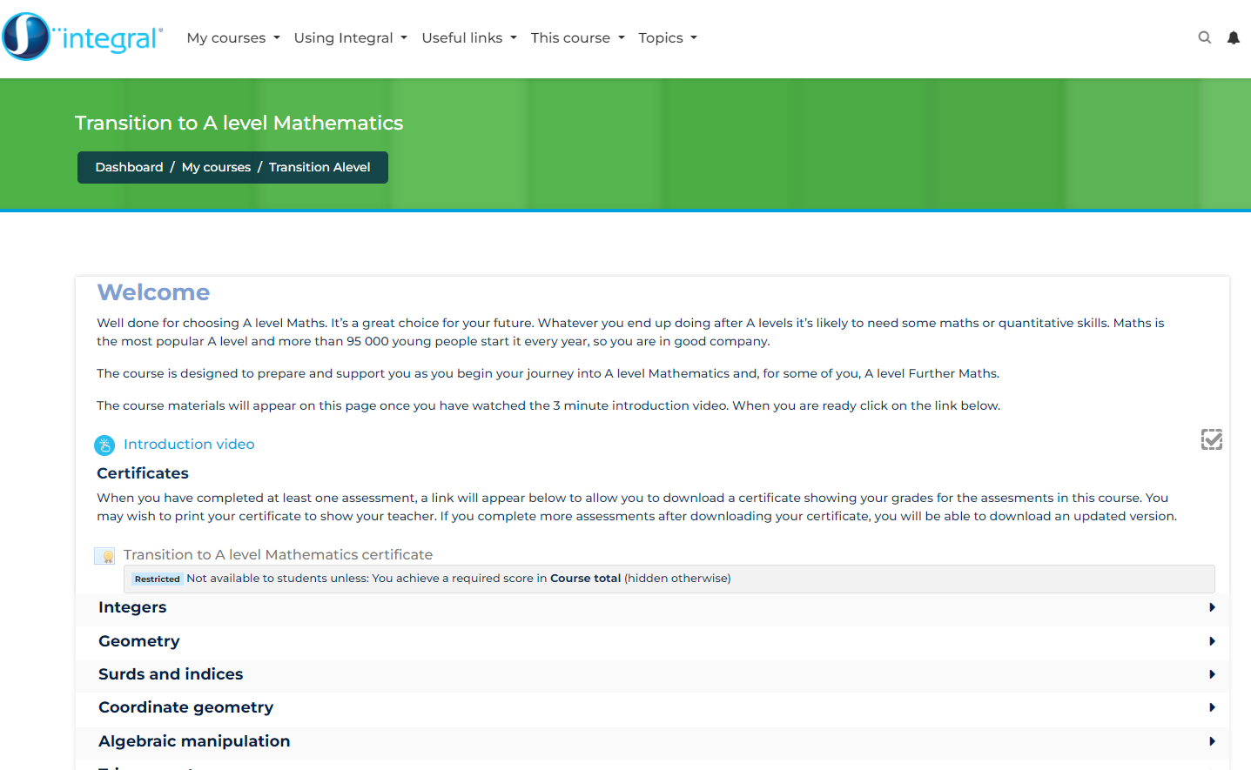
Homepage
Start with the video
Unless the tick is done you can’t unlock the next materials
https://my.integralmaths.org/mod/hvp/view.php?id=59768

