Slide 1

Little heath school learning for life  together  one community

Slide 2
gcses & other grades: Targets and progress
Understanding data and targets at KS4 If you’re not clear what 9-1 means, or what Gold, Silver and Targets are, or how you can use your child’ targets to push them to success, then this workshop is the one for you.
Tuesday 26th September 2023
apologies in advance if you are aware of some of this
Mr Rayner

Slide 3
GCSE grades and the other level 1/2 equivalent grades
GCSE grades are: 1 to 9 [9 is the highest]
A ‘standard pass’ grade = 4
A ‘strong pass’ grade = 5
There are other qualifications, such as BTECs & Cambridge Nationals, which are typical for vocational subjects (E.g. ICT/Health & Fitness/Child Development/Bus & Ent], and these are graded at either Level 1 or Level 2 and use words such as: Pass, Merit, Distinction & Distinction* for their grading system, instead of 1-9.
Level 1 means they are equivalent to GCSE grades 1/2/3
Level 2 means they are equivalent to GCSE grades 4 and higher

Slide 4
Old & new grades
How the various grades compare to each other and with the old grading system

Slide 5
Grades – hopefully explained
We now move to the various ‘targets’ students have.
BEFORE moving on, we as a school need to stress that each pupil is an individual, with their own specific learning needs and learning styles, as well as individual talents.
Sometimes, these targets do not suit some individuals, and so they may seem too harsh or too easy, but we need a generic approach that does suit the vast majority of our students.
We want every student to do their very best and be proud of their qualifications/grades, no matter what they are.

Slide 6
Student targets
Students will be given 3 targets:
  - a BRONZE target
  - a SILVER target
  - a GOLD target
For example: 3 / 4 / 5 or 6 / 7 / 8
BUT, where do we get these targets from?
Students take their KS2 SATs in Y6 at Primary School and they then achieve a Standardised Score, with 100 being average.

Slide 7
KS2 SAT scores → alps bands
Once we have their KS2 Score.
This then places them in an ALPS Band from 1 to 10.
ALPS is a national organisation which deals with data from KS2 to KS4 and then onto KS5.
Notes:
ALPS have just reset their Scores, so there will be some changes to which ALPS Band (and therefore changes to Target Grades) a student may be in.

Slide 8
Alps bands → targets
These ALPS bands have been produced from what student should go on to achieve at GCSE in Y11, if they make expected progress from KS2 to KS4.
These ALPS Bands then determine their Gold/Silver/Bronze Targets.
These targets are for all subjects.
There is an equivalent table for the Vocational Qualifications grades.
[MEG = Minimum Expected Grade]
Notes:
ALPS have just reset their Scores & MEGs, so there will be some changes to which ALPS Band (and therefore changes to B/S/G Target Grades) a student may be in.

Slide 9
Houston we have a problem
Now, that is all great IF we have the KS2 SAT scores, BUT … due to the pandemic, Primary Schools did not sit KS2 SATs for our current Y9 & Y10 cohorts.
So, … what we did at LHS is used their CAT test data from Y7 to approximate the ALPS Band they should be in, which then drives their Targets.
Obviously, this is not a perfect match, but it works reasonably well and is one way which was recommended to us and adopted by numerous schools.
Because of this, Y9 & Y10 have estimated Targets, rather than exact Targets
Y11 do have KS2 Scores, so all is good and they do have exact Targets.

Slide 10

Targets → progress
A students’ average progress from KS2 to KS4 is measured by comparing the grades/scores they actually get with what they should be expected to get, based on their KS2 Scores.
This generates an average Progress 8 [P8] score for each student.
If their P8 Score is:
                > 0 on average, they have made better progress than expected
                = 0 on average, they have made the expected progress
                < 0 on average, they have not made the expected progress
Y11 were told their current P8 score [based on the End of Y10 Recording & their Predicted Grades] at their Sharp Start Meeting with their Tutor at the start of term.
Notes:
Attainment 8:
Bucket 1 = E & M dbl weighted [4]
Bucket 2 = Ebacc – 3 highest from the Sciences/Comp Sc/Hi/Gg/Lang [3]
Bucket 3 = 3 ‘other highest’ not already used [3]

Slide 11

Interpreting the g/s/b targets
So, now we know how the targets have been generated for the 9-1 GCSE subjects.
As mentioned before, there is a similar approach to the Vocational Grades.
Why 3 targets?
We see these are stepping stones on the journey to making great progress and achieving success. Get your foot on the ladder and then work your way up.
Get to Bronze, then push on to Silver and then Gold, and beyond!
Our mantra is:
            ‘Beat Bronze and Strive for Silver, and beyond’

Slide 12


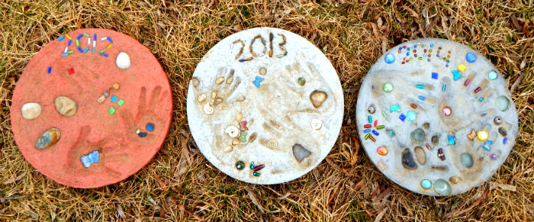


‘Beat Bronze and Strive for Silver, and beyond’
Get to your BRONZE
Push on to your SILVER
Then GOLD and BEYOND
BRONZE
SILVER
GOLD

Slide 13
How can students succeed - 1?
Listen to their teachers and act on their advice
Know them and take ownership of their targets [Beat Bronze & Strive for Silver & beyond]
Do classwork & homework to the best of their ability [there is always work to do at home]
Upgrade their work [Purple pen]
Work efficiently & effectively [stay off Social Media etc.]
Prepare for tests / PPEs properly → what revision method works for them? We are all different. Variety!
Try their very best and keep an open mind – do not give up! I Can’t … … yet!

Slide 14
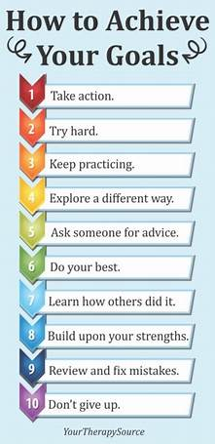
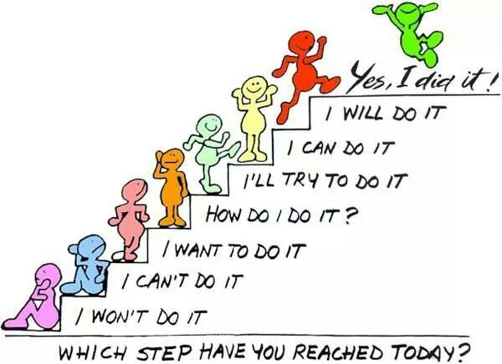
Growth mindset & goals

Slide 15
How can students succeed - 2?
Get to lessons on time
Have all the equipment (calcs)
Be in school – there is a direct correlation between fantastic attendance and great results, on average → Mr Coulson’s slide!
Grasp every opportunity offered – intervention & revision sessions
Ensure any CA/CWK is a good as possible → get those points in the bag!
Utilise key websites – SENECA/GCSEPod/Corbettmaths/some subjects have their own websites (English, History, RE)
Start REVISION early – making Summary Notes, Mindmaps, Flashcards, using PLCs, Exam Questions, …
Notes:
Just 5mins late to each lesson in a day = 5 x 5 = 25mins per day = 125mins per week = 2 hour long lessons missed (out of 25) each week. Not great at all!

Slide 16

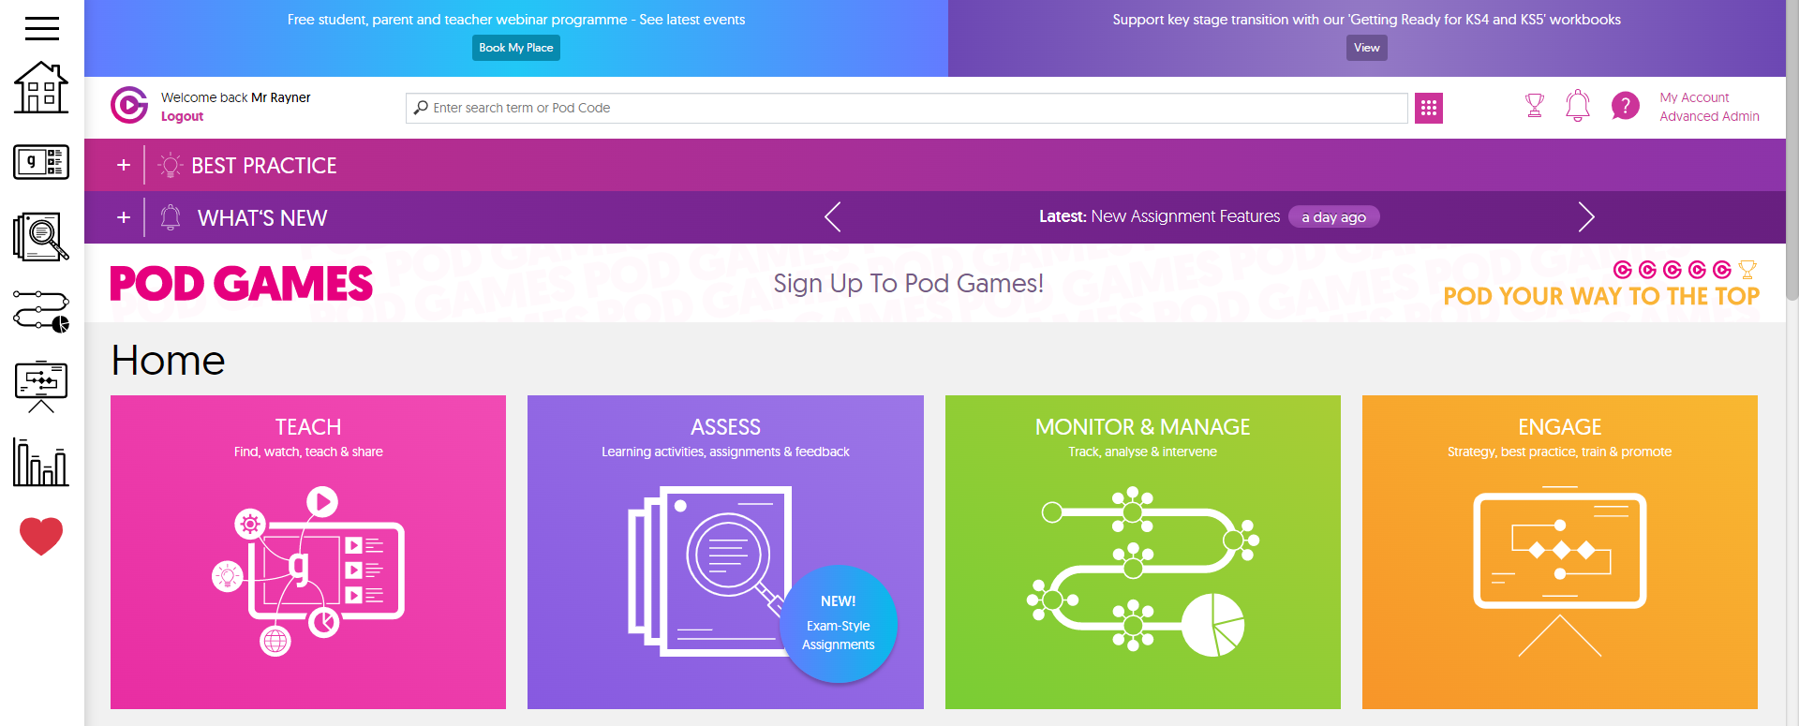
GCSEPod → what a great resource
An amazing amount of subjects / topics
Short, quick recaps & reviews
A different way to revise – VARIETY!
Watching & listening really works for some students
Instant feedback
Can be used on phones – on the bus?
Have they used it?
Go on – they should give it a try

Slide 17
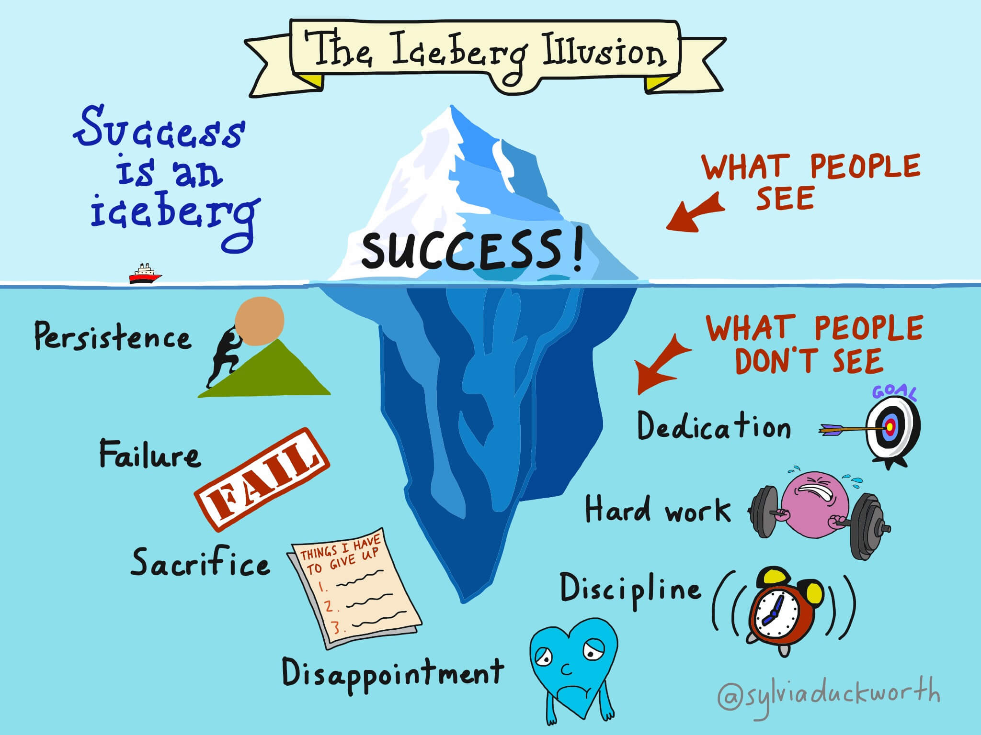
This is what ‘success’ is really about, and how to achieve it.
Could Usain Bolt just turn up and run under 10s without doing all that training?
→ Absolutely NOT!
The same is true for success at GCSE
Beat Bronze & Strive for Silver, and beyond!

Slide 18


Yes – everyone can improve by putting in the effort and trying!

Slide 19
Hard work … plus your support & encouragement
Alas, there is no getting away from it …… hard work is the key to success.
For students in Y11 – this is singularly the most important year. Making ‘the most’ of their time in school, plus evenings, weekends, holidays over the course of this year, in a measured and sensible way, is key to success! There is still time to make a massive difference to GCSE grades.
For Y9 students embarking on their GCSE journey, making sure they stay on top of the work, closing topics effectively so they are ready for Y10, and then Y11 when they get there.
For both year groups – take an interest in their studies (ask them to talk about what they have been learning), be supportive and encourage your sons/daughters to ‘do their very best’, to work hard, to go to intervention sessions, to MAX OUT their CA/CWK marks …… and to get the right balance between work, rest & play!
Notes:
Talking about their work = reinforces their learning & understanding; → MARS advert

Slide 20

FINALLY …
Thank you
Notes:
For everything YOU are doing, will be doing, as WE DO APPRECIATE it can be very tricky to get the right approach/balance at home, as those key exams get closer

